Slide 1
Unit4 Lesson3
They are having lots of fun
WWW.PPT818.COM

Slide 2
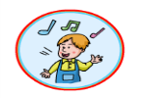
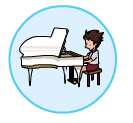
What are they doing?
What do you do on Sunday?
play the piano
play the erhu
play basketball
draw
sing Beijing Opera
Do taijiquan
make things
sing
dance
run

Slide 3
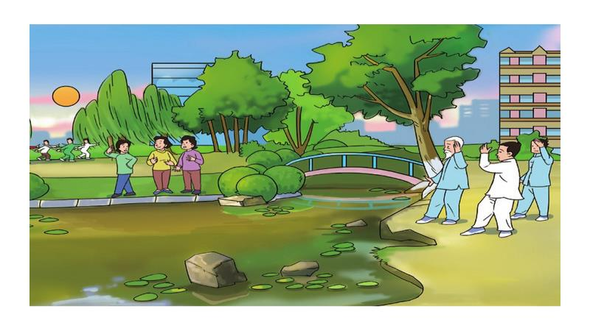
Where are they?

Slide 4
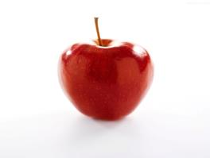
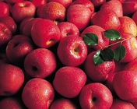
Are they having lots of fun?
an apple
lots of apples

Slide 5
Read the text and answer question.读课文，回答问题
Are they having lots of fun?
他们开心吗？
Yes ,they are.

Slide 6
Read the first paragraph and answer.读课文第一段，
回答问题
When is it?
It’s Sunday morning.
How are the people?
They are enjoying themselves.

Slide 7
Read the second and the third paragragh carefully and underliner the questions.
仔细读第二、三段，划出答案。
1.What are the women doing under the tree?
2. Where are the people doing taijiquan?
They’re singing Beijing Opera under the tree.
They’re doing taijiquan near the lake.

Slide 8
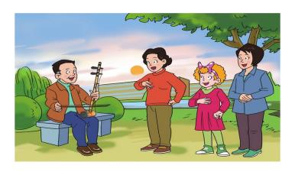
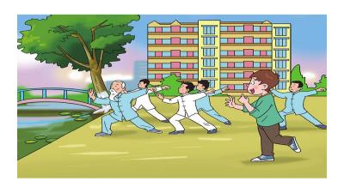
What are the women doing under the tree?
What does Jenny want to do?
Where are the people doing taijiquan?
What does Jack want to do?

Slide 9
Read the last paragragh and anwser.
读课文最后一段，回答问题
What is Jack doing?
He’s doing Chinese kung fu.
He’s following Danny.

Slide 10
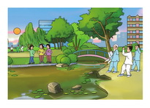
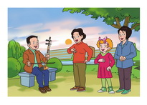
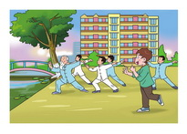
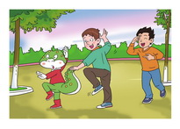
Choose and talk
For example：There are many people in the park.
They are enjoying themselves.
①
②
③
④

