Slide 1
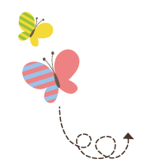
Unit 1 Li Ming Goes to Canada
六年级上册
Lesson 3 Making Breakfast
WWW.PPT818.COM

Slide 2
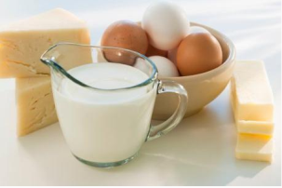
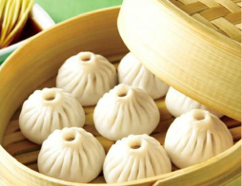
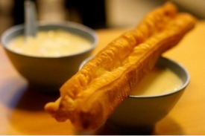
What did you eat for breakfast?

Slide 3
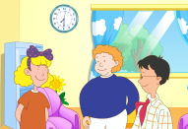
1. It’s time for breakfast!
Mrs. Smith: Good morning, Li Ming and Jenny!
Li Ming: Good morning, Mrs. Smith! What time is it?
Mrs. Smith: It’s half past seven. Time for breakfast！What would you like for breakfast, Li Ming?
Li Ming: I’d like some eggs, bread and juice, please.
Mrs. Smith: What would you like for breakfast, Jenny?
Jenny: I’d like some milk and bread, please.
Jenny: Mum is cooking eggs in the kitchen.
This is the fridge. The juice is in the fridge.
These are dishes. Let’s put some dishes on the table.
Breakfast is ready! Lets’ eat！
Li Ming: Okay.

Slide 4
讲解
知识点 1
half /hɑːf/ n./pron. 一半；半数【四会】
例句：
It’s half past eight. 八点半了。
字母a 的发音是/ɑː/。
hall (n.) 大厅
halves
发音：
形近词：
复数：
half an hour 半小时 half a day 半天
复数：

Slide 5
讲解
知识点 2
—What would you like for breakfast, Li Ming?
李明，你早餐想吃什么？
— I’d like some eggs, bread and juice, please.
我想吃一些鸡蛋、 面包和果汁，谢谢。
breakfast / brekfəst/ n. 早餐【四会】
I have breakfast at seven o’ clock.
我在七点钟吃早餐。
例句：

Slide 6
讲解
break（打碎）＋ fast（快）＝ breakfast
短语：have breakfast 吃早餐
make breakfast 做早餐
加法记忆法：
魔法记忆:
太阳升起后吃了东西，就是打破 (break) 了
禁食 (fast)。

Slide 7
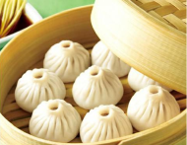
讲解
快快长大：早餐的重要性
早餐是一天中最重要的一餐。早餐所提供的热
量占全天的30%，而早餐营养的摄入不足很难在午
餐和晚餐中补充回来。

Slide 8
讲解
some / sʌm/ adj. 一些【三会】
例句：
I have some books. 我有一些书。
后面跟可数名词的复数形式或不可数名词。
come (v.) 来 home (adv. & n.) 在家；家
same (adj.) 相同的
发音：
形近词：

Slide 9
讲解
询问三餐想要吃/ 喝什么的句型及回答
问句的句型结构为“What would you like for + 三餐名
词?”，意为“……你想吃/ 喝什么?”其中what 意思是“
什么”，位于句首，引导特殊疑问句。would like 是固定
搭配，意思是“想要”， 它没有人称和数的变化。答语为
“I’d like +饮食类名词.”，意为“我想吃/喝……”。

Slide 10
讲解
易错点
提示
三餐前面的介词for 千万不能丢。
—What would you like for lunch?
你午餐想吃什么？
—I’d like some noodles.
我想吃一些面条。
例句：

Slide 11
讲解
拓展
Would you like ...?“你想要……吗?”是日常生活中征
求对方意见的委婉说法，肯定回答是“Yes, please.”,
否定回答是“No, thanks.”。
例句：—Would you like some apples?你想要些苹果吗？
—Yes, please. 是的，太感谢了。
/No, thanks. 不，谢谢。

Slide 12
讲解
______ would you like _______ breakfast?
A. What; with B. What; for C. What; at
典例
B

Slide 13
讲解
知识点 3
put / pʊt/ v. 放；安置【四会】
Let’s put the books on the desk.
咱们把这些书放在桌子上吧。
例句：
字母u 的发音是/ʊ/。
put on 穿上 put up举起 put down 放下
out (adv.) 在外面
put (原形) — putting (现在分词) —put (过去式)
发音：
短语：
形近词：
形近词：

Slide 14
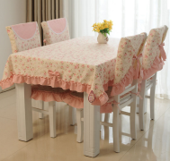
讲解
知识点 4
table / teɪbl/ n. 桌子【四会】
There are some dishes on the table.
桌子上有一些盘子。
例句：
tables。
put on 穿上 put up举起 put down 放下
on the table 在桌子上
set the table 摆餐具
发音：
复数：
短语：

Slide 15
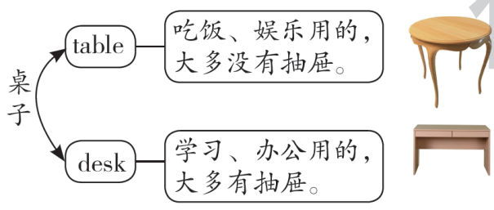
讲解
对比记忆法：
两个单词词义相近，可以用对比的方法来记忆。如：
There is a big ________ in my kitchen.
A. desk B. bed C. table
典例
C

Slide 16
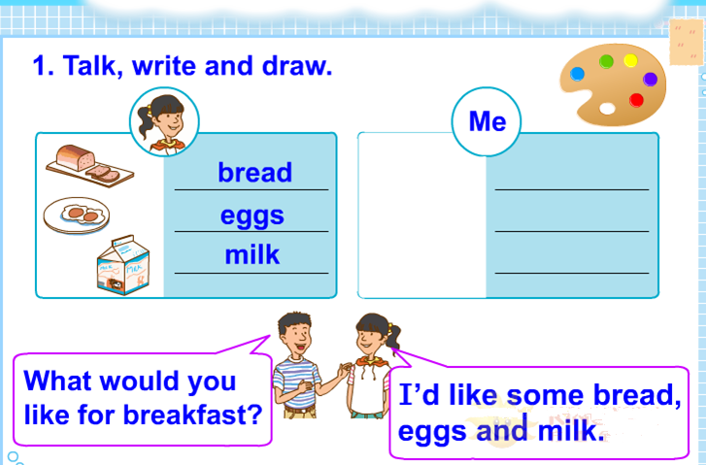
2. Let’s do it!

Slide 17
2. Let’s do it!
2. Read. Tick or cross.
Do you know the differences between Chinese food and Western food? They are different in many ways. There are more vegetables in Chinese food and you can find much meat in Western food. The Chinese like to eat cooked vegetables but people in the West often don’ t. The people in China like hot water but Western people often drink ice water. Chinese people like to use chopsticks and Western
people use knives and forks.

Slide 18
2. Let’s do it!
Chinese food and Western food are different in many ways.
There are more vegetables in Western food.
The Chinese like to eat cooked vegetables.
Western people often drink ice water.
Chinese people like to use knives and forks.
√
×
√
√
×

Slide 19
讲解
知识点 5
寻读法
寻读法，即先读题，然后带着问题或者题干中的关键词去快速阅读短文，以求在短时间内准确地寻找到我们所需要的信息。
步骤：(1) 用题干中的关键词在文中搜索，迅速确定相关词句或信息点所在的位置，缩小阅读范围。比如：Read. Tick or cross.中的第1小题，关键词是different，我们就可以确定阅读范围在课文原文的前两句话中。

Slide 20
讲解
(2)找到关键词后，仔细阅读，准确理解，认真筛选，比如Read. Tick or cross.中的第2小题，通过关键词vegetables 确定范围以后，我们还要准确理解，进一步确定另一个关键词——Western，短文中是Chinese，从而筛选出正确答案。

Slide 21
习题
一、单项选择。
(1) Its’ seven o’clock in the morning. Tim e for _______.
A. lunch B. breakfast C. dinner
(2) I would like some _______.
A. breads B. eggs C. noodle
B
根据前一句可知时间是早上七点，所以应该是吃早餐，故选B。
点拨：
B
some后面接可数名词的复数形式或不可数名词，故选B。
点拨：

Slide 22
习题
二、将括号中的单词更换一个字母变成一个新单词并填空。
(1) I like to _______(look) in the kitchen.
(2) Let’s ________(cake) breakfast for my mot her.
(3)Let ’s ________(out) the pencils on the desk.
(4)There is a ________(fish) on the table.
(5)—What time is it now?
—It’s _________(hall) past five.
cook
make
put
dish
half

Slide 23
本节课我们学习了以下知识，请同学们一定加强巩固，以便能和同学们进行灵活交流哦！
重点词汇：half, breakfast, some, put, table
重点句式：—What would you like for breakfast, Li Ming?
— I’d like some eggs, bread and juice, please.

