Slide 1
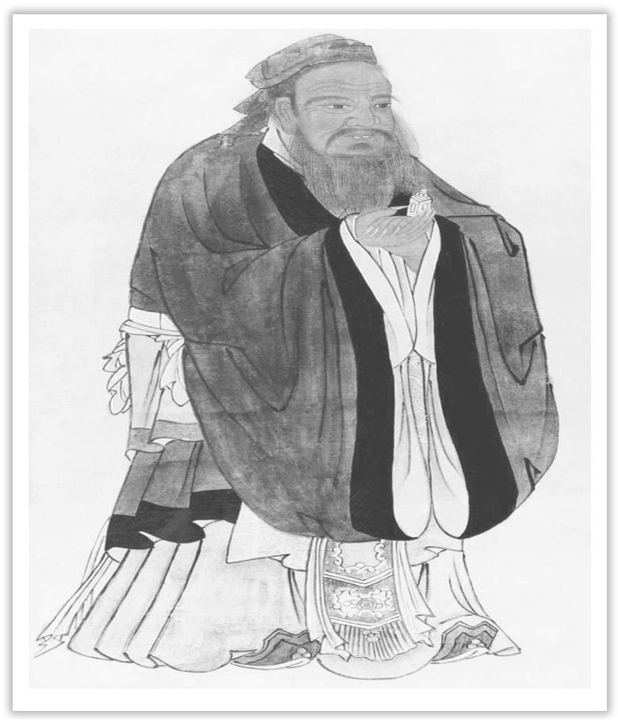
Unit 4 History and Traditions
Section Ⅳ Discovering Useful Structures
WWW.PPT818.COM

Slide 2
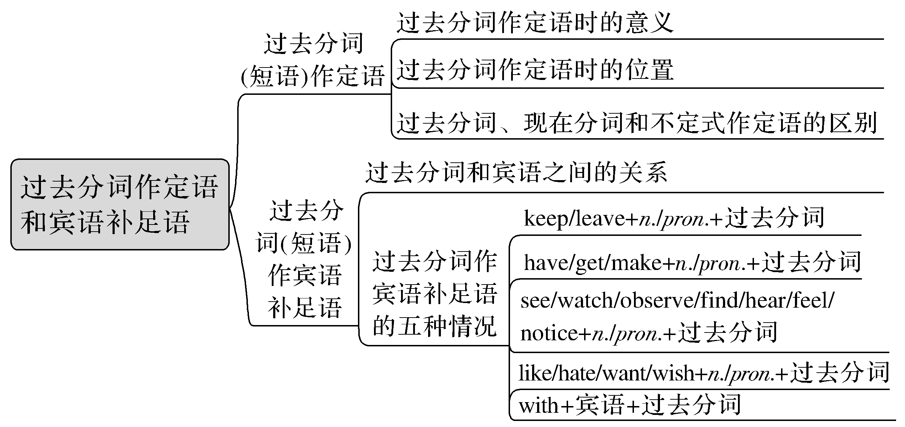
过去分词作定语和宾语补足语

Slide 3
一、过去分词作定语
1.过去分词作定语时的意义
通常及物动词的过去分词作定语强调被动、完成或只强调被动；不及物动词的过去分词作定语，只表示完成。
Her daughter brought up by me has begun to work.
由我带大的她的那个女儿已经开始工作了。(及物动词短语；被动、完成)
The wind swept the fallen leaves.风刮走了落叶。(不及物动词；完成)

Slide 4
2.过去分词作定语时的位置
(1)单个的过去分词作定语，常放在所修饰的词的前面；过去分词短语作定语时，常放在所修饰的词后面，此时，它相当于定语从句。
(2)如果被修饰的词是由every/some/any/no与thing/body/one所构成的复合代词或指示代词those等，单个分词放在被修饰词的后面。
He told me that this was the wounded soldier.他告诉我这就是那个受伤的士兵。
Near the window is a bookshelf filled with books(＝which is filled with books).
靠近窗户有一个装满书的书架。
There has been nothing changed in London since I left it two years ago.
自从我两年前离开伦敦后，它就一直没有什么变化。

Slide 5
[名师提醒]
(1)有些过去分词，如left(剩余的)，concerned(有关的)等，习惯用作后置定语。
the room left 所剩的空间 the people concerned 有关人士
(2)某些不及物动词的过去分词，不可以单独作前置定语，但可以与某些副词构成复合形容词作前置定语。
well-behaved children 规规矩矩的孩子
a widely-traveled businessman 一个游历广泛的商人
newly-arrived visitors 新来的参观者

Slide 6
3.过去分词、现在分词和不定式作定语的区别
过去分词 | done | 被动关系、动作已经完成 | used books用过的书 cooked food熟食
现在分词 | doing | 主动关系、动作正在进行 | a sleeping child一个正在睡觉的孩子
 | being done | 被动关系、动作正在进行 | the house being built正在建设的房子
不定式 | to do | 主动关系，动作尚未发生 | the guests to come即将到来的客人
 | to be done | 被动关系，动作尚未发生 | the problem to be solved有待于解决的问题

Slide 7
二、过去分词作宾语补足语
1.过去分词和宾语之间的关系
及物动词的过去分词作宾语补足语时与宾语通常为被动关系；少数不及物动词(如fall，go，change等)的过去分词作宾语补足语时仅表示动作的完成；seat，hide，dress等的过去分词作宾语补足语时一般表示宾语的状态，不表示被动或完成。
I had my watch repaired.我修理了我的手表。
When she woke up, she found the world changed.
她醒来后，发现世界变了个样。
When I came in, I found the boy hidden behind the door.
我进来时发现这个男孩藏在门后面。

Slide 8
2.过去分词作宾语补足语的五种情况
(1)过去分词用在表状态的动词keep，leave等后面，构成“keep/leave＋n./pron.＋过去分词”形式。
With English words getting popular, a Chinese dictionary has included 239 of them, leaving the public divided into two opposing groups：“For” and “Against”.随着英语单词越来越流行，一部中国字典收集了239个，这让公众分成了相反的两组：一组支持，另外一组反对。

Slide 9
(2)用在表示“致使”意义的动词后面，构成“have/get/make＋n./pron.＋过去分词”形式。
They are going to have the entrance hall painted white.
他们准备让人把门厅粉刷成白色。(表示“让某事被别人做”。)
He is trying to make himself understood.他在努力把自己的意思说清楚。
(3)用在感官动词或表示心理状态的动词后面。如：see, watch, observe, find, hear, feel, notice等，构成“see/watch...＋n./pron.＋过去分词”形式。
She felt a great weight taken off her mind.她觉得心里轻松多了。
The next morning people found the outside world completely changed.
第二天早上，人们发现外面的世界全变了。

Slide 10
(4)用在表示爱憎、意愿等动词后面，如like，hate，want，wish等，构成“like/hate...＋n./pron.＋过去分词”形式。
I wish the problem settled at the meeting.我希望这个问题在会议上被解决。
(5)用在“with＋宾语＋宾补”结构中，宾语与过去分词在逻辑上存在被动关系。这一结构通常在句中作时间、方式、条件、原因等状语。
With many brightly colored flowers planted around it, her house looks like a beautiful garden.
由于周围种了许多色彩鲜艳的花，她的房子看上去就像一个漂亮的花园。

Slide 11
[巩固内化1]
请判断下列句中加黑部分属于哪种情况
A.只表被动 B.只表完成
C.既表被动又表完成
①On the other hand, I hope to broaden my horizons in this developed country.________
②I found it hard to understand the English spoken by the native villagers.________
③It carries articles written by foreign friends about the cultures of their home countries.________
B
A
C

Slide 12
[巩固内化2]
用所给词的适当形式填空
①The adobe dwellings (土坯房)____________ (build) by the Pueblo Indians of the American Southwest are admired by even the most modern of architects and engineers.
②The witnesses ____________ (question) by the police just now gave very different descriptions.
③I was the first Western TV reporter ____________ (permit) to film a special unit caring for pandas rescued from starvation in the wild.
built
questioned
permitted

Slide 13
[巩固内化3]
用分词作定语补全句子
①Even though it is still in summer，_____________________________ on the ground.
即使仍是夏天，地上有很多落叶。
②Nowadays there are a lot of man-made satellites _______________________.
如今在太空中有许许多多人造卫星在飞行。
③There are many problems _______________________________.
有很多问题有待于解决。
there are many fallen leaves
flying in space
to be settled

Slide 14
[巩固内化4] 选择下列句中加黑部分之间的关系
A.表示被动关系
B.表示动作完成
C.表示宾语状态
①She found the necklace gone on her way home.________
②I found a girl seated in the corner, crying.________
③I had the letter posted.________
B
C
A

Slide 15
[巩固内化5]
用所给词的适当形式填空
①Back from his two-year medical service in Africa, Dr.Lee was very happy to see his mother ____________ (take) good care of at home.
②Before driving into the city, you are required to get your car ____________ (wash).
③Lucy has a great sense of humour and always keeps her colleagues ____________ (amuse) with her stories.
④With the problem ____________ (solve), the quality has been improved.
⑤The boss wouldn’t like the topic ____________ (discuss) at the meeting.
⑥He walked into the room quietly in order not to make himself ____________ (notice).
taken
washed
amused
solved
discussed
noticed

