Slide 1
七年级上册
Unit 6 Let’s Go!
Lesson 31 Let’s Go to the Bookstore!
WWW.PPT818.COM

Slide 2
学习目标
1.) Grasp main words: bookstore, ride, broken, off, lost, lady, straight, traffic, luck
2. ) Understand important structures: ride our bikes, take bus42, get lost
--Where is the bookstore?
—Go down the street, turn left.

Slide 3
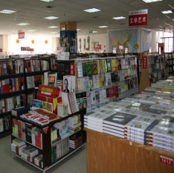
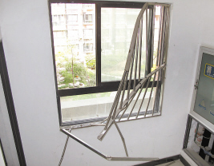
新课导入
bookstore
ride
broken

Slide 4
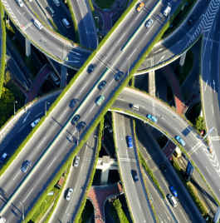
新课导入
lady
straight
traffic

Slide 5
自主反馈
(一) 单词(Word）：
bookstore
1.书店n_____________
2.骑;乘坐v__________
3.迷路的adj__________
4.幸运;运气n_________
ride
lost
luck

Slide 6
自主反馈
（二）短语 ： 阅读课文找出下列短语
1.我们怎样才能....___________________
2.让我们乘坐公交车吧!___________________
3.我不能…_________
4.我们能够....._____________
5.这是哪里？______________
6.打扰一下__________________
How can we......
Let’s take the bus!
I can’t…
We can....
Where is it?
Excuse me

Slide 7
自主反馈
试着把以下句子译成汉语并想一想这些句型的用法。
1.I can’t ride my bike.
____________________
2. Can you help us?
_______________
3.Do you have a map?
____________________
4.Good luck!
___________________
我不能够骑我的自行车。
你能帮助我们吗？
你有地图吗？
祝你好运！

Slide 8
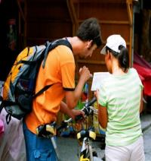
新课学习
Imagine you are in a new place. You want to go to the bank. But you don’t know where the bank is. So you could say:
Excuse me. Where is the bank?

Slide 9
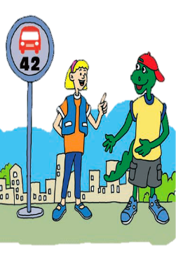
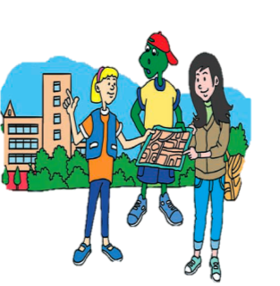
新课学习
Come on! Let’s go to the bookstore!

Slide 10
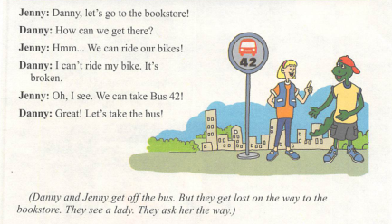
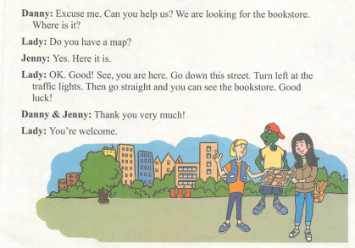
新课学习
Listen and read

Slide 11
知识探究
1. How can we get there?
询问交通方式时用how来提问，回答时用“by+交通工具名词”或者on foot。
例：—How will she go to the zoo?
— By bus/ car/ bike/ on foot.

Slide 12
知识探究
2. Danny and Jenny get off the bus.
get off 表示 “从马/火车/汽车/船/飞机上下来” ；
get on 表示“乘坐马/火车/公共汽车/船/飞机等”。

Slide 13
知识探究
get lost 为固定搭配，“迷路”。
on the way to …“在去……的路上”；还可以用on one’s way to …
例：on my way to school 在我去学校的路上

Slide 14
知识探究
4. We are looking for the bookstore.
look for 寻找; find 找到
eg. I’m looking for my book, but I can’t find it.

Slide 15
知识探究
5. Go down this street. Turn left at the traffic lights.
down 为介词，相当于along, 表示“沿着”。
turn left = turn to the left

Slide 16
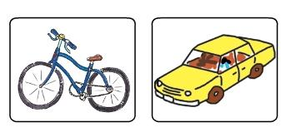
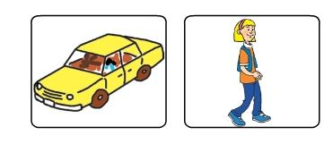
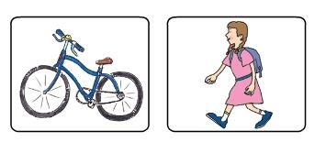
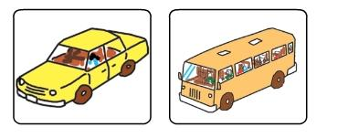
分组活动
Let’s do it
.
Listen to the dialogues circle the correct pictures.
1.
2.
3.
4.

Slide 17
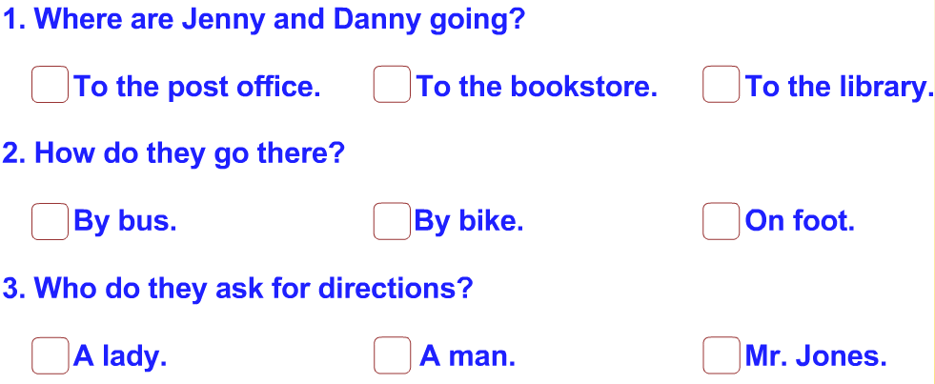
分组活动
Read the lesson and tick the correct answers.

Slide 18
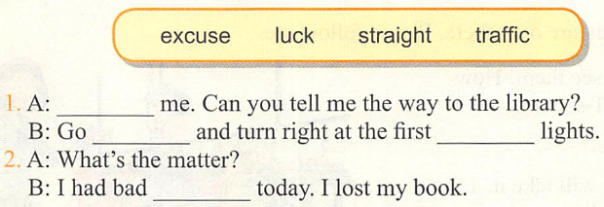
分组活动
Fill in the blanks with the word in the boxs.
1. Excuse
straight
traffic
2. luck

Slide 19
随堂检测
单项选择
1.Li Ming always _______ his bike to school.
A. drives B. takes C. rides D. walks
2. Our English teacher usually _______ the number 2 bus to school.
A. plays B. takes C. gets D. brings
3. Can you see a new store on your way ______ school?
A. for B. of C. to D. with
4. Mike went to a park _______ bike.
A. on B. with C. by
5.—_______ does Kate go to school every day?
—On foot.
A. Where B. How C. Why D. What
C
B
C
C
B

Slide 20
作业布置
1.根据导学案完成预习任务。

Slide 21
Have a good time!

