Slide 1
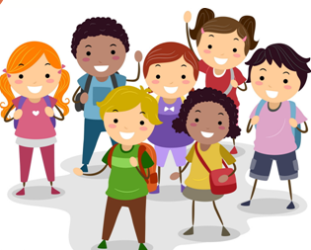
Children’s Day
第三课件
WWW.PPT818.COM

Slide 2
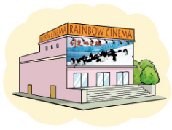
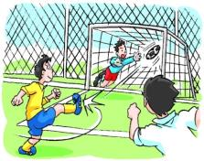
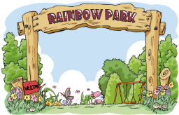
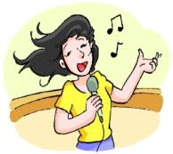
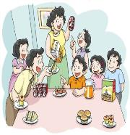
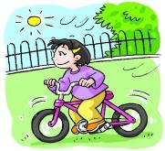
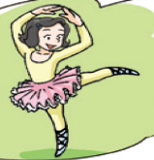
Free talk
A: What do you do on Children’s Day?
B: I …on Children’s Day.
…

Slide 3
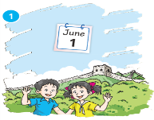
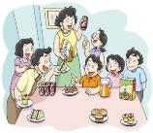
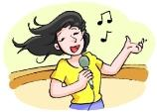

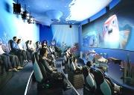
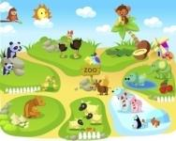
Let’s chant
In China, Childen’s Day is in June.
We have a party and eat nice food.
We sing, dance and we are cool.
We go to the cinema and watch a
cartoon.
We see animals at the zoo.

Slide 4
Listen and answer
How many countries are there?
What are they?

Slide 5
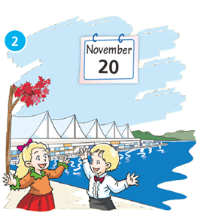

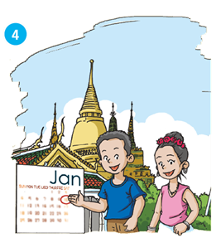
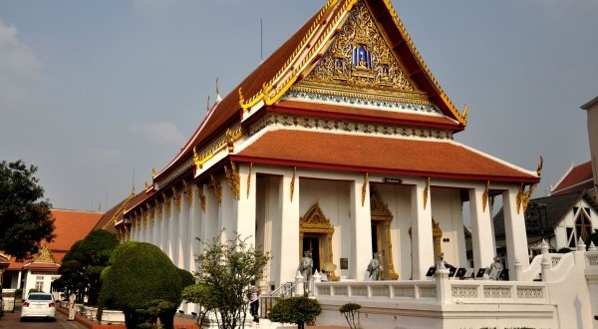
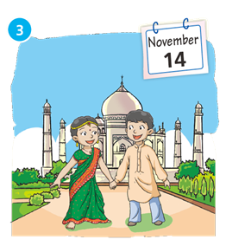
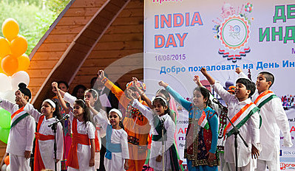
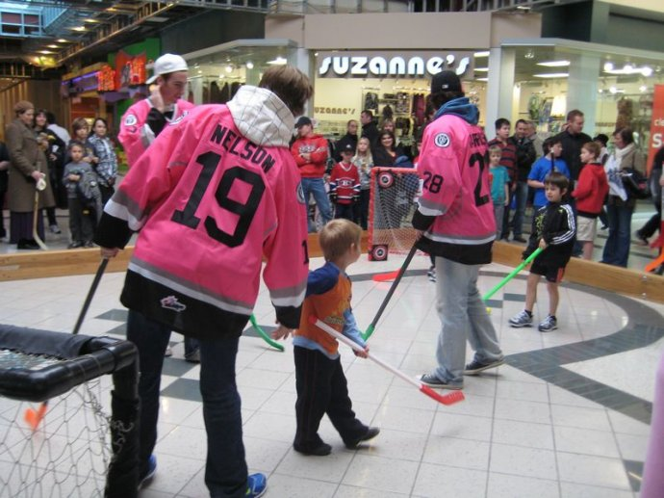
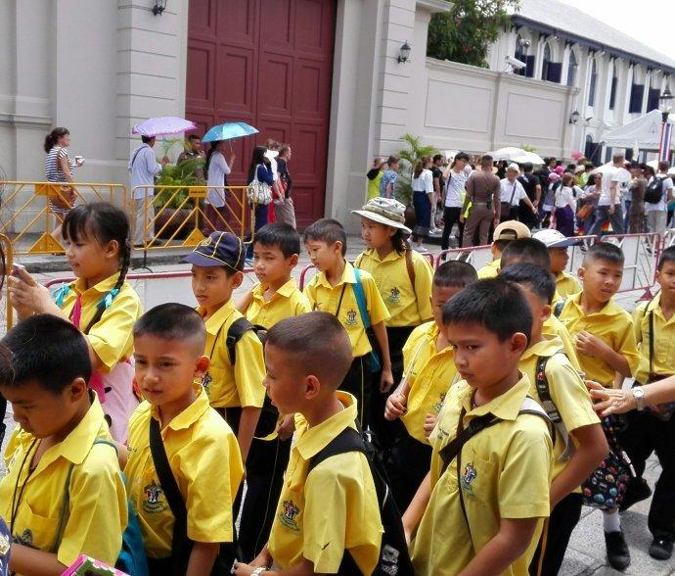
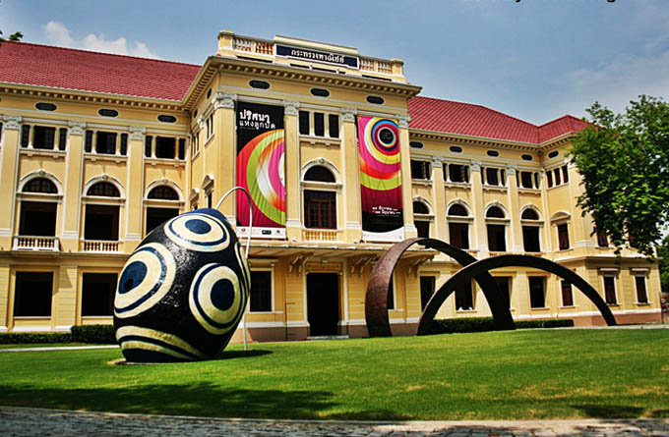
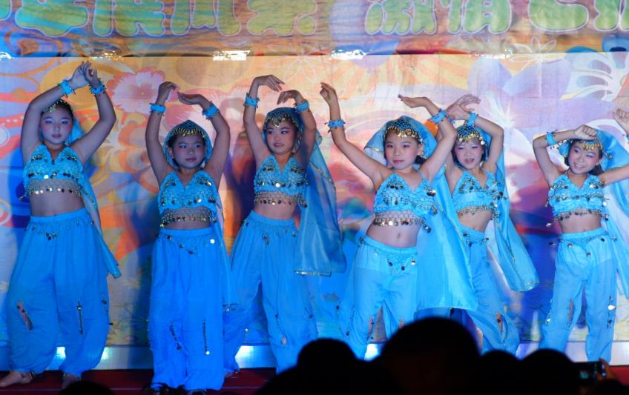
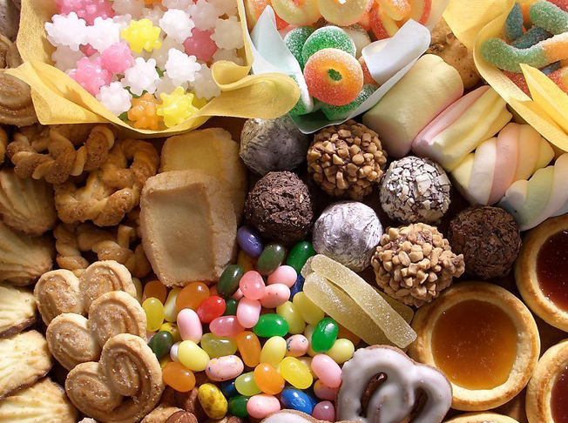
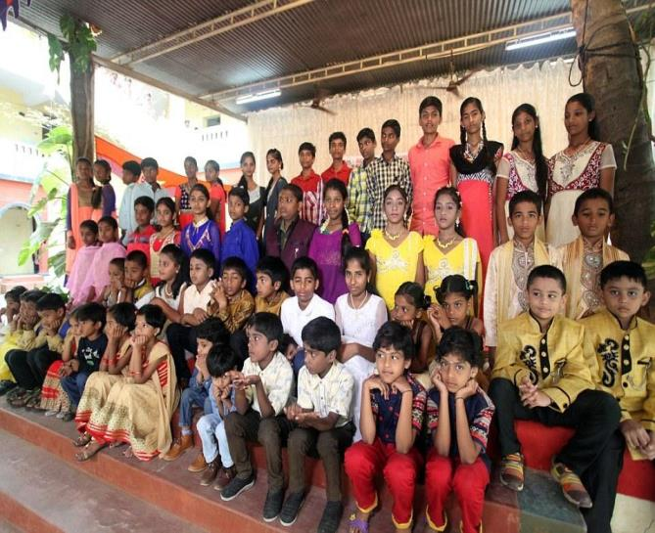
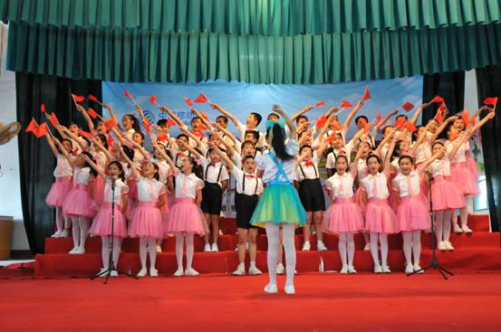
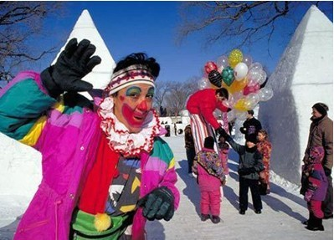
Look and check

Slide 6
Let’s check
How many countries are there?
There are four countries.
What are they?
They are China, Canada, India and Thailand.

Slide 7



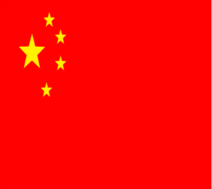
Fill in the form
Which | When | What | How
 | June
 |  | play games
 | November
 |  |  | fun
have a party，sing, dance and eat some delicious food
fun
have a carnival ,
November
exciting
watch shows,
dance and sing
interesting
January
visit some public places,
go to the shopping mall
or museum

Slide 8
Let’s read
In China, Children’s day is in June. We have no classes. We have a party at school. We sing, dance and eat some delicious food at the party. It’s fun.

Slide 9
In Canada, Children’s Day is in November.
We have a carnival after school. We play games in a big hall. It’s very exciting.

Slide 10
In India, Children’s Day is also in November. We watch lots of shows. Sometimes we dance and sing together. It’s interesting.

Slide 11
In Thailand, Children’s Day is in January. We visit some public places. We go to the shopping mall or museum. We play games there. It’s fun.

Slide 12
Let’s guess
It is in November. Children have a carnival after school. They sing and play games in a big hall. It’s very exciting.
Children’s Day in Canada
It is in January. The children visit some public places. They go to the
shopping mall and play games there. It’s fun.
Children’s Day in India

Slide 13


Let’s retell
Which | When | What | How
 | June | have a party，sing, dance and eat some delicious food | fun
 | November | have a carnival, play games | exciting
 | November | watch shows, dance and sing | interesting
 | January | visit some public places, go to the shopping mall or museum | fun
In _______，Children’s Day is in _______. Children__________________.It’s_______.

Slide 14
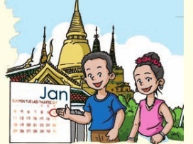
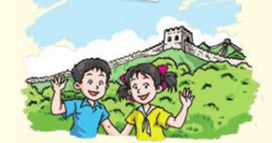
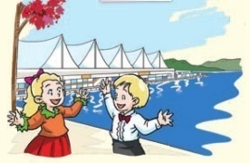
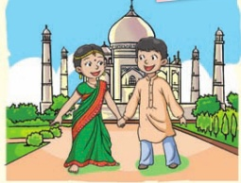
Let’s talk
A：Which country’s Children’s Day is your
favourite? Why?
B： I like Children’s Day in… .
Because …

Slide 15
Homework
Listen and read the passages three times.
2. Choose one to do:
(1) Choose one of your favourite countries’
Children’s Day and describe it.
E.g: I like Children’s Day in… . Because …
(2) Surf the Internet about one country’s Children’s Day and share it next class.

