Slide 1
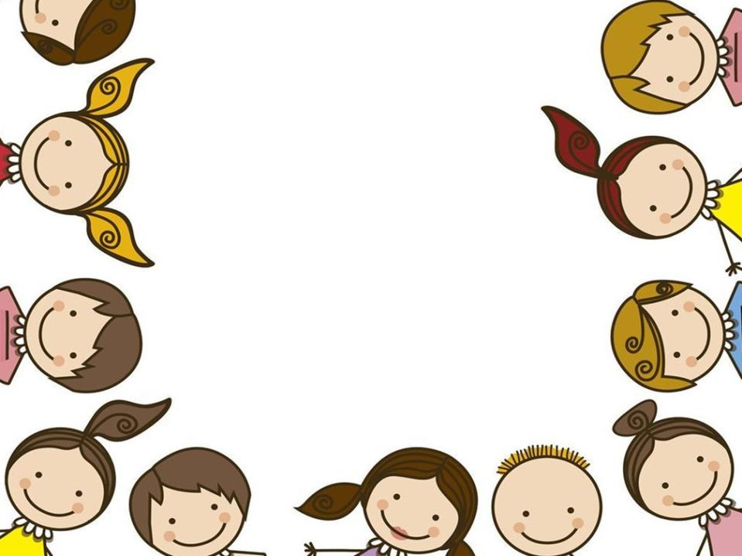
Unit 11
Sad movies make me cry
Section B 第1课时
WWW.PPT818.COM
Notes:
1

Slide 2
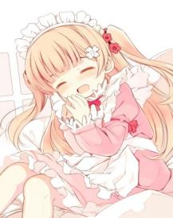
Colors and feelings
1. in the pink 健康有力
Today I feel in the pink! I had a good night’s sleep.

Slide 3
Colors and feelings
2. tickled pink 感到万分高兴
(= very pleased; delighted)
I’m tickled pink to hear that Bob’s askedSusan to marry him. They’re both my
good friends.

Slide 4
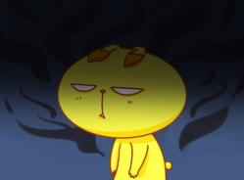
Colors and feelings
3. feel blue 闷闷不乐
I woke up feeling blue and I’ve been feeling blue all day.

Slide 5
Colors and feelings
4. sing the blues; cry the blues 诉苦
She called me every now and then to sing the blues about her troubles.

Slide 6
Retelling
upon
unhappy
Once ______ a time, there lived an ________ king in a rich and beautiful _______. He slept ______ and didn’t feel like _______. The queen
and his people were very _______. They sent the most famous doctor to _______ him. The doctor said _______ could help the king except a happy man’s _____. The prime minister, the banker and the ______ singer were called in to the palace at once, but _____ of them said they were happy and ____ of them had their own worries. Finally, the king’s __________ was sent to find a happy man ____________ time.
country
badly
eating
worried
examine
nothing
shirt
palace
none
each
top general
in three days’

Slide 7
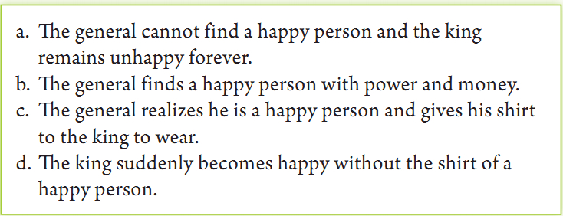
1a Look at the possible endings to the story about the unhappy king. Do you think any of these is the right one? If so, which one?

Slide 8
Discussion
1b What are some other possible endings to the story? Discuss your ideas with your partner.

Slide 9
1c Listen to The Shirt of a Happy Man (Part II) and check (√) the things that happened in the rest of the story.
______ The general searched for three
days and found a happy person.
______ The general could not find a happy
person.
______ The general saw a poor man on the
street.
______ The poor man was a happy man.
______ The poor man gave the general his
shirt.
√
√

Slide 10
1d Listen again. Answer the questions.
How long did it take the general to find the happy man?
What was the poor man doing on the street?
It took the general two days to find the happy man.
He was eating some food with his hands and singing happily to himself.

Slide 11
3. What made the poor man so happy even though he had no power, money or fame?
4. Do you think the general will return to the king with the poor man’s shirt?
Why or why not?
He had everything he wanted and didn’t want what he couldn’t have.
No, because the poor man did not have a shirt.

Slide 12
Listen again and fill in the blanks.
The general __________ everywhere for a happy man but ________ find anyone. Everyone had their own ________. ______ days passed and the general saw a ______ man sitting on the street. The man was eating, singing happily to _______. The general __________ the man and said, “You ______ very ______, my friend.” “Of course, I’m happy,” he said. “But you have no _______, _______ or ______. Well, I want your _____.” The man laughed, “I’m _____, gentlemen. But I _______ got a shirt.”
searched
couldn’t
problems
Two
poor
himself
went up to
sound
happy
power
money
fame
shirt
sorry
haven’t

Slide 13
Free Talk
What do you think of the top general’s thoughts about happiness?
Have a discussion with your partner about your ideas about happiness.

Slide 14
Proverbs about happiness
Happiness is when what you think, what you say, and what you do are in harmony. ― Mahatma Gandhi
Happiness is not something ready made. It comes from your own actions. ― Dalai Lama XIV
You will never be happy if you continue to search for what happiness consists of. You will never live if you are looking for the meaning of life. ― Albert Camus

Slide 15
Happiness is a warm puppy. ― Charles M. Schulz
All happy families are alike; each unhappy family is unhappy in its own way. ― Leo Tolstoy, Anna Karenina
Many people lose the small joys in the hope for the big happiness. ― Pearl S. Buck
Success is getting what you want; happiness is wanting what you get. ― W.P. Kinsella

Slide 16
Language Points
1. … and the king remains unhappy forever.
remain解释为“保持，依然”时，后常接表语。
How can we remain silent on this question?
对于这个问题我们怎么能保持沉默呢？
The true author of the book remains unknown.
那本书的真正作者依旧不详。

Slide 17
词语辨析
remain, stay这两个词都有“留下，逗留”之意，其区别是：
stay通常指在某地呆一段时间而不离开，或暂时留（住）在某地，尤指以宾客身份逗留；
remain则指别人已经走了，而某人仍在原地。例如：
He was staying at his father’s home.
他在父亲家里暂住。

Slide 18
2. The general searched for three days and …
search v. 搜寻；寻找
The firemen searched the buildings for survivors.
消防员在建筑物中搜寻幸存者。
search for 搜寻；寻找
He searched for work at various stores.
他在各家商店寻找工作。

Slide 19
— The children are so afraid. Shall we
________ the bush to find the strange
thing?
— OK, let’s have a look. There may be
something strange.
A. search for B. search
C. look for D. look
B

Slide 20
Rose finished her study in the university and went to ______ a good job.
A. take after B. look after
C. care for D. search for
D

Slide 21
词语辨析
search、 search for 和look for 都有“寻找”的意思。
(1) search 指“搜查某地或搜身”，其宾语可以是房屋、人身、衣袋等名词。如：
They searched his homes without any reason.
他们毫无理由地搜查了他的家。
They searched him but found nothing.
他们搜他的身，但没有找到什么。

Slide 22
(2) search for 则指“搜寻、搜索某人或物”
They searched for him everywhere.
他们到处搜寻他。
The police searched the wood for the lost child.
警察在树林里寻找走失的孩子。
试比较：They searched his clothes.
他们搜查了他的衣服。（看是否藏有东西）
They searched for his clothes.
他们在搜寻他的衣服。（要找到衣服）

Slide 23
(3) look for 意为“寻找”，同search for意义大体相同。但search for 意味较强，用很大注意力搜寻。而look for则较为通俗，常用于日常用语。如:
I looked for my missing pen everywhere.
我到处找我丢失的那支笔。

Slide 24
3. What made the poor man so happy even though he had no power, money or fame?
even though 虽然，即使
I know I can do better even though I have never made anything of the sort.
我觉得我可以做得更好，虽然我以前没有做过类似的东西。
Bill went on talking even though no one was listening.
虽然没有人在听，比尔还是继续讲。

Slide 25
There was never any time for Kate to feel lonely, ____ she was an only child.
ever since B. now that
C. even though D. even as
解析： A. 曾经； B. 既然；C. 尽管，即使；没有D选项这种用法。句意：尽管她是家里的独生女，她也从没有感到孤独。
C

