Slide 1
I'm watching TV.
Section B 第1课时
WWW.PPT818.COM

Slide 2
American any
other young
delicious still
shop study
miss wish
pool supermarket
man race
host child
the United States
Dragon Boat Festival
living room

Slide 3
The man is swimming in a pool.
man /mæn/ 男人、人--men(复数)
pool /puːl/ 游泳池、水池
My mother is shopping at the supermarket.
shop /ʃɒp/ v. 购物 n. 商店 -- shopping
supermarket /'suːpəmɑːkɪt/ 超市

Slide 4
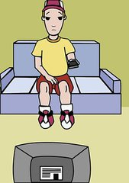
American /ə'merɪkən / 美国的、美国人
state /steɪt/ 州
the United States 美国
still /stɪl/ 还、仍然
living room 客厅
Jack is an American boy.
He is from the United States.
It's 11:00 p.m., but he is still watching TV in the living room.

Slide 5
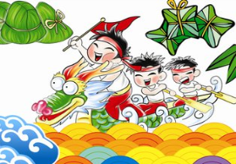
dragon /'dræɡən/ 龙
Dragon Boat Festival 端午节
race /reɪs/ 竞赛
delicious /dɪ'lɪʃəs/ 美味的
Today is the Dragon Boat Festival.
I'm watching the boat races on TV.
My mother is cooking delicious meal.

Slide 6
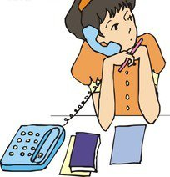
study /'stʌdi/ n.&v. 学习、研究
any /'eni/ 任何的
other /'ʌðə(r)/ 其他的
young /jʌŋ/ 幼小的、年轻的
child /tʃaɪld/ 儿童 --children (复数)
miss /mis/ 思念 --misses
Lily is studying English in the United States.
Like any other young child, she misses her parents.

Slide 7
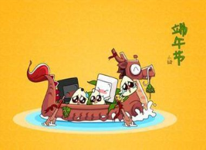
host /həʊst/ 主人、东道主
host family 寄宿家庭
wish /wɪʃ/ 希望 --wishes
wish (sb.) to do sth. 希望（某人）做某事
Today is the Dragon Boat Festival.
Lily is living with her host family in Canada.
She wishes to meet her parents.

Slide 8
根据汉语意思或首字母提示完成句子
1. I'm shopping at the s____________.
2. Jim is an ______________ boy. （美国的）
3. Today is ____________ Day.（儿童）
upermarket
American
Children's

Slide 9
完成句子
1. I wish ___________ my mom's delicious food.
我希望吃到妈妈做的美味食品。
2. He is taller than ____________ student in his class.
他比他们班上其他任何一个学生都高。
to have
any other

Slide 10
形 容 词 / 副 词
American any
other young
delicious still
词 组
动 词
the United States
Dragon Boat Festival
living room
shop study
miss wish
key words
名 词
pool supermarket
man race
host child

