Slide 1
Unit 14
I remember meeting all of you in Grade7.
Section B Period 3 1a-2e
WWW.PPT818.COM
Notes:
1
1

Slide 2

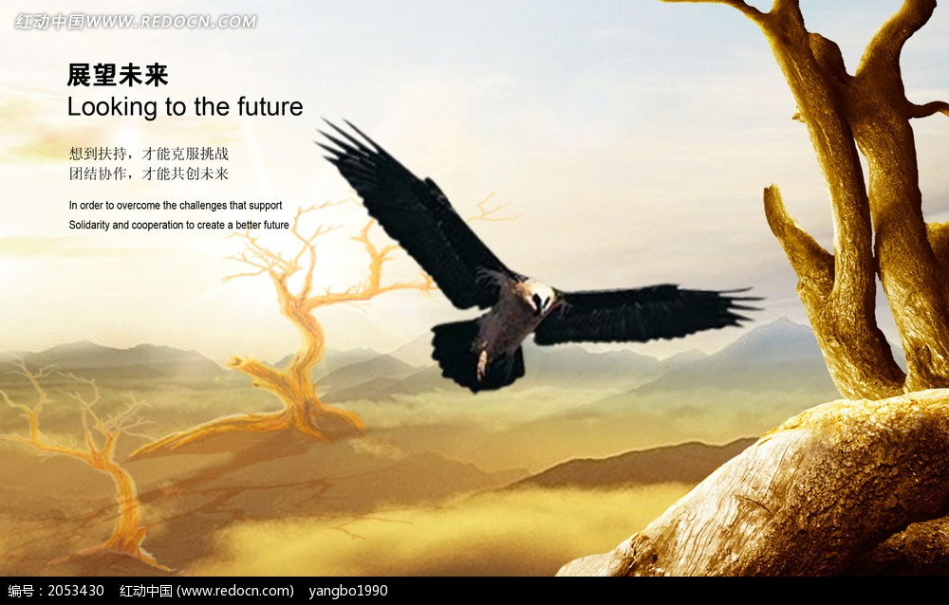
What do you hope to do in the future?
I remember meeting all of you
in Grade 7.SectionB

Slide 3
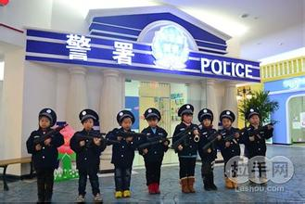
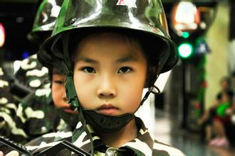
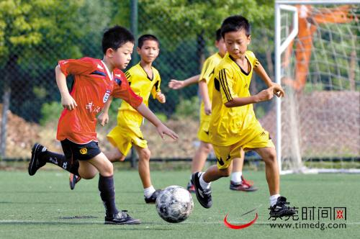
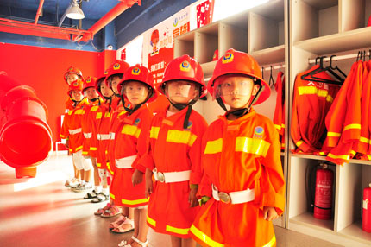

Slide 4
Free talk

Slide 5
Talk about what you hope to do in the future with your parnter.
A: What do you hope to do in the future?
B: I hope to get a business degree and
become a manager.

Slide 6
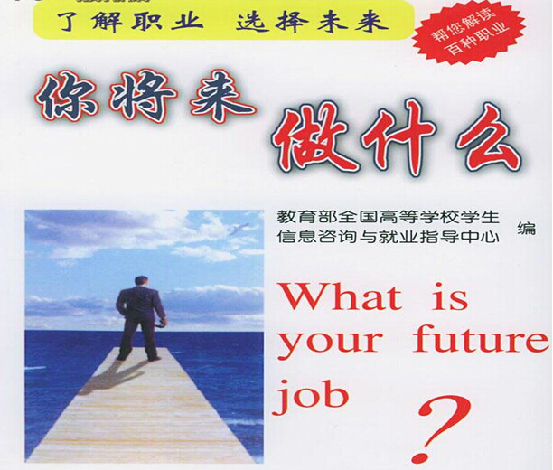
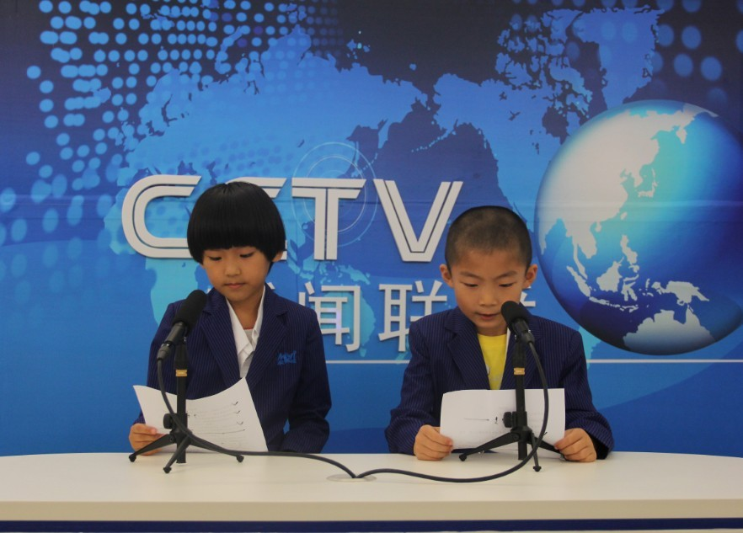
host
hostess
What do you hope to do?

Slide 7
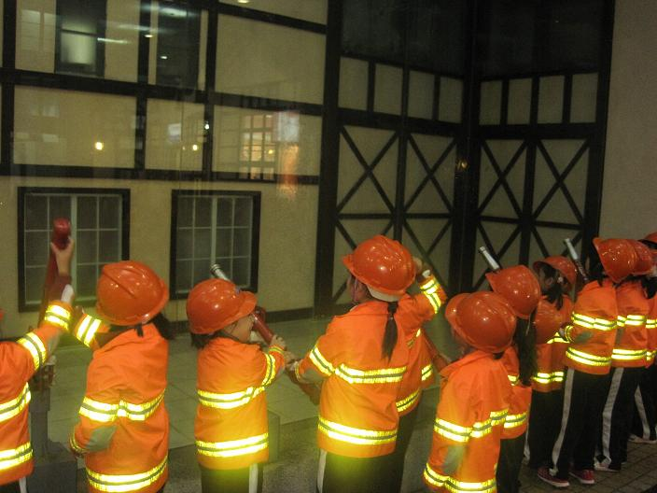
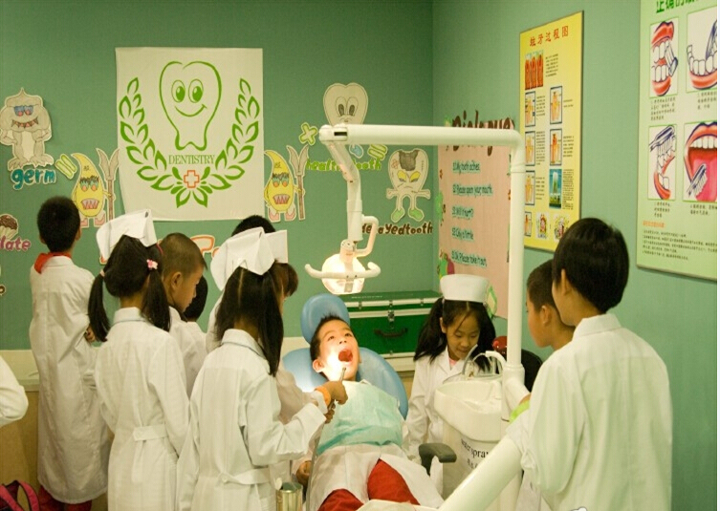
fireman
doctor
What do you hope to do?

Slide 8
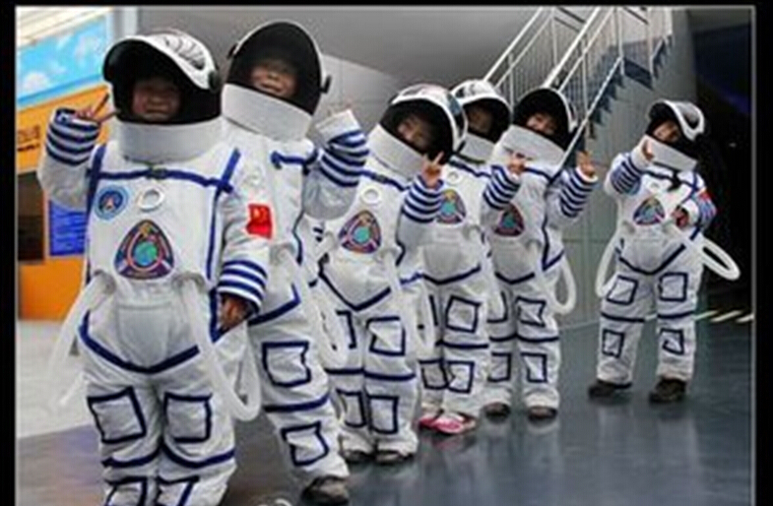
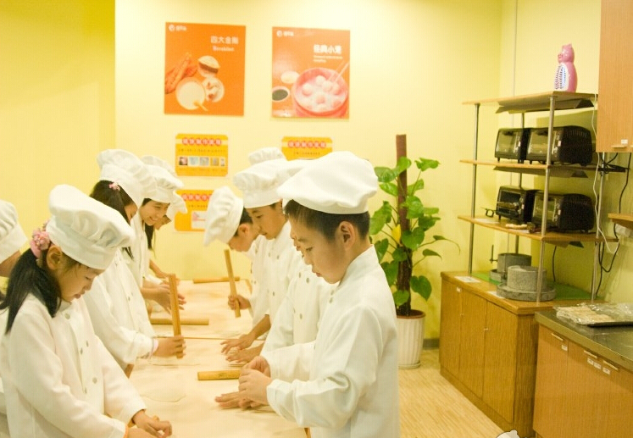
astronaut
cook
What do you hope to do?

Slide 9
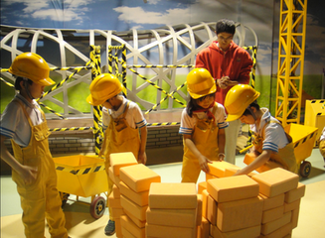
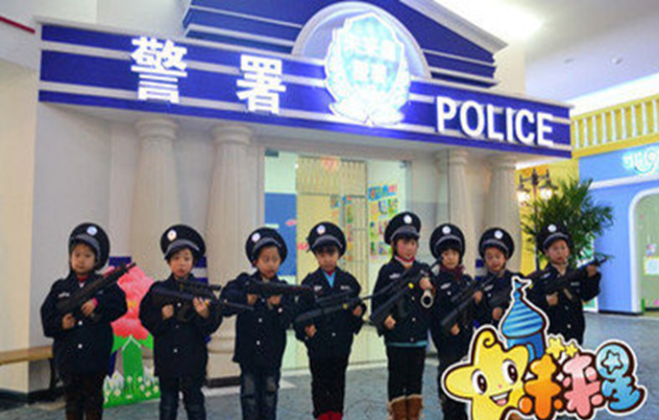
worker
policeman
What do you hope to do?

Slide 10
Listening

Slide 11

1a
Write about what you would like to do in the future.
1. _____________________________________.
2.______________________________________.
3.______________________________________.
get a business degree and become a manager
sing beautiful songs and become a muscian
sing beautiful songs and become a muscian

Slide 12


1b
Talk about what you hope to do in the future.
What do you hope to do in the future?
I hope to get a business degree and become a manager.

Slide 13


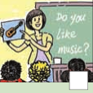

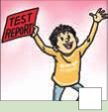

1c
Listen to a class discussion. Check (✔) the hopes you hear.
✔
✔
✔
✔

Slide 14

1c
Listen to a class discussion. Check (✔) the hopes you hear.
person | Hopes to...
Bob | get into senior high school
Shirley | get into a music school, play in a band
Ken | be an astronaut, go into space
Anna | teach kids English

Slide 15
1d
Listen again. Complete the passage.
Today is the students’ last class. Bob feels _____ about it and thinks Mrs. Chen’s classes have been______. The students talk about what they want to do in the future. Bob hopes to _____ the exam to get into sennior high school. Shirley wants to get into a _______.
sad
great
pass
music

Slide 16
1d
Listen again. Complete the passage.
Ken is good at ________and he won a _____ for it. So he wants to be an _________. Mrs. Chen believes in all of them and tells them to “________ ”. To celebrate the end of junior high, they’re having a _____ . They ask Mrs. Chen to come, and she is happy to accept the invitation.
science
prize
astronant
go for it
party

Slide 17
1e
Prepare a speech Use the questions to help you.
How have you changed since you started junior high school? Who has helped you most? What advice have your parents given you? What will you do after you graduate? What are you looking forward to?

Slide 18
Reading

Slide 19

2a
What is the most important thing you
have learned in junior high school ?
Discuss the question with a partner.

Slide 20

Read the passage and answer the questions.
2b
1. What kind of text is this? Is it a story,
a speech or a notice?
2. Who do you think wrote it?
3. Who is it for?
It's a speech.
It's for the graduating students of the school.
The princlpal of school is probably the person who wrote it.

Slide 21
Read the passage again and answer
the questions.
2c
1. What were the students like in Grade 7?
2. How have the students changed?
They were all so full of energy and thirsty for knowledge.
They become talented young adults who are full of hope for the future. They’ve all grown up so much.

Slide 22
3. Who should the students thank and why?
4. What will senior high be like?
They should thank people in their lives who helped and supported them--their parents, their teachers and their friends.
It will be harder and that you have many difficult tasks ahead of you.

Slide 23
5. How should the students deal with the future?
They should choose wisely and be responsible for your decisions and actions.

Slide 24
Fill in the blanks with the correct
forms of the words in the box.
2d
attend
be thirsty for
none
set out
be proud of
1. It is time to say goodbye, but _____________
of us want to leave.
none

Slide 25
2. It is always hard to separate from those
whom you have spent so much time with for
the past three years. However, we are still
excited to ___________ on a new journey
when we enter senior high school.
3. The teacher can see in our eyes that we
_______________ knowledge. She tells us
that knowledge will give us wings to fly.
set out
are thirsty of

Slide 26
4. We will _____________ the junior high
graduation ceremony tomorrow. It is a very
special time for us.
5. Our teachers and parents will ____________
us because we have grown up and can be
responsible for ourselves.
attend
be proud of

Slide 27
2e
Underline the sentences you like in the
passage. Tell your partner what they
mean and why you like them.

Slide 28
Language points
1. Thank you for coming today to attend the graduation ceremony at No. 3 Junior High School.
（1）graduation作名词，意为“毕业； 毕业典礼”。
如：It was my first job after graduation.
那是我毕业后的第一个工作。
I have determined on going to Tibet after graduation. 我已决定毕业后去西藏。
His graduation will never take place if he doesn't get to work. 他要是不用功就永远毕不了业。

Slide 29
Language points
（2）ceremony作可数名词，意为“典礼；仪式”，复数形式为ceremonies。
如：The ceremony was an ordeal for those who had been recently bereaved. 这个仪式对于那些新近丧失亲友的人来说是一种折磨。
All the local clergy were asked to attend the ceremony.
所有当地的圣职人员都获邀参加这项仪式。
All the pomp and ceremony of a royal wedding
王室婚礼的盛大场面与仪式。

Slide 30
Language points
2. First of all, I’d like to congratulate all the students who are here today.
（1）first of all意为“首先”。
如：If you want to speak good English, you should first of all listen to good English as often as possible.
如果想英语说得好，首先应当尽可能地经常听好的英语。
First of all, let’s read the new words.
首先，让我们读生词。

Slide 31
Language points
（2）congratulate作及物动词，意为“向（某人）道贺；祝贺”， 过去式为congratulated ，过去分词为 congratulated ，现在分词为congratulating ，第三人称单数为congratulates。
如：I should congratulate you that you resisted the temptation. 我应向你祝贺，你抗住了这种引诱。
Listeners wrote in to congratulate the radio actor on his performance. 听众写信祝贺那位广播员的演技。
I congratulate you with all my heart. 我衷心祝贺你。

Slide 32
Language points
【拓展】①congratulate sb. for sth. 为某事像某人祝贺。
如：He is to be congratulated for his success.
他将会由于取得的成就而受到祝贺。
②congratulate sb. on...就…向某人表示祝贺。
如:We congratulated him on having passed the exam. 我们祝贺他通过了考试。

Slide 33
Language points
3.You were all so full of energy and thirsty for knowledge.
be thirsty for意为“渴望；渴求”，常构成be thirsty for doing sth 渴望做某事；be thirsty for sth 渴望得到某物。
如：Young man should be thirsty for knowledge.
青年人应该渴望知识。
And this aroused him to be thirsty for ideal life style.
并由此引发了他对理想的生命形式的呼唤。

Slide 34
Write about what you have gotten in the junior
high school and your plan in the senior high school.

