Slide 1
Module 3 Unit 2
The sun is shining.
WWW.PPT818.COM

Slide 2
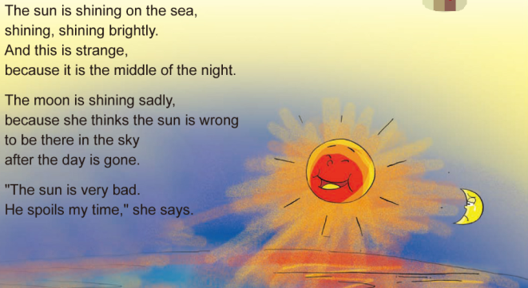
创设情境
Let’s chant

Slide 3
Collect words
shine
v.闪耀
brightly
adv. 明亮地
spoil
v.掠夺

Slide 4
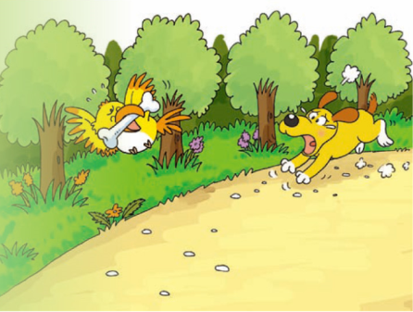
启发思考
What can you see in the picture?
I can see a naughty bird and a running dog.
What are they doing?
The bird is flying and the dog is crying.

Slide 5
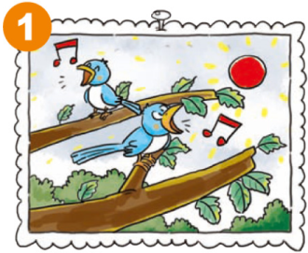
自主或小组探究
In this photo, the sun is shining.
The birds are singing in the trees.

Slide 6
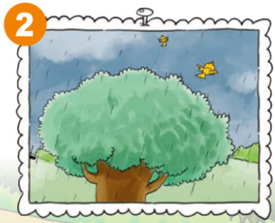
Now look at this photo.
It’s starting to rain and the birds are flying away.

Slide 7
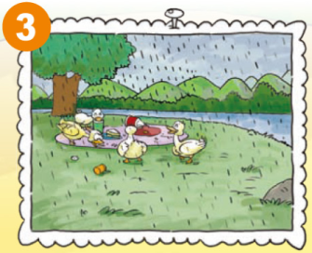
And in this photo, it’s raining.
The ducks are eating our sandwiches.

Slide 8
Ask and answer
How many birds are there in Photo 1?
There are two birds in Photo 1.
2. What is happening in Photo 2?
It’s starting to rain and the birds are flying away.
3. What are the ducks doing in Photo 3?
They are eating our sandwiches.

Slide 9
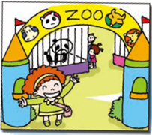
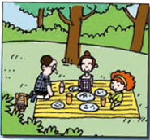
Look and say
Talk about the photos.
In this photo, She is seeing the animals.
She’s in the zoo.
In this photo, they are having a picnic.
They’re in the park.

Slide 10
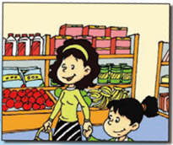
In this photo, she is reading books.
She’s in the library.
In this photo, they are going shopping.
They’re in the supermarket.

Slide 11
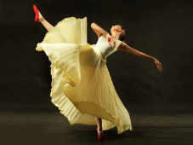
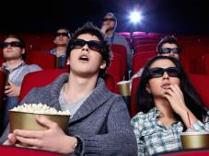
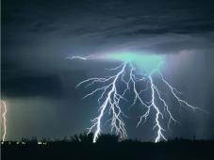
More photos

Slide 12
协作交流
Make a story with following words and expressions.
Then tell the class about it.

Slide 13
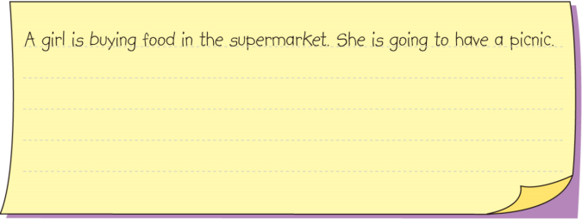

Slide 14
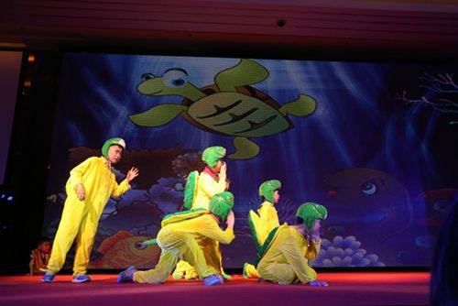
Let’s play your stories!

Slide 15
总结提高
When you look at photos, you can say
Look at the photo/picture.
A is V-ing XX.
B is in XX.
Notice
shine + ing= shining

Slide 16
Homework
1.完成 配套练习。
2.记诵本课出现的生词，完成看图写作。

