Slide 1
陕旅版小学英语三年级下册
Unit8 The Ruler Is Long
第3课时
WWW.PPT818.COM

Slide 2
学习目标
1. 回顾单复数is, are, 名词后+s的运用：
2. 听说句子：
It has a long nose and big ears.
Its eyes are small.
How big it is!

Slide 3
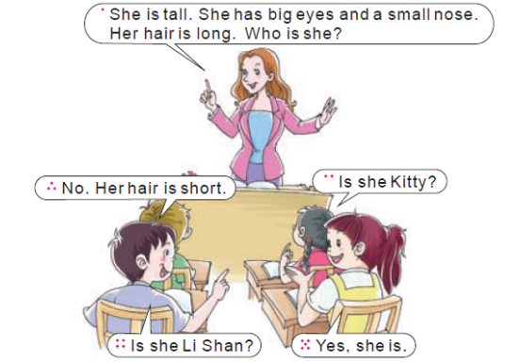
Part B Let’s play

Slide 4
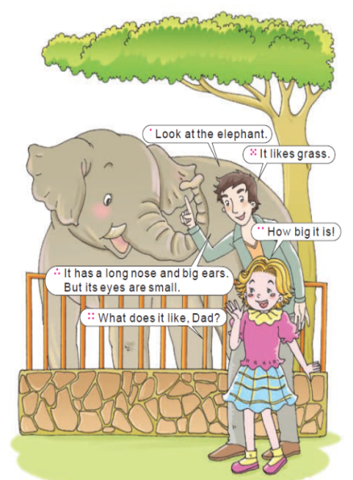
Part B Let’s learn more
Look at the elephant.
看这只大象。
How big it is!
它好大呀！
It has a long nose and big ears.
它有只长长的鼻子和大大 的耳朵。
What does it like, dad?
爸爸，它喜欢什么？
It likes grass.
它喜欢吃草。

Slide 5
it 为动物“它”第三人称，后跟动词单数形式+s
例如：It likes grass.

