Slide 1
Module 10 Australia
Unit 1 I have some photos that I took in Australia last year.
WWW.PPT818.COM

Slide 2
新课导入
Words review
我们这就看看
adj. 中心的；在中间的
根据；按照；
据……所说
adj. 神奇的；迷人的
n. 高度；身高
帆船
adj. 在东北的
n. 羊；绵羊
here we go
central
according to
magical
height
sailing boat
northeast
sheep

Slide 3
新课导入
Words review
n. 帽子
v. 使保持(某种状态);
记录；存储(信息)
(使)避开；(使)不靠近
n. 苍蝇
n. [复数]剪刀
把某物从某物上剪掉
n. 羊毛
hat
keep
keep sb./ sth. away
fly
scissors
cut sth. off sth.
wool

Slide 4
新课导入
Words review
n. 日记；日记薄
写日记
v. 憎恨；讨厌
n. 蚂蚁
v. (用刷子)刷
把某物从某物上
刷掉
那时；在那段时间
diary
keep a diary
hate
ant
brush
brush sth. off sth.
at the time

Slide 5
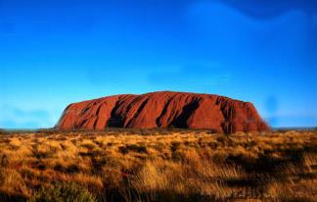
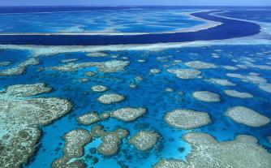
新课导入
Can you tell us some famous things in Australia?
思 考
Ayers Rock
Great Barrier Reef

Slide 6
新课导入
思 考
The Olympic Games in 2000 were held in Sydney.

Slide 7
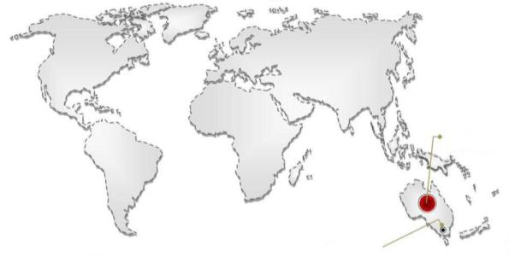
新课导入
Australia is the largest English-speaking country in the southern part of the world.
思 考
This is Australia.
Canberra is the capital.

Slide 8
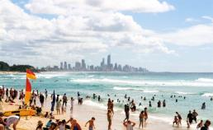
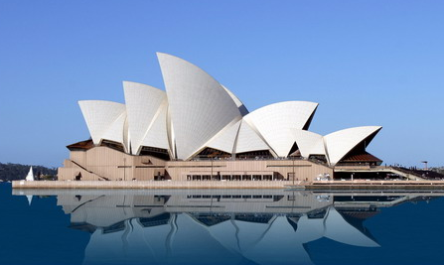
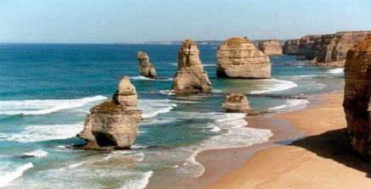
新课导入
Gold Coast
思 考
The Sydney Opera House

Slide 9
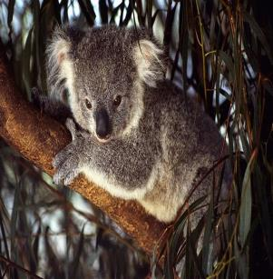
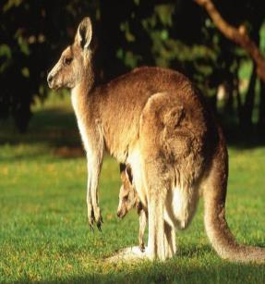
新课导入
思 考
koala
kangaroo

Slide 10
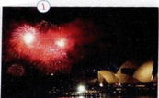
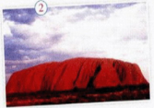
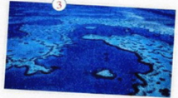
新课讲解
1
Answer the questions. Use the pictures on the right and on the next page to help you.
思 考
1．Where were the Olympic Games held in 2000?
2．What is the largest English­speaking country in the southern
part of the world?
3．What famous things can you see there?
The Olympic Games were held in Sydney in 2000.
It is Australia.
Ayers Rock, the Sydney Opera House and the Great Barrier Reef.

Slide 11
新课讲解
2
Listen again and complete the sentences.
思 考
1．The country that Tony would like to visit is ________．
2. In Tony's opinion，Australia is famous for _______________________．
3．Ayers Rock is a huge rock in the________ of Australia.
4．Australia is __________ English­speaking country in the southern part of the world.
Australia
the 2000 Olympic Games
centre
the largest

Slide 12
新课讲解
Tapescript
思 考
Mr Jackson: OK, homework. Has everyone decided which country you’d like to visit? Tony?
Tony: Yes, the country that I’ve chosen is Australia.
Mr Jackson: Good, and what is Australia famous for?
Tony: Well, the Olympic Games in 2000 were held in Sydney. Er, but that’s all.
Mr Jackson: Well, in the centre of the country is a huge rock called Ayers Rock. And something else to see is the Great Barrier Reef.

Slide 13
新课讲解
思 考
Did you know Australia is the largest English-speaking country in the southern part of the world?
Tony: No.
Mr Jackson: OK. For homework, you must all choose
a country that you’d like to visit. I’d like
you to imagine you’re there, and you’re
writing a letter to your parents back home.

Slide 14
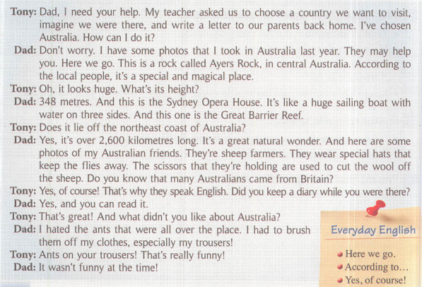
新课讲解
3
Listen and read.
思 考

Slide 15
新课讲解
Now complete the table.
思 考
Facts about Australia
Name |  | Sydney Opera House | Great Barrier Reef
Location |  | Sydney
Details | a special huge rock
Ayers
Rock
central
Australia
the northeast coast
of Australia
like a huge sailing boat with water on three sides
a great natural wonder and over 2,600 kilometres long

Slide 16
新课讲解
4
Answer the questions.
思 考
1. What is Tony going to write about?
He is going to write a letter about Australia.
2. Why does Tony’s dad show his photos of Australia to Tony?
Because they may help Tony.
3. Who are the people in some of the photos?
They are his Australian friends.
4. Why do many Australians speak English?
Because many Australians came from Britain.
5. What did Tony’s dad not like about Australia?
The ants.

Slide 17
新课讲解
5
Complete the passage with the correct
form of the words and expression in the box.
思 考
according to ant brush central diary hat hate height scissors
Tony is going to write a letter about Australia. His dad helps him. He shows Tony some photos. Tony sees a photo of Ayers Rock in _________ Australia. Ayers Rock has a(n) _______ of 348 metres, and _____________ the local people, it is a magical place. Tony also sees some photos of sheep famers with special _____ to keep away flies.
central
height
according to
hats

Slide 18
新课讲解
思 考
The farmers use ________ to cut the wool off sheep. Tony’s dad says Tony can read his ______. He also says he ________ the _________ that he had to ________ off his clothes!
scissors
diary
hated
ants
brush

Slide 19
新课讲解
6
Say the sentences aloud and decide which intonation is most likely.
1. Here we go.
2. Yes, of course!
3. That’s really funny!
Now listen and repeat.

Slide 20
新课讲解
7
Think of a place you have visited. Make notes about the best things you have seen there.
what it is called
where it is
what is special about it
—What's the name of the place that you have visited?
—It's called Mount Tai.

Slide 21
新课讲解
Language points 1
Point
according to 根据……
according to一般可以引出表示原因或者参考等的状语。
(1)根据；按照
eg：They divided themselves into three groups according to their age.
他们按年龄把自己分成三组。

Slide 22
新课讲解
Language points 1
Point
according to 根据……
(2)取决于
eg：We will go or we won't, according to circumstances.
我们或去或不去，都将视情况而定。
(3)据……所载；据……所说
eg：According to her, Grandfather called at noon yesterday.
据她说，祖父在昨天中午打电话了。

Slide 23
新课讲解
Language points 2
Point
height /haɪt/ n. 高度
辨析：high, highly与height
high | 形容词 或副词 | 作形容词讲时，意为“高的”，修饰名词；作副词讲时，意为“在高处”，修饰动词
highly | 副词 | 意为“高级地”，修饰动词或形容词。
height | 名词 | 意为“高度”，常与介词in连用。

Slide 24
新课讲解
Language points 2
Point
height /haɪt/ n. 高度
height常用的结构
(1) at a height of在……的高度
(2) in height 在高度上
(3) What’s the height of...？
＝What's...height？……的高度是多少？

Slide 25
新课讲解
Language points 3
Point
lie off 稍离陆地(或他船)；稍离陆地等
lie＋介词的用法
lie off | 表示[海]稍离陆地(或他船)；稍离(陆地等) eg：It lies off the northeast coast of Australia.它在澳大利亚东北海岸不远处。

Slide 26
新课讲解
Language points 3
Point
lie off稍离陆地(或他船)；稍离陆地等
lie to | 表示位于……(某范围之外且不接壤) eg：Japan lies to the east of China. 日本在中国以东。
lie on | 表示位于……(某范围之外且与之接壤) eg：India lies on the southwest of China. 印度位于中国的西南。
lie in | 表示位于……(某范围内) eg：Changchun lies in the northeast of China. 长春位于中国的东北部。

Slide 27
新课讲解
Language points 4
Point
keep the flies away 赶走苍蝇
keep sb./sth. Away 使某人/某物离开
keep sb./sth. away from sth.使某人/某物远离某物
keep away from... 远离……
eg：Her illness kept her away from work for several weeks.
她病得好几周都上不了班。

Slide 28
新课讲解
Language points 5
Point
scissors /'sɪzəz/ n.剪刀
在英语中，有些名词，如scissors, jeans, glasses, chopsticks, trousers, shoes, gloves等，是由两部分构成的物体，所以常用复数形式；表示数量时，常用“数目＋pair(s) of”。但此短语作主语时，要根据pair的单复数来决定谓语动词的形式。

Slide 29
新课讲解
Language points 6
at this time | 意思为“这个时候”。 eg：I was walking in the street at this time last Friday. 上个星期五的这个时候我正在街上走。
Point
at the time 那时
辨析：
at the time | 那时。多用在句子的开头或末尾，句子一般用一 般过去时。 eg：This was a wise decision at the time.这在当时是一个明智的决定。
at that time | 与at the time意思和用法相近，也用于一般过去时。 eg：He was very poor at that time.那时他很穷。

Slide 30
当堂小练
一、根据句意及首字母或汉语提示完成句子
1．I bought a pair of （剪刀）yesterday.
2．We should keep an English d every day.
3．You‘ll always see plenty of （蚂蚁）before the heavy rain comes. 4．（中考·宁波）“Jackie is of medium ”means Jackie is neither tall nor short.
5． The place is so （迷人的） that all of us are fond of it.
scissors
iary
ants
height
magical

Slide 31
当堂小练
二、用所给词的适当形式填空
6．【易错题】 Lots of （sheep） are at the foot of the hill.
7． The biggest supermarket is in the （central）of Liaocheng.
Tom （hate） ants climbing up his body and giving him some bites.
9．（模拟·扬州）Have you read the book （call） Gone with the Wind？
10．He showed me some photos that he （take） in Australia last year.
sheep
centre
hates
called
took

Slide 32
课堂小结
Key words
magical, height, sailing, sailing boat, sheep, wool, ant, fly, hat, scissors, diary, central, hate, brush
Key Phrases
keep a diary,
according to,
keep sb/sth away,
cut off,
brush sth off sth.
Key sentences
The farmers use seissors to cut the wool off sheep.
According to the local people,it's a special and magical place.

