Slide 1
Unit 14
I remember meeting all of you in Grade 7.
Section A 第1课时
R·九年级下册
WWW.PPT818.COM

Slide 2
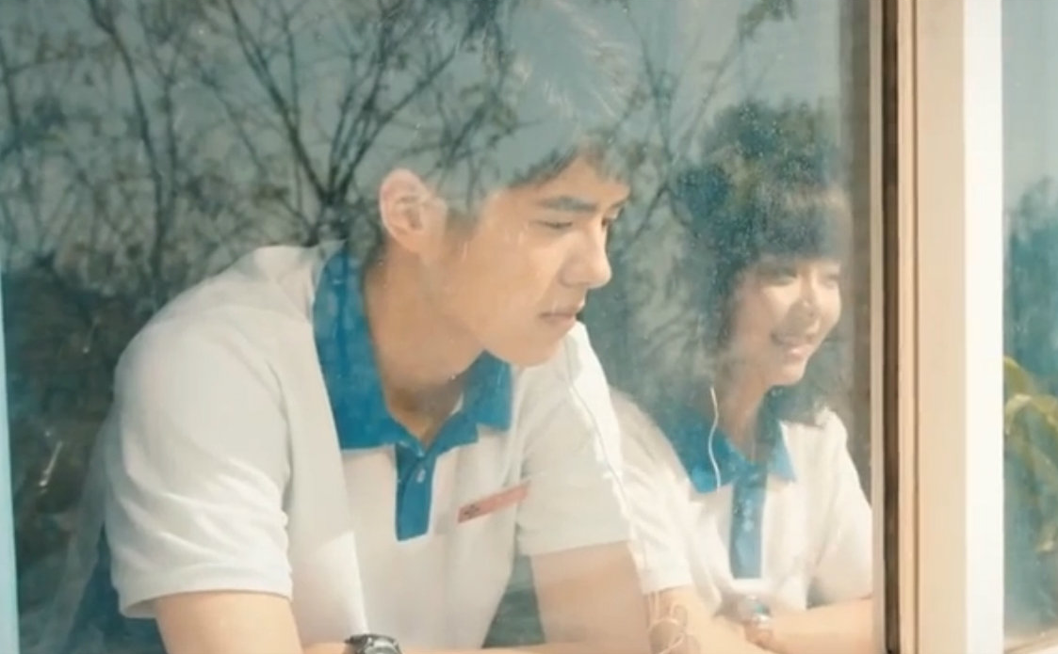
Lead-in
Junior high school days are going to be over.
Do you have any special memories?
Teacher ?
Deskmate ?
school ?
Friend ?
book?
…

Slide 3
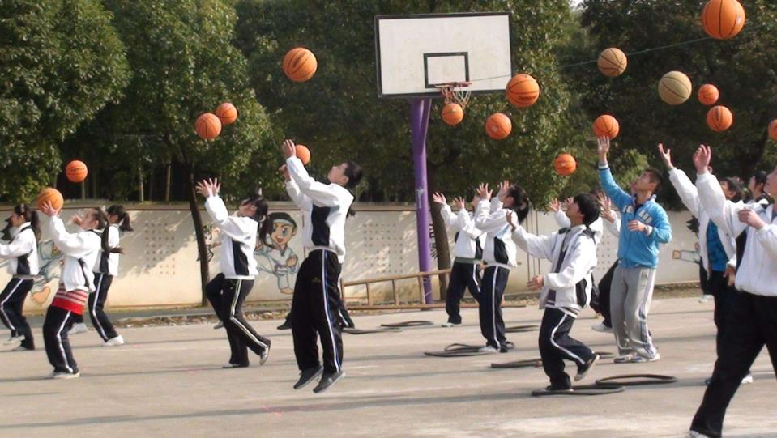
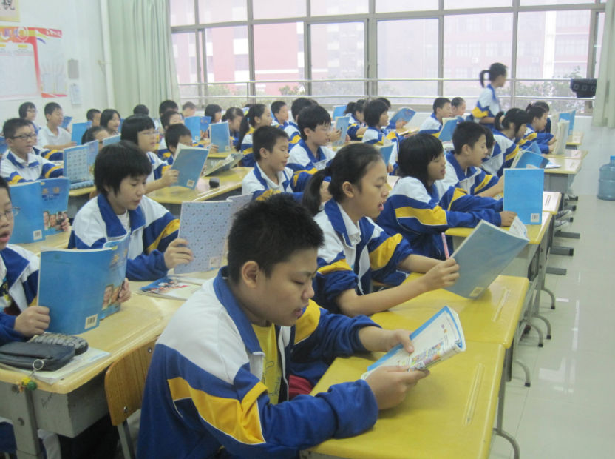
Reading in the classroom
Making a new friend
Having an interesting P.E lesson

Slide 4
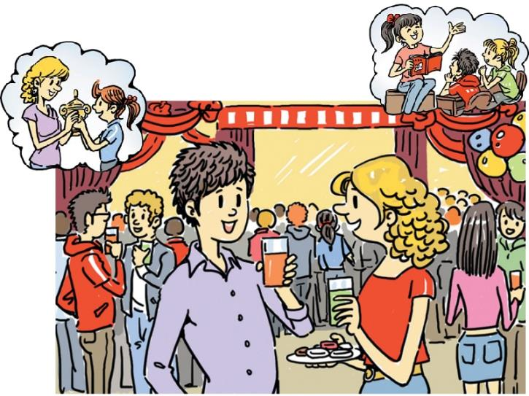
1a
Check(✔) the things you remember doing at junior high school. Add more to the list.
remember doing sth.
记得做过……事(已做过)
Well, junior high school days are over. Do you have any special memories?
I remember meeting all of you in Grade 7.

Slide 5
At junior high school, I remember:
_____ winning a prize
_____ being a volunteer
_____ doing a school survey
_____ a friend helping me with a problem
___________________________________
___________________________________
Receiving a gift from my penfriend
my deskmate losing her schoolbag
the first day of school

Slide 6
1b
Listen and match the memory with the person.
____ Mary a. did homework carefully to meet the
standards of a strict teacher
____ Frank b. remembers losing a schoolbag
____ Sarah c. remembers meeting this group of friends
____ Peter d. has enjoyed every year of junior high
school
b
达到标准
d
c
a
Tip： Read this part fast before listening.

Slide 7
Answer the following questions according to the conversation.
1. What did Mary lose in Grade 7? ____________
2. Who helped her find it? ___________
3. What kind of person is Mr. Brown? _________
4 .What did Peter do to meet Mr. Brown’s standards?
________________________________
Her schoolbag.
Peter.
Strict.
He did his homework carefully.

Slide 8
听力原文
Mary: Hey, Frank! Peter, Sarah and I were just sharing memories of junior high school.
Frank: Great! Do you have any special memories, Mary?
Mary: Oh yeah, lots … I remember losing my schoolbag in Grade 7.
Frank: I remember that! We all helped you to look for it, remember?

Slide 9
Mary: Yes, and Peter found it. Thanks for saving my
life that day !
Peter: No problem.
Mary: How about you, Peter? What do you remember?
Peter: Hmm … I used to be scared of Mr. Brown in Grade
8. He was so strict! I always did my homework
carefully to meet his standards.

Slide 10
Sarah: Me, too. And I remember meeting all of you in
Grade 7. And we’ve been good friends ever since,
haven’t we, Frank?
Frank: Yeah! I’ve enjoyed every year of junior high school.
Peter: And we’re all going to miss this place.

Slide 11
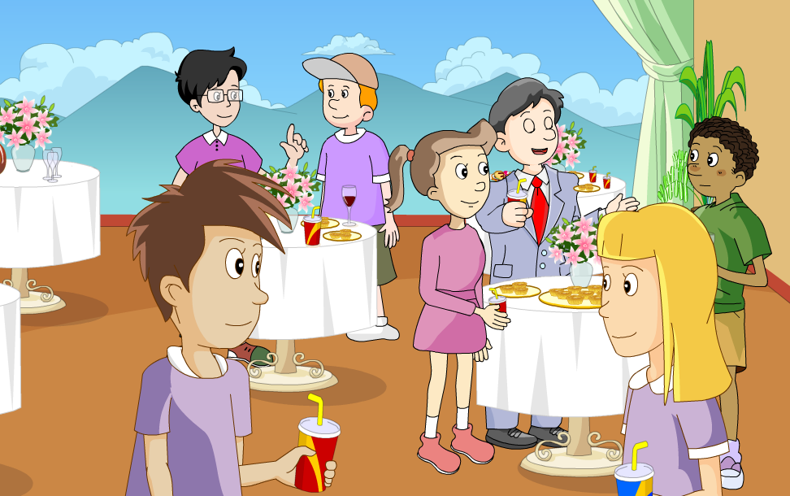
点击画面 播放视频

Slide 12
Language points
doing a school survey
survey还可作动词，意为“测量土地；调查；勘测”。
例：勘探者爬上土丘去勘测周围的土地。
The explorers climbed a mound to survey the
land around them.
过去式
过去分词
现在分词
第三人称单数
survey
surveyed
surveyed
surveying
surveys

Slide 13
2. did homework carefully to meet the standards of
a strict teacher
standard 意为“标准；水平”。
常用短语： high/low standard 高/低标准
meet/reach a standard 达到某一标准
例句：我们的老师在班上对我们确立了很高的标准。
Our teacher sets very high standards on us in the class.

Slide 14
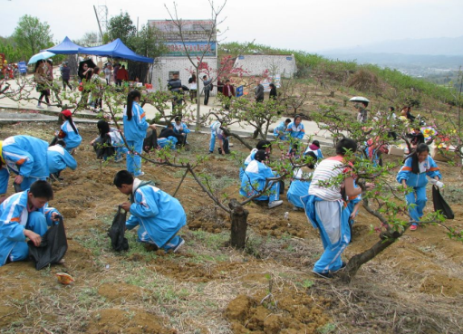
Memories & Experiences
—What do you remember
doing?
—I remember _________
_________.
Memory
being a
volunteer

Slide 15
— What do you remember
doing?
—I remember ___________
_________________.
Memory
riding a bike
to school every day

Slide 16
—What have you learned
in the three years?
—I have learned
_________________.
Experience
a foreign language

Slide 17
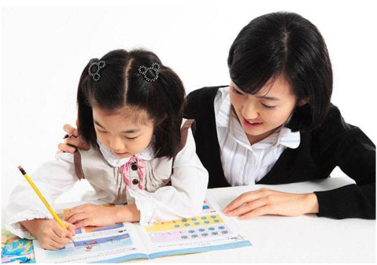
—What do you remember
about junior high school?
—I have _______________
____________________.
Experience
improved English
with the help of Ms. Li

Slide 18
— What do you remember
from junior high school?
— I remember …
Memories

Slide 19
List some memories and experiences from junior high school. Share your lists with your partner.
1c
Memories and experiences
I remember...
scoring two goals in a raw during a soccer
competition.
___________________________________ _______________________________
putting a plastic snake into a classmate’s
schoolbag.

Slide 20
Memories and experiences
I have...
learned to play the keyboard in music class.
___________________________________ _______________________________
learned to play basketball with my friends.
known how to cook a simple meal.

Slide 21
Language points
… learned to play the keyboard in music class.
learn 为及物动词，意为“学习；学会”，后接名词、代词或动词不定式。
相关短语：learn to do sth. 学会做某事
learn from sb. 向某人学习
learn about sth. 了解；知道

Slide 22
Listen to the conversation. Check (✔) the facts you hear.
2a
_____ Someone didn’t like P.E.
_____ Someone was advised to take a break from
running by a teacher.
_____ Someone had a health problem.
_____ Someone joined the school band.
_____ Someone liked Mr. Hunt’s teaching methods
✔
✔

Slide 23
Listen again. Match each question with the name of the person.
2b
Question | Answer
____1. Who wants to study medicine? | a. Luke
____2. Who told someone to take a break from running? | b. Brian
____3. Who hurt his or her knee? | c. Mr. Hunt
____4. Who thinks the That’s Life concert is the best memory? | d. Lisa
d
c
b
a

Slide 24
Listen and answer the following questions.
1. Why is the P.E. teacher great?
It has been fun though a lot of hard work.
2. What do they think of their life in junior high?
Because he gave clear instructions and he was fine when the students got hurt.

Slide 25
3. How did they invite the band That’s Life to play at
their school?
By writing a letter to them.
4. What is Lisa going to do after she graduates from
junior high?
To go to senior high and then university.

Slide 26
听力原文
Lisa: So Brian, here we are at the end of junior high.
Brian: Yeah, I’m so happy I don’t have to do P.E. again.
Lisa: Oh, Brian! But we did have a great P.E. teacher.
He gave us really clear instructions so that we’d
be safe when playing sports.

Slide 27
Brian: Yeah, I remember Mr. Hunt was kind when
I hurt my knee. He told me to take a break
from running.
Lisa: What about you, Luke? Do you have any
special memories?

Slide 28
Luke: My best memory is when That’s Life played at school. Remember we wrote a letter to the band about our dream of hearing them play, and they offered to come?

Slide 29
Lisa: Yeah, that was so cool. Don’t you think that junior high has been fun?
Luke: Yes…and a lot of hard work, too! What are you going to do after you graduate, Lisa?
Lisa: I want to go to senior high and then university, so I can study medicine.

Slide 30
Role-play a conversation in your group
using the information in 2a and 2b.
2c
Of course! He’s a great teacher.
He gave really clear instructions
during P.E. Class.
Do you remember
Mr. Hunt?
Yeah, he...

Slide 31
2.He gave really clear instructions during P.E.
可数名词
不可数名词
instruction
instructions
instruction
意义
指示；命令
讲授，指导，教学
常可接动词不定式或that
从句作定语或同位语
其后常与介词in
搭配使用
用法
例：你必须注意这些指示。
You must attend to these instructions.

Slide 32
相关短语：
(1) follow the instructions 遵守指示
(2) ignore/carry one’s instruction 忽视/执行某人的命令
(3) on/under sb.’s instructions 遵照某人的指示
例：我接到指示讲话要简短。
I am under instructions to keep my speech short.
例：你应该遵循做蛋糕的说明。
You should follow the instructions for making a cake.

Slide 33
Listen to the conversation, then complete the chart.
2d
Clara
Judy
math
patient, helped her to work out the answers
Ms. Lee
Mr. Brown
science
took the time to explain things clearly
Ms. Griffin
encouraged
her a lot
English

Slide 34
Role-play the conversation.
Judy: Which teachers will you miss the
most after junior high school, Clara?
Clara: Ms. Lee and Mr. Brown.
Judy: I know that Ms. Lee was always patient with you
in math class. She helped you to work out the
answers yourself no matter how difficult they were.
Clara: Yes, and Mr. Brown guided me to do a lot better in
science. He always took the time to explain things to
对……有耐心
无论怎么……

Slide 35
me clearly Whenever I couldn’t understand
anything. Who will you miss?
Judy: Ms. Griffin. She encouraged me in English class. She
always told me, “You can do it!” Because of her, I put
in more effort and my exam scores doubled.
Clara: Shall we get each of them a card and gift to say
thank you?
Judy: Good idea. Let’s go shopping tomorrow!
翻倍

Slide 36
点击画面 播放视频

Slide 37
Fill in the blanks according to the conversation.
Judy and Clara are talking about their junior high school life. Clara says she will miss Ms. Lee and Mr. Brown the most because Ms. Lee _____ always ___________ her in math class. And Mr. Brown always _____ the time __________ things to her clearly ________ he couldn’t understand anything. Judy will miss Ms. Griffin because she encouraged her in English class, and Judy’s exam _______ doubled. They will _____ each of them a card and gift to say thank you.
was
patient with
took
to explain
whenever
scores
get

Slide 38
Language points
宾语从句的复合句
主语
可省略
谓语
谓语
主语
1. I know that Ms. Lee was always patient with you
in math class.
宾语从句
从句谓语动词时态常常受到主句谓语动词时态的影响。

Slide 39
2. I know that Ms. Lee was always patient with you
in math class.
be patient with sb. 对某人有耐心
be patient to do sth. 有耐心地做某事
你要对你的母亲有耐心。
You should be patient with your mother.

Slide 40
3. She helped you to work out the answers yourself
no matter how difficult they were.
no matter意为“无论；不管”
与疑问词连用构成“no matter+疑问词”结构
引导让步状语从句，可以和“疑问词+-ever”结构互换。
例：不管你去哪儿，我都不会忘记你。
I’ll never forget you no matter where (=wherever) you go.

Slide 41
4. Shall we get each of them a card and gift to say
thank you?
Each of 为固定短语，意为“……中的每一个” 作主语时谓语动词用单数
我的每一位朋友都是来自中国。
Each of my friends is from China.

Slide 42
指两者或两者以上中的“每一个”，侧重个体。
形容词
each
可作主语或宾语，其后可跟介词of。
代词
指三者或三者以上中的“每一个”，侧重总体，不能单独使用。
every
形容词

Slide 43
Exercise
1. The problem is a little difficult. Can you ____.
A. work out B. work it out
C. work on D. work on it
2. ___ difficult they are, we can work hard to solve it.
A. No matter what B. Whatever
C. Whenever D. No matter how
3. The price of the book has risen. It ____.
A. doubles B. doubled
C. increase two D. is doubled
B
D
B

Slide 44
根据汉语意思完成句子。
1. 我们已经收到了指示我们将每月见两次。
We have received ___________ _____ we are to meet
twice a month.
2. 她总是很耐心地为我们做一切事。
She ___ always ________ _____ _____ everything for us.
instructions that
is
patient to do

