Slide 1
M8 My future life
Unit 2
I know that you will be better at maths.
九年级 下册
WWW.PPT818.COM

Slide 2
Learning aims
Understand and read the text fluently.
Grasp the words and phrases about thanks.
Write a speech about giving thanks.
Learn to show thanks to other people.

Slide 3
New words and expressions
rose n. 玫瑰
kindness n. 善举; 好意
disappointed adj. 失望的
He is not disappointed at he failure.
bedside n. 床边
note n. 短笺; 便条

Slide 4
whom pron. …….的人, 那个人, 那些人
laugh at 嘲笑; 对……一笑置之
give up 放弃(努力)
Don’t give it/them up.
try one’s best 尽某人最大的努力
You had better try your best to achieve your goal.

Slide 5
Checking the Preview----Translate the phrases
1) 选择某人做某事
2) 嘲笑
3) 幸亏; 多亏
4) 没有......就不...... 5) 尽某人的努力
6) 不但......而且......
7) 在......努力学习 8) 站起来
9) 作为答复
10) 保持联系
choose sb. to do sth.
2. laugh at
3. thanks to
4. no+n/not+v...without
5. try one's best
6. not only...but (also)
7. work hard at
8. stand up
9. in reply
10. stay / keep in touch
chose -chosen

Slide 6
no+n/not+v...without
There is ______ peace ________ the soldiers’ protection of the country.
no
without
The poor boy hasn’t taken online courses without a computer.
do … in reply
He waved his hand in reply.
他挥了挥手作为回答。
What did he say in reply to his suggestion.
你如何答复他的建议？

Slide 7
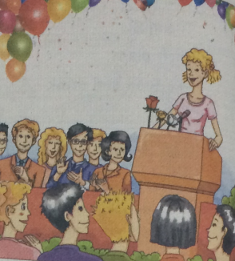
Pre-reading
书本 P66 第一题，看图猜问题答案
Think about a speech at a school leavers’ party, and answer the questions. There may be more than one answer.
① Who will probably get thanks
from the school - leavers?
a) Family. b) Friends.
c) Teachers.
② What is the speaker probably going to say?
a) Thank you. b) Good luck!
c) Cheers!

Slide 8
If you are given a speech at the school leavers’ party,
How will you feel?
Who will you thank?
What will you thank for?
Do you know how to express your thanks?
Betty has been chosen to give a speech. Let’s see how she feels and learn to say “thanks” from her.

Slide 9
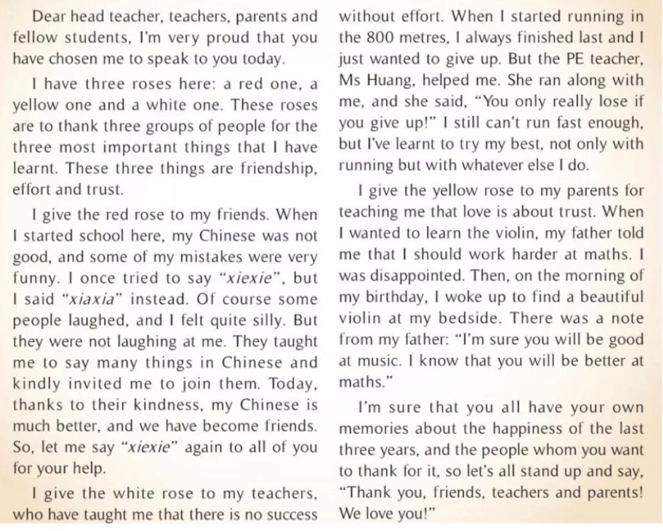
I. Skimming 1
How does Betty feel?
She feels proud.

Slide 10
I. Skimming 2
the three things the speaker has learnt
the three groups of people the speaker wants to thank

Slide 11
I. Skimming 2: 1. Read and find the sentences which show:
1) the three things the speaker has learnt
2) the three groups of people the speaker wants to thank
These three things are
——————————————————
friendship, effort and trust.
her friends
She gives the red rose to _____________.
She gives the white rose to ____________…
She gives the yellow rose to ___________…
her teachers
her parents
Do you know why she has chosen the roses in different colours?

Slide 12
I. Skimming 3
3) What the speaker has learnt from each
group of people . (Three key words)

Slide 13
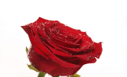
3) What the speaker has learnt from each
group of people
She has ___________________ their friends.
She has ___________________ their teachers.
She has ___________________ their parents.
learnt kindness from
Thanks to her friends’ kindness.
learnt effort from
There is no success without effort
Love is about trust.
learnt trust from

Slide 14
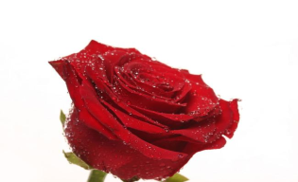
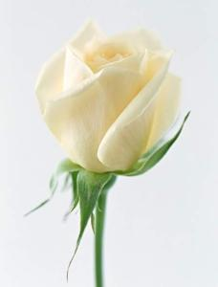
Guess the language of roses.
true love
purity(纯洁), respect(尊重)
joy and happiness, apology（n.道歉）apologize v.

Slide 15
II. Scanning 1
Look at Para 3.
Why is Betty’s Chinese much better?

Slide 16
3. Choose the best answers.
1) Why is Betty’s Chinese much better in the passage?
Thanks to _________.
A. her own hard work
B. the help from her Chinese teacher
C. the kindness from her friends
D. the help from her parents

Slide 17
II. Scanning 2
如果你放弃你就真的失败了。
Look at Para 4.
Try to translate the underlined sentences.
不努力就不会成功。

Slide 18
2) What does the sentence in Paragraph 4 (There is no
success without effort.) mean?
A. Where there is a will, there is a way.
B. It’s never too late to learn.
C. You have to work hard to succeed.
D. If you stop trying, you can never succeed.
3. Choose the best answers.

Slide 19
II. Scanning 3
What did Betty receive on the morning of her birthday?
What did Betty’s father want her to do?
How do you think Betty would write to her father in reply?
如果你放弃你就真的失败了。
作为回复

Slide 20
3) What did Betty receive on the morning of her birthday?
A. A yellow rose. B. A beautiful violin with a note.
C. A beautiful piano D. Nothing
4) What did Betty’s father want her to do?
A. He wanted her to work harder at maths and enjoy
music.
B. He wanted her to work harder at maths instead of
music.
C. He wanted her to try her best with whatever else she
does.
D. He wanted her to work harder at music instead of
maths.

Slide 21
I woke up to find a beautiful violin at my bedside. There was a note from my father: “I’m sure you will be good at music. I know that you will be better at maths.
4. How do you think Betty would write to her father in reply?
She would write and say thank you for the violin and his encouragement.

Slide 22
II. Scanning 4
如果你放弃你就真的失败了。
That 引导的定从
Thanks to (多亏）…, 句子
Thanks to the teacher, I have passed the exam.
老师教会我不努力就不会成功。

Slide 23
5. “I’m sure that you all have your own memories about the happiness of the last three years, and the people whom you want to thank for it…”
What does it mean?
It means the happiness of the last three years.

Slide 24
计时钟
我朗读 我进步
Reading time

Slide 25
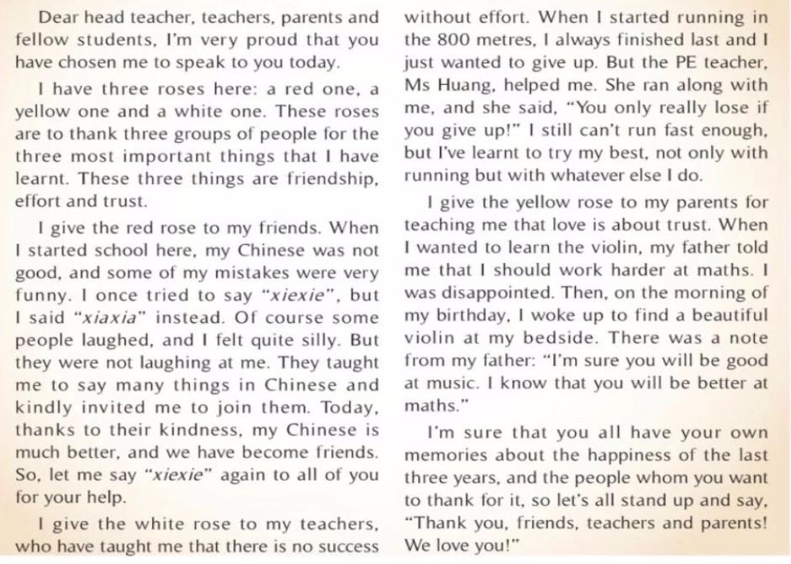
Reading aloud

Slide 26
4. Read and check the answers to the questions.
1) Which words can you use to describe
the speech in Activity 1?
careful excited moving polite
silly troubled warm worried
√
√
仔细的
激动的
感人的
有礼貌的
√
傻的
麻烦的
温暖的
担心的

Slide 27
What’s the purpose（目的） of the speech?
a) To thank people.
b) To say sorry.
c) To describe personal achievements.

Slide 28
Do you know how to express “thanks” to other people?
1. Thank sb for sth. / doing sth.
这个病人感谢医生和护士的耐心与治疗。
The patient thanked the doctors and nurses for their patience and treatment.
2. be thankful (grateful) to sb. for (doing)sth
因为…感谢某人 /感到欣慰 to do
我感谢父母出钱让我受教育。
I’m thankful (grateful)to my parents for paying for my education.
I’m thankful to see they had all arrived safely.
看到他们平安到达，我感到欣慰。

Slide 29
Do you know how to express “thanks” to other people?
3. give thanks to sb for sth.
I will give thanks to my teachers for their teaching.
4. Thanks to sb/sth., … (多亏，由于)
多亏了政府，疾病被控制住了。
Thanks to the government, the disease has been controlled.
5. It’s very kind of you to help me.
帮助我，你真是太好了

Slide 30
The whole world is bright for those who are grateful.
心存感激的人，整个世界都是光明的。

Slide 31
How do you write a speech at a school leavers’ party?
happy
beginning
feeling
proud
excited
Who will you thank
Middle part
Why will you thank them
How will you give thanks
ending
Giving best wishes
Thank you and good luck for the future.

Slide 32
Imagine you’re going to give a speech at your school-leavers’ party.
Start your speech by saying what your speech is going to be about.
Dear head teacher, teachers and parents, I’d like to thank you for …
Decide who you want to say thank you to.
There are many people who I’d like to thank. First, I want to thank …

Slide 33
Decide what you want to thank them for.
They have always given me great help …
Finish your speech by giving best wishes for the future.
Thank you and good luck for the future.

Slide 34
Possible answer:
Dear head teacher, teachers, parents and friends:
I am honored today to be able to give you all my thanks (1) three of the best years of my life, right here at school.
There are many people(2) I’d like to thank. First, I am really (3) to my class teacher, Miss Shi. She always encouraged me when I felt like (4) up. I must also thank my English teacher, Miss. Yang. (5) to her, I’ve made great progress in English.
to
who
thankful
giving
Thanks

Slide 35
And of (6) I’d like to thank our head teacher, Ms. Li, who has made such a fantastic school (7) us to learn and grow up in.
And last of all – don’t think I’ve forgotten you! – I want to thank my many friends, who have (8) junior high such a wonderful time. It’s very kind(9) you.
Thank you all, and I (10) everyone the best for the future.
course
for
made
of
wish

Slide 36
Summary of phrases
1) 选择某人做某事
2) 嘲笑
3) 幸亏; 多亏
4) 没有......就不...... 5) 尽某人的努力
6) 不但......而且......
7) 在......努力学习 8) 站起来
9) 作为答复
10) 保持联系
choose sb. to do sth.
2. laugh at
3. thanks to
4. no/not...without
5. try one's best
6. not only...but (also)
7. work hard at
8. stand up
9. in reply
10. stay in touch

Slide 37
Summary of key sentences
Thanks to their kindness, my Chinese is much better.
There is no success without effort.
You only really lose if you give up.
I have learnt to try my best with whatever I do.
I should work hard at maths.
I’m sure that you all have your own memories about the happiest of the last three years.

Slide 38
A sample speech
Ladies and gentlemen, I’d like to thank you for your coming to listen to my speech. I feel a bit nervous as I’ve never given a speech before, so please forgive me if it shows.
As we all know, this is the school-leavers’ party, and it’s time to say goodbye to everyone. At this moment, there are many people who I’d like to thank.

Slide 39
The first is my head teacher. I can never pay her back for her kindness, her patience, and gift of knowledge which she has offered me. Sometimes she has been strict with me. I remembered once I made some mistakes in my math homework because of my carelessness. She was angry and let me redo all the exercises. But she has always been fair and she will always be our role model.

Slide 40
The second I’d like to thank are my friends, and what I’ve learnt is the importance of friendship. We’ve worked hard together, we’ve even shared some difficult times together, but we’ve also had a lot of fun. When I met some difficulties in study, they often helped me. We’ll stay in touch.

Slide 41
The school days are the best days of my life. From the bottom of my heart, I thank you all and wish you success for the future.

Slide 42
1. It’s not right to laugh ___ others when they make mistakes.
A. for B. to C. at D. with
2. I’ll try ____ best to finish the work before Friday.
A. I B. me C. my D. mine

Slide 43
3. I can’t get high marks ______ your help.
A. with B. without
C. at D. under
4. His father didn’t buy the toy bear, so he felt ______.
A. happy B. disappointed C. kind D. wonderful

Slide 44
1. But they were not laughing at me.
laugh at sb. 嘲笑，对……一笑置之
e.g. We shouldn’t laugh at the person
who is disabled.
我们不应该嘲笑残疾人。

Slide 45
2. Today, thanks to their kindness, my Chinese is much better, and we become friends. 今天，因为他们的善良，我的汉语比前更好，而且我们成为了朋友。
thanks to +名词/v-ing 多亏，由于
表示原因，在句中作状语，可以置于句首或句末。
e.g. Thanks to his help, we found the
hospital.
kindness n. 善举，好意 是不可数名词

Slide 46
3. I always finished last and I just wanted to give up.
give up 放弃
e.g. Smoking is bad for you, so give
up smoking right now.
吸烟对你有害，所以马上戒烟
吧。

Slide 47
give短语：
give back ①还给，归还；②恢复（健康
等）。
give in ① 交进来；②认输，投降；③
让步，勉强同意。
give out ①散发；②停止运转；③被用
完，耗尽；④发出，散发出。
give away ①送给人，分发；②背弃，出
卖；③泄露。

Slide 48
4. I give the white rose to my teachers, who have taught me that there is no success without effort.
我将白玫瑰献给我的老师们，他们教会了我不努力就不会成功的道理。
who have taught me that there is no success without effort是一个非限制性定语从句，对前面的先行词teachers进行信息的补充，而不是限定性描述。与限定性定语从句不同，非限定性定语从句前面通常加逗号，从句部分即使被省略也不会造成主句意义上的不完整。

Slide 49
非限定性定语从句中的关系代词不能省略。此句中还包含有一个宾语从句that there is no success without effort, 作have taught的宾语。
no/not … without …表示“没有……就不……”。
e.g. We can’t achieve anything without you.
没有你（们）我们将一事无成。

Slide 50
5. I still can’t run fast enough, but I’ve learnt to try my best, not only with running but with whatever else I do.
我还是跑不快，但是我学会了无论做什么事都要尽最大的努力，不仅在跑步上。
try one’s best 尽某人最大努力
其后常接带to的动词不定式，即try one’s best to do sth.，表示“尽力做某事”。
e.g. Try your best to do whatever you
do.
无论你做什么事都要尽力去做。

Slide 51
not only … but .... 不但……而且……
e.g. The girl is not only clever but
hardworking.
这个姑娘不仅聪明而且还很努力。
6. I was disappointed.
disappointed adj. 失望的
e.g. I felt disappointed when he gave up
studying.

Slide 52
亲爱的校长、各位老师、各位家长和同学们，能被大家选出来作这次演讲，我深感自豪。
我带来了三支玫瑰，一支红的、一支黄的、一支白的。这些玫瑰用来表达我对三组人的谢意，因为我从他们那里学到了最重要的三件事。这三件事是友谊、努力和信任。
我要把红玫瑰献给我的朋友们。我刚入校的时候，汉语不好，经常犯一些很可笑的错误。一次，我想说“谢谢”，却说成了“xiaxia”，很自热地，有些人笑了起来，我感到很尴尬。但是我的朋友们并不是在嘲笑我。他们教我用中文表达很多事情，还好心地邀请我参加他们的活动。多亏了他们的热心帮助，现在我的汉语好多了，我们也成为了朋友。所以，现在让我再说一次“谢谢”吧，谢谢你们大家给我的帮助。

Slide 53
我将白玫瑰献给我的老师们，他们教我明白了不努力就不会成功的道理。刚刚开始跑800米的时候，我总是最后一个，只想放弃。但体育老师黄老师帮助了我。她陪我一起跑，并对我说：“如果你放弃了，那么你才真的失败了！”现在我仍然跑得不够快，但我学会了要尽力争取，不仅仅在跑步的时候，而是做任何事都是如此。
我把黄玫瑰献给爸爸妈妈，感谢他们让我懂得爱就是一种信任。当年我想学小提琴时，爸爸告诫我，让我好好学数学。我很失望。后来，在过生日的那天早上，我醒来发现床边放着一把美丽的小提琴。爸爸给我留了一张便条：“我相信你的音乐会学得不错。我也知道你的数学会有进步。”

Slide 54
对于过去的三年，我相信你们大家都有着各自美好的记忆，以及你们因此想要感谢的人，让我们大家起立，一起说一声：“感谢你们，朋友们、老师们和家长们！我们爱你们！”

Slide 55
A wonderful and perfect life is a life of gratitude.
精彩完美的人生是怀着感激的人生。

Slide 56
Homework
翼课网上熟读课文。
练习册作业。
仿照课文写一篇毕业典礼的发言稿。

Slide 57
谢谢观看

