Slide 1
Unit2 What’s your number?
人教精通版四年级上册
WWW.PPT818.COM

Slide 2
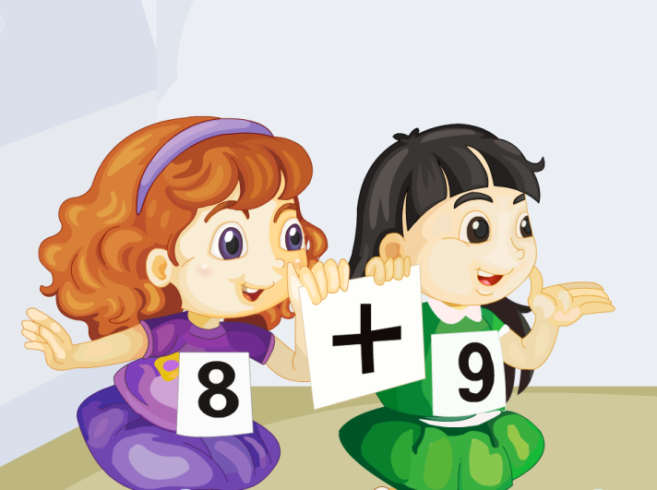
Review
Let’s chant

Slide 3
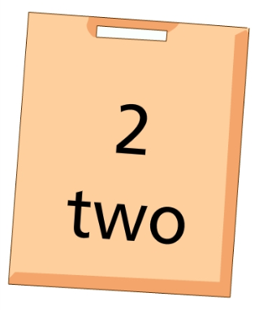
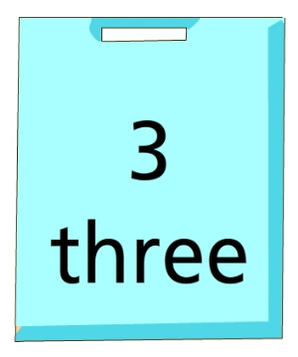
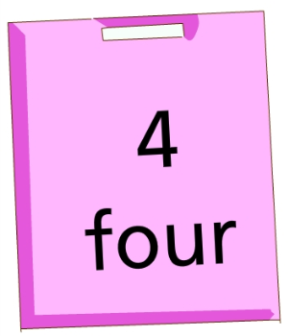
Lead-in
Play a game
Quick
response
16
18
14
17
15
13

Slide 4
Presentation
Let’s count
nine
nineteen

Slide 5
Presentation
Let’s count
ten
twenty

Slide 6
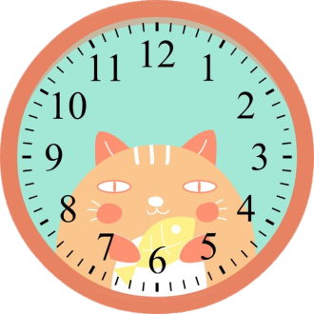
Presentation
Look and say
What’s the time?
9:20
It’s _____.
It’s nine twenty.

Slide 7
Presentation
Look and say
What’s the time?
It’s _____.
10:00
It’s ten o’clock.

Slide 8
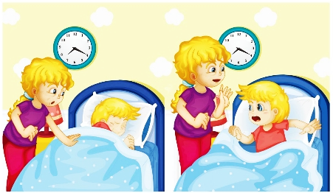
Presentation
What’s the time?
It’s seven twenty.

Slide 9
Presentation
Look, listen and say
Guess! What do they say?

Slide 10
Presentation
Listen and imitate
1
Wake up! Wake up, Peter.
2
What’s the time, Mum?
It’s 7:20.
3
Oh, no! I’m late!
4

Slide 11
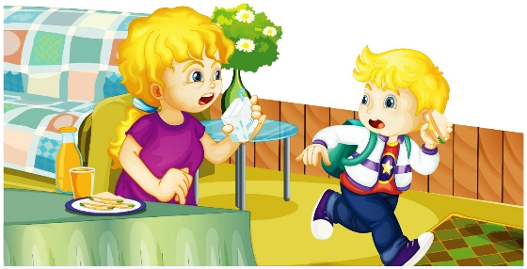
Presentation
Listen and imitate
5
Have some milk.
6
No, thanks!

Slide 12
Show time
两人一组，练习对话并表演，其他同学评价。
 | 模仿录音中的语音语调，有感情地朗读。
 | 可以脱离课本，适当改动其中部分，语音地道。
 | 适当添加内容，意思完整，有创新，表演生动。
Good
Great
Excellent

Slide 13
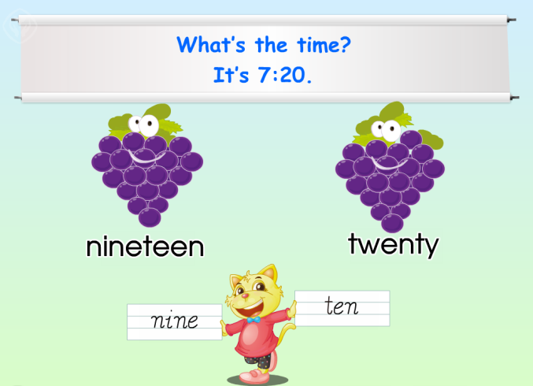
Practice
Just read and write

Slide 14
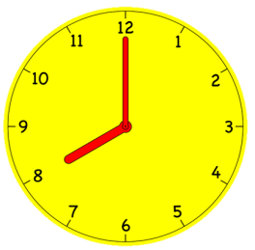
Practice
Look and say
What’s the time?
It’s …
8:10
9:15
10:20
eight ten
nine fifteen
ten twenty

Slide 15
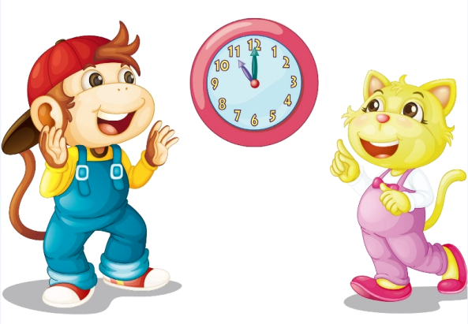
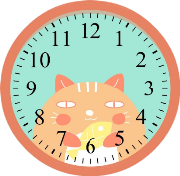
Practice
Let’s paly
活动
我会认时间
What’s the time?
It’s seven twenty.

Slide 16
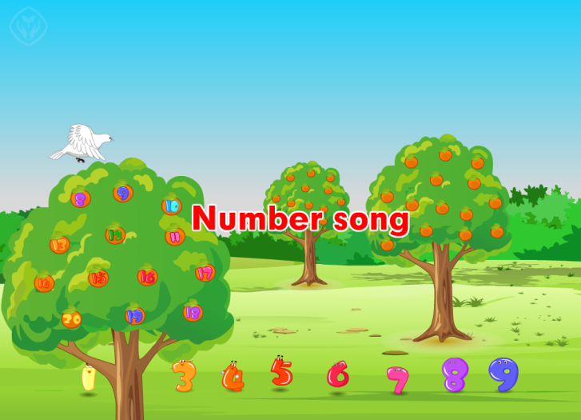
Practice
Let’s sing

Slide 17
Summary
本课学习的数字类单词有:
nineteen
twenty

Slide 18
Summary
本课的重点句型:
—What’s the time?
—It’s seven twenty.

Slide 19
Homework
1. 跟读Just talk部分的课文录音，并注意语音、语调。
2.制作一个指针能拨动的钟表，并与自己的父母玩猜时间的游戏。
3. 预习Lesson12。
Close

