Slide 1
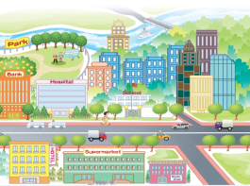
Unit2 There is a park near my home.
人教精通版六年级下册
WWW.PPT818.COM

Slide 2


>>Warm-up
Sing a song

Slide 3
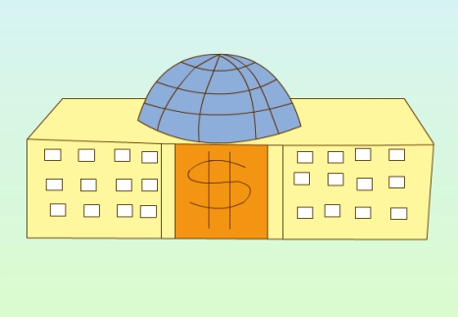
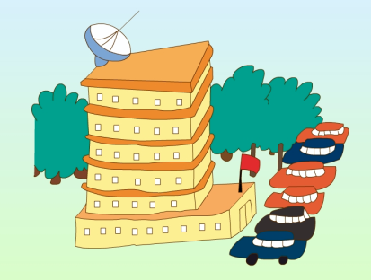
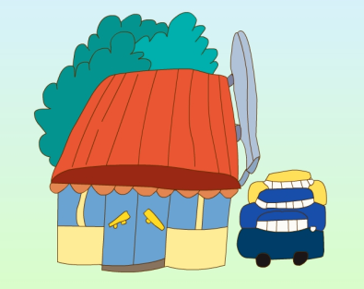
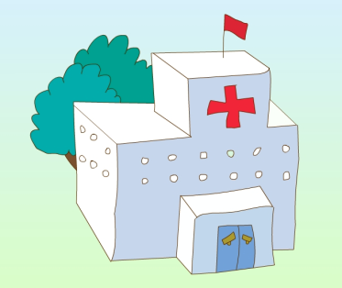
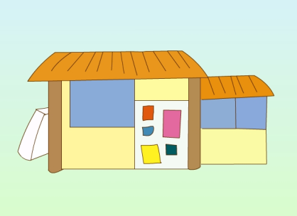

>>Lead-in
Play a game
What can you see?

Slide 4





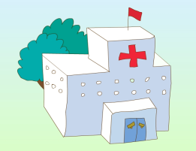
>>Presentation
Look and say
New words
bank
bookshop
supermarket
hotel
hospital

Slide 5


>>Presentation
Look and point
What can you see in the picture?
Susan’s community

Slide 6

>>Presentation
Look and say
Look at the community. What’s near Susan’s home?
There is a park near her home.

Slide 7
>>Presentation
Look and say
What’s behind the park?
There is a river behind the park.

Slide 8
>>Presentation
Look and say
What’s in the park?
There are a lot of trees and flowers in it.

Slide 9
>>Presentation
Look and say
What’s beside the bank?
(在…旁边)
There is a hospital beside the bank.

Slide 10
>>Presentation
Look and say
What’s across the road?
(在…对面)
There is a big supermarket between a
hotel and a bookshop.

Slide 11


>>Presentation
Read, write and say
My name is Susan. Look at this picture of my community. ________ many tall buildings in it. I live in one of the buildings. ________ a park _____ my home and ________ a river ______ the park. ________ a lot of trees and flowers in the park. It’s beautiful.
There are
There is
near
there is
behind
There are
Words there is
there are
behind
near

Slide 12
>>Presentation
Read, write and say
On the main street is a _____ . ______ the bank is a hospital. ______ the road, there _____ a big supermarket _______ a hotel and a bookshop. My mum and I often buy fruit, vegetables and other healthy food there.
bank
Beside
Across
is
between
Words
between
is
bank
across
beside

Slide 13
>>Presentation
Read, write and say
Look! What’s in the centre of the community? ________ a school! It is my school. I can see everything on my way to school. I like my community. It’s a busy, clean and nice place!
There is
Words
there is
there are

Slide 14
>>Presentation
Listen and read
My name is Susan. Look at this picture of my community. There are many tall buildings in it. I live in one of the buildings. There is a park near my home and there is a river behind the park. There are a lot of trees and flowers in the park. It’s beautiful.
On the main street is a bank. Beside the bank is a hospital. Across the road, there is a big supermarket between a hotel and a bookshop. My mum and I often buy fruit, vegetables and other healthy food there.
Look! What’s in the centre of the community? There is a school! It is my school. I can see everything on my way to school. I like my community. It’s a busy, clean and nice place!

Slide 15
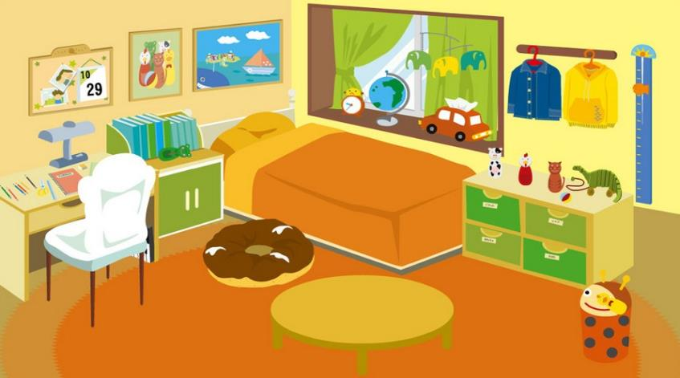


>>Practice
This is Candy’s bedroom. What can you see?

Slide 16



>>Practice
Look and say
There is a/an…

Slide 17
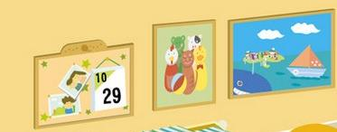

>>Practice
Look and say
There are some…

Slide 18
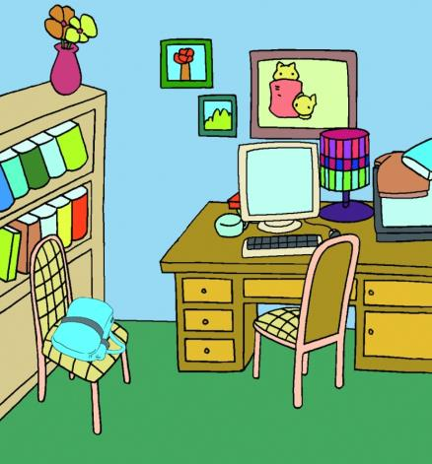
>>Practice
Look , write and say
What Can You See?
1. There’re some books on
the bookshelf.
2. There is __________
_________________
3. _________________
_________________
4. _________________
_________________
5. _________________
_________________

Slide 19
>>Summary
There is/are … near/behind/beside/across …

Slide 20


>>Homework
1.观看课文动画，按照正确的语音、语调朗读课文对话。
2.运用本课学习的there be句型写一篇小短文，介绍自己的社区或房间（不少于6句）。
3.预习 Lesson 8。

