Slide 1
Unit 8 Topic 2
We can design our own uniforms.
Section C
WWW.PPT818.COM

Slide 2
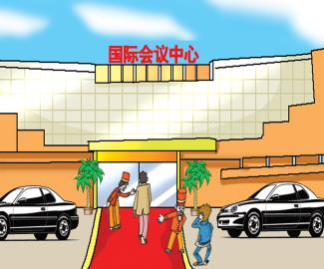
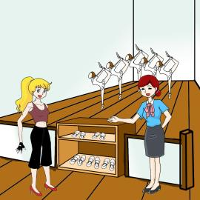
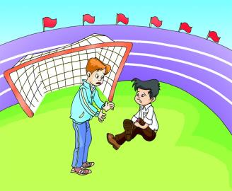
Make up a short dialog after the example and act it out.
Example:
S1: Sorry, sir. You can’t wear jeans here.
S2: I’m sorry. I’ll change my clothes.
T: Why can’t he wear jeans there?
Ss: Because it is impolite that he wears jeans there. / It is impolite for him to wear jeans there.

Slide 3
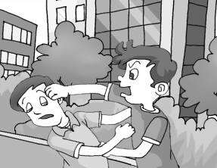
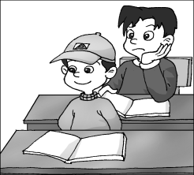
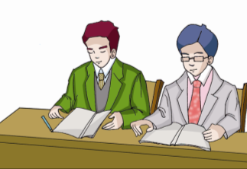
Look at the pictures and make sentences with It's +adj.+(for sb.) to do sth.and It's+ adj. +that...
fight with each other
wear hats in class
wear business suits

Slide 4
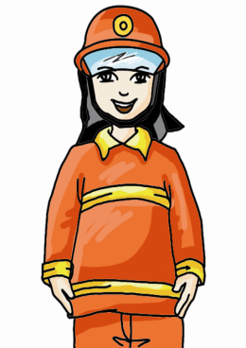
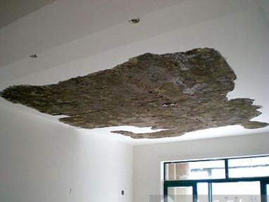
Firefighters wear special coats and helmets to protect themseleves from heat and falling ceilings.
n.温度；热
v.把......加热
a helmet
a special coat
firefighter
n.消防人员
ceiling
n.天花板，顶棚

Slide 5
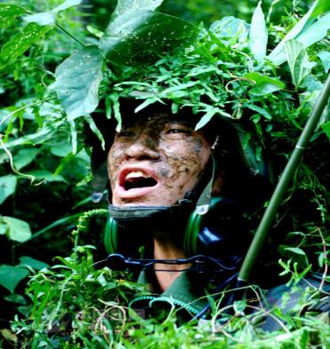
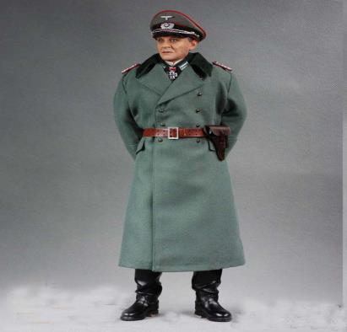
soldier
n.士兵，战士
officer
n.警官，军官，官员

Slide 6
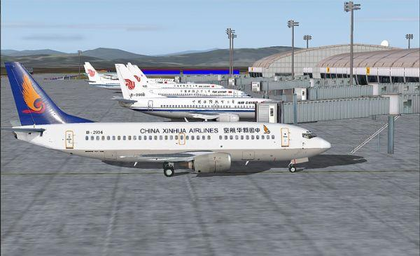
airport
n.航空站，飞机场

Slide 7
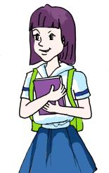
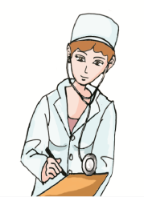
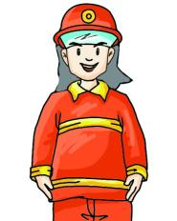
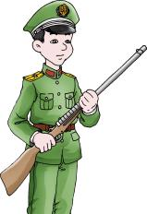
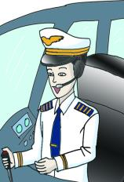
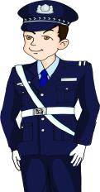
Look at the pictures and discuss the following questions with your partner. Then read and compare your opinions with the writer's.
1.What are the functions of uniforms?
2.How many kinds of uniforms are there in the text? What are they?
n.正文，文本

Slide 8
1b
Read 1a again and complete the table.
Job | Uniform | Purpose
student
 |  | to protect themselves from heat and falling ceilings
 | green clothes
official
 | pilot uniforms
 |  | to let us know we can get help from them
doctor
school uniforms
to show good discipline
firefighter
special coats and helmets
soldier
to protect themselves in the forest
official uniforms
to make themselves look important
airline pilot
to make us believe that they know how to fly the plane
police officer
police uniforms
doctor uniforms
to make patients find them easily and to stop the spread of diseases

Slide 9
Key points of 1a
1. Firefighters wear special coats and helmets to protect themselves from heat and falling ceilings.
消防人员穿特殊服装和戴头盔是为了保护他们自己免受高温和坠落的天花板的伤害。
(1)此句的“to + v.”意为“为了...” 是动词不定式作目的状语的用法。
E.g:我到北京去是为了参观长城。
I will go to Beijing to visit the Great Wall.
(2)protect... from... “保护...... 免受......的伤害”
E.g:我们戴太阳镜是为了保护眼睛免受阳光的伤害。
We wear sunglasses to protect our eyes from the sun.
2. When we see airline pilots wearing uniforms at the airport,we believe that they know how to fly the plane.
当我们在机场看见航空公司飞行员穿着制服时，我们相信他们知道怎样驾驶飞机。
(1)when引导一个时间状语从句，在主句中又包含了由that引导的宾语从句，宾语从句中有一个how to fly...的“疑问词+动词不定式”结构。
(2)wearing uniforms 现在分词作宾语补足语，修饰airline pilots。
3. So it's necessary for us to know different uniforms in the daily life.
所以对于我们来说了解日常生活中的不同制服是有必要的。
in the daily life 在日常生活中

Slide 10
Listen and follow,then try to retell it.
Uniforms
People wear uniforms for different reasons. We students wear school uniforms at school to show good discipline. Firefighters wear special coats and helmets to protect themselves from heat and falling ceilings. Soldiers wear green clothes to protect themselves in the forest.
When officials dress in their official uniforms, they look important. When we see airline pilots wearing uniforms at the airport, we believe that they know how to fly the plane. If we have a car accident on the street and we see a police officer in uniform, we know we can get help from him or her. When doctors wear uniforms, it is easy for patients to find them. Also, their uniforms are clean so they stop the spread of diseases.
Different uniforms show different jobs. So it's necessary for us to know different uniforms in the daily life.

Slide 11
Work in groups and discuss different uniforms. Then retell the passage with the help of 1b.
1c
You may begin like this:
People wear uniforms for different reasons.
Job | Uniform | Purpose
student
 |  | to protect themselves from heat and falling ceilings
 | green clothes
official
 | pilot uniforms
 |  | to let us know we can get help from them
doctor
school uniforms
to show good discipline
firefighter
special coats and helmets
soldier
to protect themselves in the forest
official uniforms
to make themselves look important
airline pilot
to make us believe that they know how to fly the plane
police officer
police uniforms
doctor uniforms
to make patients find them easily and to stop the spread of diseases

Slide 12
3a
Choose the correct words to complete the passage. Then read it aloud.
系动词+形容词（系表结构）
副词修饰动词，放动词之后
副词修饰动词，放动词之后
形容词修饰名词
Most people believe we should dress__________(correct/correctly) on every occasion. What's more, we should choose different clothes in different seasons. In China,the temperature changes_________ (great/ greatly), so the clothes people wear in each season are very different. Li Mei comes from________(northern/north) China. In spring,it is windy there,so Li Mei likes to wear a windbreaker.She likes summer very much because she can wear different colorful clothes,___________(for example/such as) shorts, T-shirts and dresses. In fall, it is _________ (cool/cold). Li Mei likes to wear casual clothes, especially jeans. They make her look__________(beautiful/beautifully). In winter it is ______ (cool/cold)there. She usually wears a sweater or _______(other/another) warm clothes and boots.
correctly
greatly
northern
such as
cool
beautiful
cold
other

Slide 13
3b
Read 3a again and fill in the table.
Season | Clothes
spring
summer
fall
winter
windbreaker
shorts,T-shirs and dresses
casual clothes, jeans
sweater or other warm clothes, boots

Slide 14
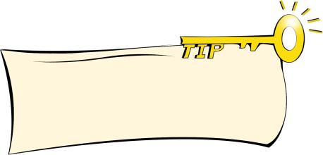
Project
2
Discuss with your classmates whether students should wear uniforms at school.Then write a passage about your opinions.
opinion
n.意见，想法，看法
Writing notes of others' opinions and your own will help you have a clear passage.
Some students think it is important for them to wear uniforms because... But other students have different opinions...
In my opinion,___________________________________
_________________________________________________
_________________________________________________
_________________________________________________

Slide 15
Example:
Some students think it is important for them to wear uniforms because school uniforms can not only show good discipline but also make us look more active. Besides, school uniforms are cheaper than casual clothes .What's more, it shows no difference between students if everyone wears school uniforms.
But other students have different opinions. They say that school uniforms look ugly on them. What's more, it seems boring that one wears the same clothes every day. They want their clothes to be colorful.
In my opinion,students should wear uniforms. But we should be allowed to design our own uniforms.

Slide 16
Exercises in class
单项选择。
( ) 1. It’s important for us ______ exercise an hour every day.
A. do B. to do C. finishing D. finished
( ) 2. Everyone should ______our lakes, rivers, seas
and oceans ______pollution.
A. protect, away B. protect, it
C. protect, from D. protect, out
( ) 3.____my opinion,students shouldn't smoke,it's bad___our
health.
A. On,for B.With,at C. In,at D. In,for
( ) 4.We should help old people and children ____________.
A. in the day life B.in the daily life
C. at the day life D.on the daily life
B
C
D
B

Slide 17
Exercises in class
短文综合填空。
School Uniforms
I am a middle school student. I think students should wear school ________ at school every day, especially at school meeting. ________ （合适的）school uniforms can not only ______(展示) good discipline but also make us happy. I think they can even make us study much harder. What’s more, school uniforms are _________（便宜）than casual clothes. Clothes in fashion cost too much. We can’t _______（支付）them. So I don’t think we should wear them at school.
uniforms
Suitable
show
cheaper
afford

Slide 18
Summary
We learn:
◆Some new words and phrases:
text,firefighter,heat,ceiling,soldier,official,airport,officer,patient,
daily,opinion,greatly,northern,casual,beautifully,boot,reson,spread
protect...from..., in one's opinion
We can:
1. Talk about the functions of different uniforms:
Firefighters wear special coats and helmets to protect themselves from heat and falling ceilings.
Soldiers wear green clothes to protect themselves in the forest.
2. Talk about school uniforms.
School uniforms can not only show good discipline but also make us look more active.
School uniforms are cheaper than casual clothes.
3. Talk about different clothes in different seasons.
We should choose different clothes in different seasons.
So the clothes people wear in each season are very different.

Slide 19
Homework
1.Read 1a aloud and try to repeat it.
2.Finish Section C in your workbook.
3.Preview Section D.

