Slide 1
七年级上册
Unit 3 Is this your pencil?
Section B (第3课时)
WWW.PPT818.COM

Slide 2
学习目标
1、复习巩固本单元的重点词汇和句型
2、能听懂有关谈论物主的对话并进行自由交际。
3、会用英语写寻物启示和失物招领启示。

Slide 3
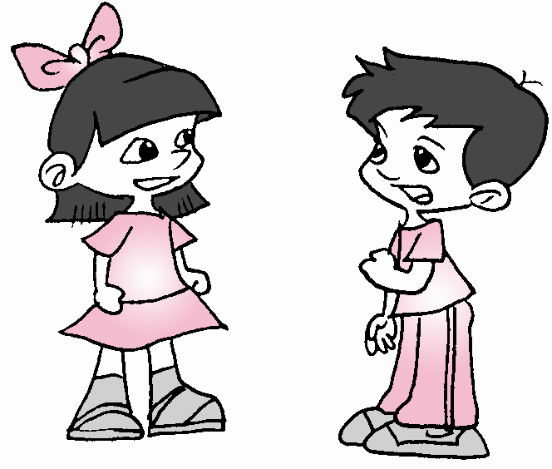
知识回顾
Pair work
Make conversations about your things with your partner.
A: I’m looking for my watch.
B: OK. Is this your watch?
A: No, it isn’t. That’s my watch.
B: Here you are.
A: And that’s my ID card.
B: Ok. What’s your name?
A: Linda.
…
....

Slide 4
自主反馈
排列顺序
① Yes?(有事吗?)
② No, my key is at home(在家). Ask(问) that girl.
I think(认为) it’s her key.
③ Excuse me. Is this your key?
④ Is this your key?
⑤ Bye-bye.
⑥ Oh, yes. It’s my key.
⑦ Thank you very much. You are a good boy.
⑧ Here you are.
⑨ You are welcome. Goodbye.
⑩ Thanks. Excuse me.
3
2
10
1
4
6
8
7
9
5

Slide 5
自主反馈
3a.Complete the notices with the words or phone number in the box.
选择正确的单词或号码补全对话。
name yours found 284-5486 lost call
Found
:My notebook
My is David.
Please me at
679-8871.
:A set of keys
Are these ？
Call Jenny at .
Lost
name
yours
call
284-5486

Slide 6
Read the message together.
Found: A set of keys
Are these yours?
Call Jenny at 284-5486.
解析：
1. A set of keys 一串钥匙
2. call + sb + at +telephone number:
用这个号码打电话给某人。

Slide 7
新课学习
Lost 寻物启事
当你丢失东西的时候, 你需要写Lost,共四部分:
1. 标题
2. 丢失的东西
3. 失者的姓名
4. 联系电话

Slide 8
新课学习
Lost:
My school ID card.
My name is Tony.
Please call 685-6034.

Slide 9
新课学习
Found 失物招领
如果你拾到别人的东西，你该怎样归还给失主呢? 你需要写Found, 分五部分:
1. 标题
2. 拾到的东西
3. 询问某物是不是失者的
4. 联系人
5. 联系电话

Slide 10
新课学习
Found: notebook.
Is this your notebook?
Please call Mary.
Phone #235-0285.

Slide 11
Write your own lost or found notice with your name and phone number. 写一则你自己的寻物启示或事物招领启示， 加上你的姓名和电话号码。
新课学习

Slide 12
新课学习
3b.Write your own bulletin board message.
写一段自己的公告信息。
Helen，
Is that your new watch in the lost and found case?
Kim
Kim，
Yes, it is.
Helen

Slide 13
Self check
Write the school things you know.
pencil pencil box
schoolbag notebook book ruler
dictionary eraser
pen ruler

Slide 14
Self check
2. Complete the chart with pronouns.
I | me | my | mine
 | you |  | yours
 | her |  | hers
he | him
you
your
she
her
his
his

Slide 15
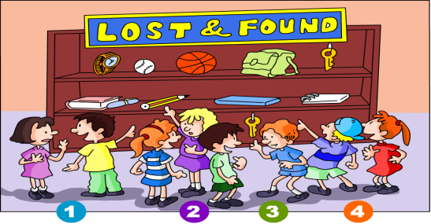
Self check
3.Look at the picture and write the conversations.

Slide 16
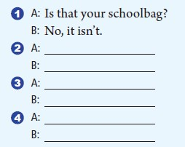
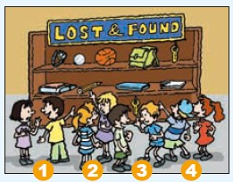
Self check
3.Look at the picture and write the conversations.

Slide 17
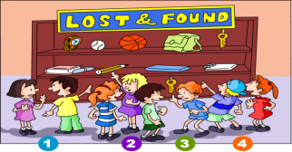
Self check
Is this / Is that …？
Yes, it is. / No , it isn’t.
1
Is that your backpack?
No, it isn’t.
2
Is this your book?
Yes, it is.
3
Is that your key?
Yes, it is.
4
Is this your ball?
No, it isn’t.

Slide 18
分组活动
小组讨论
1 组
2 组
3 组
4 组
总结本课自己的收获，小组内交流。

