Slide 1
七年级英语（JJ下）教学课件
A Door to the World
WWW.PPT818.COM

Slide 2
Learning targets
1. Be able to use the words and phrases: article,
opportunity, knowledge, communicate, connect,
all over the world, a good knowledge of,
communicate with, ask for directions,
connect...with..., in many ways, a door to...
2. To know the importance of English as a door to
the world
3. To learn some key sentences:

Slide 3
(1)All over the world, many people are learning English.
(2)It can be a challenge，but the new language can give people more opportunities.
(3)You can communicate with different people and learn new things.
(4)You can order food and drinks at restaurants，and ask for directions.
(5)In many ways, English opens a door to the world for you.
PPT模板：www.1ppt.com/moban/ PPT素材：www.1ppt.com/sucai/
PPT背景：www.1ppt.com/beijing/ PPT图表：www.1ppt.com/tubiao/
PPT下载：www.1ppt.com/xiazai/ PPT教程： www.1ppt.com/powerpoint/
资料下载：www.1ppt.com/ziliao/ 范文下载：www.1ppt.com/fanwen/
试卷下载：www.1ppt.com/shiti/ 教案下载：www.1ppt.com/jiaoan/
PPT论坛：www.1ppt.cn PPT课件：www.1ppt.com/kejian/
语文课件：www.1ppt.com/kejian/yuwen/ 数学课件：www.1ppt.com/kejian/shuxue/
英语课件：www.1ppt.com/kejian/yingyu/ 美术课件：www.1ppt.com/kejian/meishu/
科学课件：www.1ppt.com/kejian/kexue/ 物理课件：www.1ppt.com/kejian/wuli/
化学课件：www.1ppt.com/kejian/huaxue/ 生物课件：www.1ppt.com/kejian/shengwu/
地理课件：www.1ppt.com/kejian/dili/ 历史课件：www.1ppt.com/kejian/lishi/

Slide 4
Lead in
Do you want to know the outside world?
How can you do that?

Slide 5
Words and expression
article
opportunity
knowledge
communicate
connect
n. 文章
n. 机会
n. 知识；学问
v. 交流
v. 连接；联结

Slide 6
all over the world
a good knowledge of
communicate with
ask for directions connect...with...
in many ways
a door to...
全世界，世界各地
(非常）了解;（丰富的)······的知识
与······交流
问路，询问方向
把······与······连接起来
在许多方面
通往······的大门

Slide 7
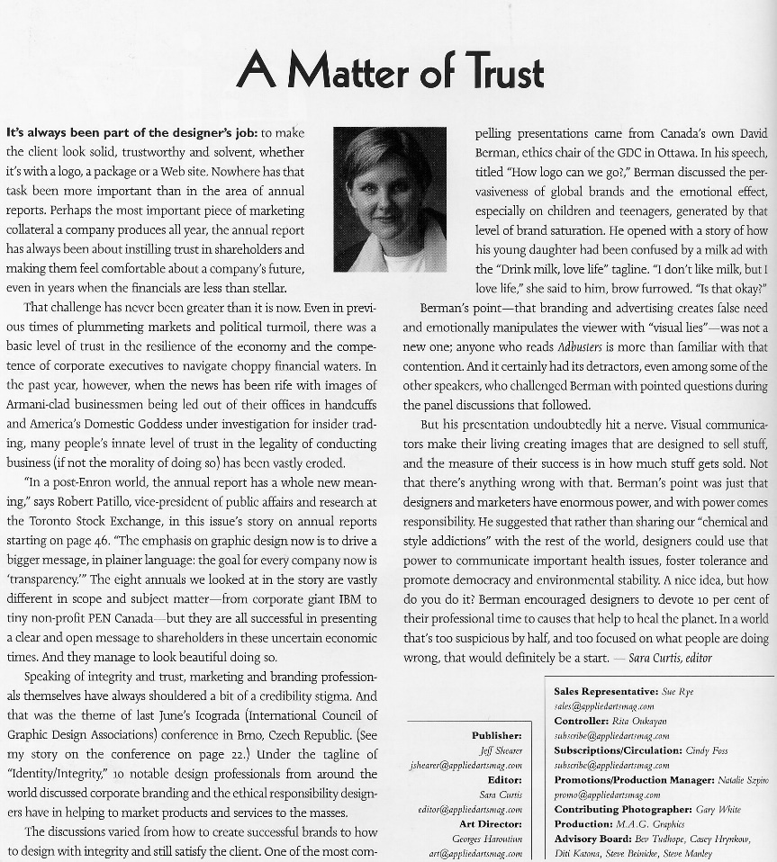
English article
communicate with people
a good knowledge of English

Slide 8
Presentation
Culture Tip
Is there really a “door” to the world？Not really！In English, “opening a door” means having opportunities，learning something new or having more choices.

Slide 9
Read the lesson and write true or false.
People all over the world are learning English.
With a good knowledge of English, students can have bright futures.
English helps you communicate with people from different countries.
Learning a new language is very easy.
English connects you with the world.
F
F
T
F
T

Slide 10
Let’s Do It!
1. Read the lesson and match the words with the correct meanings.
knowledge
A good chance for success
article
something difficult or not easy to do
a piece of writing in a newspaper
or magazine
opportunity
differences
facts and ideas learned from study
and experience
challenge
things that are not the same

Slide 11
2. Some students are talking about learning English. Complete the dialogue with the correct forms of the words from Activity 1.
Li Ming：I love reading English________. With a good__________of English, I can understand ________ between cultures around the world.
Gao Baoli：English is a big________ for me. I don't really want to learn it.
Wang Mei：Learning a foreign language takes time, but the new language can give us new____________.
articles
knowledge
differences
challenge
opportunities

Slide 12
3. Fill in the blanks with the correct forms of the words or phrases in the box.
life a good knowledge of anywhere
connect ask for
1．He must stay home. He can't go_________else.
2．Internet________us with the rest of the world.
3．I got lost on my way to the bookstore. So I went to a
policeman and________help.
4．She has____________________Chinese history.
5．With a good education, we can make a better
________.
anywhere
connects
asked for
a good knowledge of
life

Slide 13
4. Work in groups.What can you do with a good knowledge of English？Talk about it and make a list.
I can...

Slide 14
Language points
1. It can be a challenge, but the new language can give
people more opportunities.
(1)challenge名词，意为“挑战”。
例：This exam is a real challenge.这次考试是一次真正
的挑战。
(2)opportunity名词，意为“机会”。常用短语：
have/take the opportunity to do/of doing sth.有/抓住机
会做某事。例：Everyone should take the opportunity
to learn more new knowledge.每个人都应该抓住机会
学习更多新知识。

Slide 15
2. With a good knowledge of a new language, you can
enjoy a better life.
knowledge是不可数名词，但可用作单数，如a
(good) knowledge of（非常）了解；（丰富的）
……的知识。
例：Knowledge is power. 知识就是力量。
Mr. Brown is very knowledgeable. 布朗先生知识非
常渊博。

Slide 16
3. You can communicate with different people and
learn new things.
communicate作不及物动词，意为“交流”。其名词
形式为communication(交流，通讯)。常用短语：
communicate with sb.与某人交流。例：You had
better communicate with your parents often. 你最好
经常和你的父母进行交流。

Slide 17
4. In many ways, English opens a door to the
world for you.
(1)in many ways意为“在许多方面”。介词in常与名词way构成短语，如：in some ways在某些方面；in different ways在不同的方面；in a way在某种程度上；(get) in the way挡道，妨碍某人；in this way用这种方式；in another way用另一种方式。 例：His suggestion from him is useful in many ways. 他的建议在很多方面都有用。

Slide 18
(2)a door to通往……的大门。这里面的to是介词，其后跟名词或代词。
例：This is a door to that house. 这是一扇通往那栋房子的大门。
English is a door to the world.英语是一扇通向世界的大门。

Slide 19
Exercises
Ⅰ. 选择适当的介词填空。
1. Some students ______ different countries live and study in this school.
2. Study can help you open the door ______ the outside world.
around from to for in
from
to

Slide 20
for
3. You can ask the police _____ directions.
4. She found the news _____ a newspaper.
5. English can help you communicate with people
________ the world.
in
around

Slide 21
Ⅱ. 根据汉语意思完成句子。
1. 作为一名歌手，她有丰富的音乐知识。
As a singer, she has ______ ______ __________
______ music.
2. 与他人很好地交流是重要的。
It’s important to _____________ _______ ______
others.
3. 这个小男孩常请病假。
The little boy often _____ _____ sick leave.
a good
knowledge
of
communicate well with
asks for

Slide 22
4. 有些人常把幸福和金钱联系在一起。
Some people often ______ happiness ______ money.
5. 英语会给你一个周游世界的机会。
English can give you ______ ________ ______ travel
around the world.
6. 这位老人独自一人生活。
The old man lives ______ ______.
connect with
an opportunity to
by himself

Slide 23
Summary
1. Learned some useful words and phrases: article,
opportunity, knowledge, communicate, connect, all
over the world, a good knowledge of, communicate
with, ask for directions, connect...with..., in many
ways, a door to...
2. Learned some key sentences:
(1)All over the world, many people are learning English.
(2)It can be a challenge, but the new language can give
people more opportunities.

Slide 24
Homework
1.What else can you do with a good
knowledge of English? Make up a
dialogue and share with your
classmates.
2.Finish the exercises of this lesson.

