Slide 1
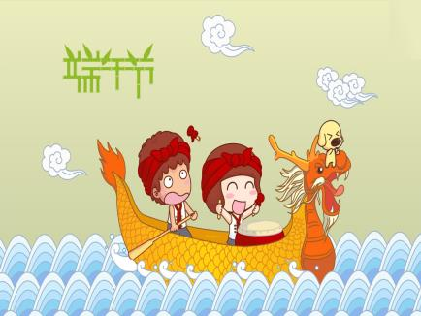
Unit 7
Chinese Festivals
第一课时
WWW.PPT818.COM

Slide 2
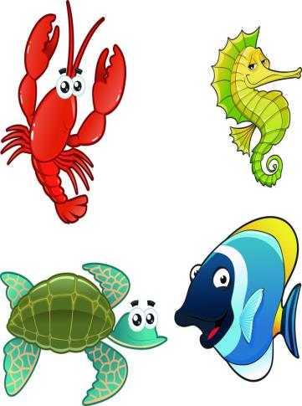
Introduce
A: Which one do you like?
B: I like meat.
C: I like fish.

Slide 3
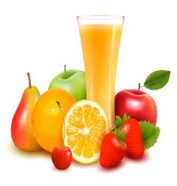
Words
or [ɔ:, ə]
连词，意为“或者，或”;用于否定句后，意为“也不，也没有”。
eg： There isn’t any milk or juice in the fridge.
在冰箱里没有牛奶也没有果汁。
Would you like to some orange juice or apple juice?
你想要一些橘子汁或者苹果汁？
小练习：汉译英：
你喜欢住在大城市还是小镇？
Do you like living in a big city or a small town?

Slide 4
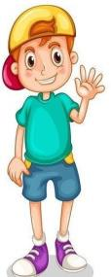
Words
call [kɔ:l]
动词，意为“以...称呼”;“打电话”;“召见”;作名词，意为“电话”。
eg： The king calls the two man to make new clothes for him.
国王召见两位裁缝为他做新衣服。
I’ll give you a call this weekend.
这个周末我打电话给你。
小练习：用所给词的适当形式填空：
It isn’t polite _____（call）her fat.
to call.

Slide 5
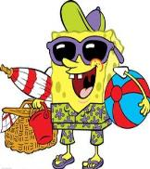
Words
at [æt, ət]
介词，意为“在...”；意为“朝，向...”,表示在某一个时间；
表示在某处；和形容词连用，表示程度。
eg： I often go camping at the weekend. 我经常在周末去野营。
What is she looking at? 她在看什么？
She is not good at English. 她的英语不是很好。
小练习：汉译英：
在夜里
at night

Slide 6
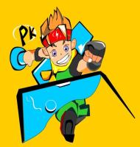
Words
race [reis]
名词，意为“比赛”;作动词，意为“赛跑，角逐” 。
race, match, game的区别：
race指的是速度赛，match指的是球类赛，game指的是游戏。
eg： We will have a swimming race this afternoon.
今天下午我们将会举行一场游泳比赛。
I’ll race you home.我要和你比赛，看谁先到家。
小练习：一场跑步比赛
a running race

Slide 7
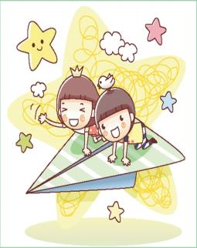
Words
get [ɡet]
动词，意为“收到，获得，购买”; “使...变得”
固定搭配：get together 团聚
get sb. to do sth. 说服某人做某事
eg： I get him to join us. 我说服他加入我们。
小练习：汉译英：
团聚
get together

Slide 8
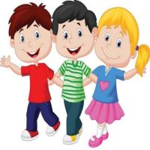
Words
people [ˈpi:pl]
作“人”讲时，是集合名词，表复数概念。
people与person的区别：person是个体名词，它泛指man，woman或child中的任何一个，其复数形式是persons，但人们习惯用 people代替persons。
eg： There are a lot of people in the street.在街上有很多人。
小练习：用所给词的适当形式填空：
（people）in the library should be quiet.
people

Slide 9
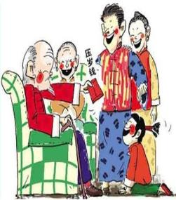
Dialogue
The Spring Festival is in January or February.
春节在一月或二月。
People also call it Chinese New Year.
人们也称呼它为中国的新年。
At this festival, people get together with their family.
在这个节日，人们都和他们家人聚在一起。
Some people eat dumplings.
一些人吃饺子。

Slide 10
Expand
how much与how many的区别
how much与how many的区别在于：
how many 后接可数名词复数形式
how much 后接不可数名词。
例如：
－How many people are there in your family?你家有几口人？
－There are five.五口人。
－How many birds can you see in the picture?图画中你能看见多少只鸟？
－Only one.仅看见一只鸟。

Slide 11
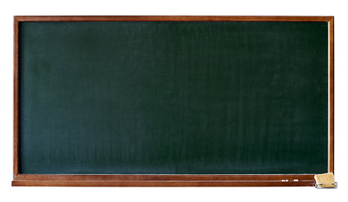
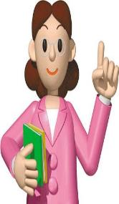
Summary
or
at
call
race
get
people
The Spring Festival is in January or February.

Slide 12
Exercise
阅读短文，判断正（T）误（F）
The Spring Festival is a traditional festival in China.It usually comes in January or February. According to the Luna Calendar,it is the first day of a new year.Since it always comes in spring,we call it Spring Festival.It is a favorite festival of the Chinese people.Children like it best.Children can get lucky money from their grandparents,their parents,uncles,aunts and other elder people.Old people also like it. Because the family will get together, they can see their children and grand children.They can also get lucky money from their children who have worked.

Slide 13
Exercise
（ ）1.This passage is about Spring Festival.
（ ）2.At Spring Festival, people usually go to work together.
（ ）3.The children like Spring ,but the old people don’t.
（ ）4. Spring Festival is a favourite festival in China.
（ ）5.Spring Festival usually comes in May.
T
F
F
T
F

Slide 14
Exercise
单项选择。
（ ）1.People usually eat ______ at Spring Festival.
A.moon cakes B. dumplings C. rice dumplings
（ ）2.We call_____ Chinese New Year.
A.Spring Festival B. New Year C.Christmas
（ ）3.At Dragon Boat Festival, we can _____ dragon boat races.
A.look at B. see C.watch
（ ）4.________is about a great poet（诗人）QuYuan.
A.Christmas B. Chinese New year C. Dragon Boat Festival
（ ）5.At Spring Festival, we usually _______.
A.eat dumplings B. get together with our family C. A & B
B
A
C
C
C

Slide 15
Homework
Talk about your favorite festivals.

