Slide 1
Unit 6 I'm tall
WWW.PPT818.COM

Slide 2
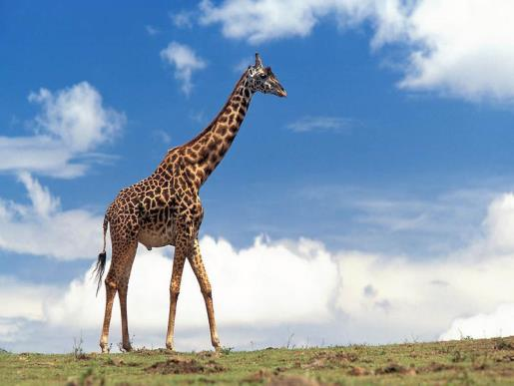
tall

Slide 3
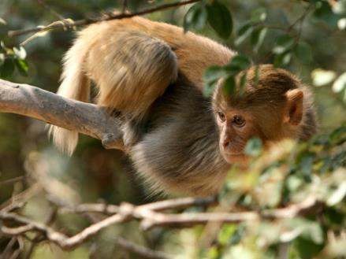
short

Slide 4
I'm tall,you are short

Slide 5
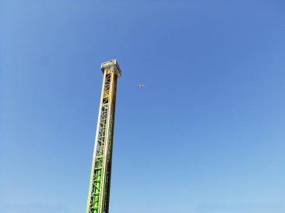
We are both tall.
tall

Slide 6
opposite
tall short

Slide 7
小知识
both 两个人都
all 三个人及三个人以上都
eg：We are both tall.
eg: We are all tall.

Slide 8
重点句型
How tall I am?
你有多高啊？
How funny!
多么的好玩啊！

Slide 9
小习题
将对应的词连线。
1．long A．small
2．big B．short
3．green C．red
4．black D．warm
5．cool E．white

Slide 10
连词成句。
1．are，tall，both，We(.)
________________________________________________________________________
2．I，very，am，tall(.)
________________________________________________________________________
3．tall，is，so，Peter(！)
________________________________________________________________________
4．Lily，coming，is(.)
________________________________________________________________________
5．is，Your，tall，mother(.)
_______________________________________________________________________

Slide 11
答案
1.We are both tall.
2.I am very tall.
3．Peter is so tall！
4.Lily is coming.
5．Your mother is tall.

