Slide 1
初中英语仁爱版七年级下
Unit7 Topic 1
When is your birthday?
Section A
WWW.PPT818.COM

Slide 2
Warm-up
1
Presentation
2
Summary
3

Slide 3
Warm-up
Look at some pictures
February
March
January
April
May
June

Slide 4
Presentation
1c. Listen and read 12 months.
Ask and answer after the example.
A:When were you born ?
B:I was born in______.

Slide 5
Read the first six years .
2a
1900
nineteen hundred
1840
eighteen forty
1904
nineteen o four
1976
nineteen seventy-six
2000
two thousand
2008
two thousand and eight

Slide 6
Can you write them in English?
1800_______________1820________________
1903_______________1996________________
2009___________________
2050____________________________
eighteen hundred
eighteen twenty
nineteen o three
nineteen ninety-six
two thousand and nine
two thousand (and) fifty/twenty fifty

Slide 7
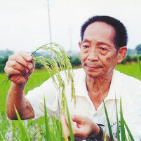
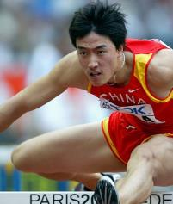
Listen and write down the year or month in each coversation.
2b
______,1879
1930
March
September,______
July
February,______
______,1983
1973

Slide 8
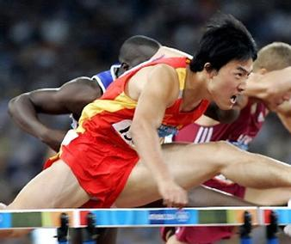
Pair Work
两人一组，用下面的句型进行对话演练
A:Who is he?
B:He is Liu Xiang.
A:When was he born?
B:He was born in July,1983.
A:Where was he born?
B:He was born in Shanghai.

Slide 9
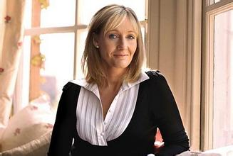
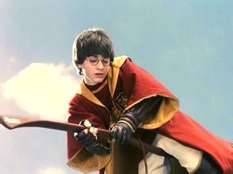
Do you know this woman?
She is J.K.Rowling, the writer of Harry Potter.
When and where was she born? Do you know?

Slide 10
1. When was J.K.Rowling born? 2. Where was she born?
Read 1a and work in pairs.
Listen and answer.
She was born in July, 1965.
She was born in Wales, the UK.

Slide 11
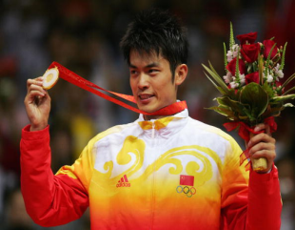
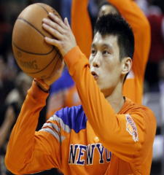
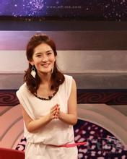
Look at the following pictures and information, then make up new coversations like 1a.
Lin Dan Fujian 1983.10
Lin Shuhao the U.S.A. 1988.8
Xie Na Sichuan 1981.5
Li Na Hubei 1982.2

Slide 12
Listen and read the sounds and words aloud.
ou
sound | /au/ | /u:/ | /Λ/
Word | count house mouth ... | group route through ... | country touch tough ...

Slide 13
Letter | ow |  | p | ph
Sound | /əu/ | /au/ | /p/ | /f/
Word | grow slow window ... | brown cow town ... | help party pencil ... | elephant photo physics ...

Slide 14
Listen and circle the words with
the sound/au/or/əu/.
/au/ route phone cow how
group window blouse low
brown doubt
/əu/ down yellow touch grow
slow borrow enough row
blow own

Slide 15
Summary
Learn how to express 12 months in English.
Learn how to read different years.
Learn the past simple tense with “was/were”.
(1)When was she born?
She was born in July, 1965.
(2)Where was she born?
In Wales, the UK.
(3)When were you born?
I was born in January, 1999.

Slide 16
Homework:
1.Read years and months;
2.Remember 12 months;
3.Read 1a.

