Slide 1
Unit7 Topic3
Everyone had a good time.
Section A
WWW.PPT818.COM

Slide 2
Ask and answer.
T: When were you born?
S1: I was born...Could you ride a bike
when you were five?
S2: Yes, I could./No, I couldn't.
Could you...?
S3: ...
am/is——was
are——were
can——could

Slide 3
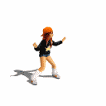
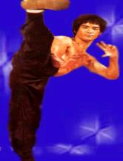
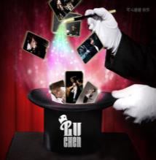
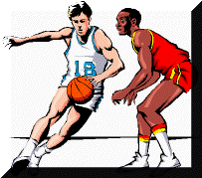
sing a song
dance
perform kung fu
perform magic tricks
故人...
play the guitar
play basketball
recite a poem

Slide 4
What did they do yesterday afternoon?
They played basketball.
Did they home very late?
No, they didn’t.

Slide 5
Listen and understand.

Slide 6
Read 1a again and match what each child did.
danced
played the piano
performed some magic tricks
sang an English song
Jane
Maria
Sally
Tom

Slide 7
Pair Work
Suppose you are Kangkang's friend. Talk about what the children did at Kangkang's birthday party.
Example:
A:Did you/Tom/Jane dance at the party?
B:Yes, I/he/she did.
A:Did he/she play the piano?
B:No, he/she didn't.
A:What did you/Jane/... do?
B:I/She/...sang a song.

Slide 8
A.Listen and circle the programs you hear in the program list below.
1. Guitar playing Jane 6. Piano playing Maria
2. Dancing Sally 7. English song Jane
3. Chinese song Michael 8. Ballet Maria
4. Magic tricks Tom 9. Disco Jack
5. Dancing Judy 10. Kung fu Kangkang
Program List

Slide 9
B. Listen again and fill in the blanks.
A:What did...do at the party yesterday?
B:He/She....
played
Jane_______the guitar.
sang
Michael_______a Chinese song.
played
Tom________magic tricks.
At Kangkang's birthday party yesterday
Maria_______the piano.
performed
performed
danced
Kangkang_________Chinese kung fu.
Jack_______to disco.

Slide 10
把下列单词变为过去式，并总结变化规律。
1.play--
2.look--
3.miss--
4.perform--
5.live--
6.hope--
7.recite--
8.dance--
9.study--
10.worry--
11.stop--
12.plan--
13.am--
14.can--
15.sing--
16.are--
played
studied
looked
worried
missed
stopped
performed
planned
lived
was
hoped
could
recited
sang
danced
were

Slide 11
动词过去式的规律:
① 一般情况+ed
② 以不发音的e结尾的+d
③ 以辅音字母+y结尾的, 变y为i+ed
④ 末尾只有一个辅音字母的重读闭音节词, 先双写辅音字母, 再加ed
⑤ 不规则动词的过去式参见英语书最后一页

Slide 12
Write down the past forms of verbs.
1.play---- 2.do/does---
3.is------ 4.dance---
5.are----- 6.recite---
7.perform-- 8.like-----
9.ask------- 10.try-----
11.stop------ 12.die ---
13.worry--- 14.plant---
played
did
was
danced
were
recited
performed
liked
asked
tried
stopped
died
worried
planted

Slide 13
Listen and read the sounds and words aloud.

Slide 14
Listen and circle the word with the different sound of the colored letters in each group.
1. student true ruler blue
2. full pull but push
3. throw they think thing
4. then those mother fifth

Slide 15
Summary
1. enjoy oneself=have a good time
just now=a moment ago
2.Learn the past simple tense.
(1)Did you sing a song at the party?
Yes, I did./No, I didn't.
(2)What did Sally do? She danced.
(3)What about Tom?
He performed some magic tricks.

Slide 16
Homework
1.Read 1a, and try to retell 1a in your own words. You may begin like this:
Kangkang was very happy at his birthday party. Jane sang an English song...
2.Finish Section A in your workbook.

