Slide 1
Module 3 Life now and then
They sometimes work harder
WWW.PPT818.COM

Slide 2
学习目标
words: wealthy, fear, used to, wealth, double, seldom, spare, spare
time, speak up, deaf
Sentences:
(1) Do you think that life is better today than in the past?
(2) I suppose that’s because more people have cars, and they walk or
use their bikes less.
(3) Why don’t you go and ask Mrs Li, our neighbour?
(4) She’s seen how life has changed.

Slide 3
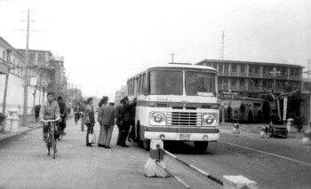
新课导入
Lead in
Talk about the photo. Say what life was
like in the early 1980s.

Slide 4
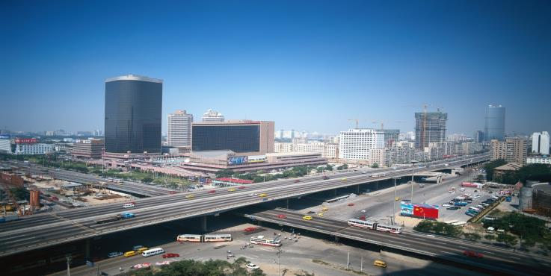
新课导入
And what life is like today?

Slide 5
New words
wealthy
fear
used to
wealth
double
seldom
spare
spare time
speak up
deaf
adj. 富有的；富裕的
n. 担心；害怕
过去
n. 财富；财产
v. 使加倍；把……增加一倍
adv. 很少地；不常
adj. 空余的；备用的
业余时间；闲暇
大点声说
adj. 聋的

Slide 6
Listen and answer the questions.
What is the history homework?
2. What is the question they need to answer?
3. What does Betty ask?
4. What does Daming ask?
Writing about life in the past and life today.
The question is “Is life today better than it was in the past?”
Betty asks if they can write about medicine and pollution.
Daming asks if they can write about personal safety.

Slide 7
Read and choose the correct answer. 1. People live longer today because_____. a) they have better health care
b) they do not work as hard as they did
c) they take more exercise 2.There is more pollution so ____. a) life may be healthy b) people do not eat as well as before c) people do not take as much exercise as before
a
b

Slide 8
b
3. Pepole work harder today and_____.
a) they do not live as long as they did
b) they do not usually have enough free time
c) they live a healthier life
4. Betty will be more relaxed and less nervous about the exams if ____.
a) she works harder
b) she asks Mrs Li for help
c) she goes on the school trip
c

Slide 9
Complete the questions with the words and expression in the box.
deaf doubled fear relaxed spare used to wealth
fear
1. What kinds of things do you _______?
2. What do you do in your ________ time?
3. What can someone not do if they are _________?
4. If something is ________, is it more or less?
5. What do you usually do to make yourself _______ before exams?
6. Do you think people ________ take more exercise than they do
today?
7. Do you think people have more ________ today than they
used to?
spare
deaf
doubled
relaxed
used to
wealth

Slide 10
Everyday English
Nearly finished!
That’s true.
I suppose ...
Talking of ...
快做完了！
的确如此。
我(猜)想……
谈到……

Slide 11
Important sentences
1. Do you think that life is better today than in the past?
你认为现在的生活比过去更好吗？
2. I suppose that's because more peole have cars, and
they walk or use their bikes less.
我猜那是因为更多的人有汽车，他们更少步行或骑
自行车。
3. Why don't you go and ask Mrs Li, our neighbour?
你为什么不去问问李太太，我们的邻居？
（= Why not go and ask Mrs Li, our neighbour?）
4. She's seen how life has changed.
她见证了生活是如何变化的。

Slide 12
辨析：nearly / almost
nearly, almost虽然都可以表示“几乎”，但是当要表示“接近”或“就要到了”时最好用nearly；当想表达“不足”或“尚差一点儿”时最好用almost。

Slide 13
nearly
The sea covers nearly three-fourths of the world's surface.
This product has been a best seller for nearly one year.
almost
Confidence of success is almost success.
She said almost nothing.

Slide 14
当堂小练
一、根据句意及首字母或汉语提示完成单词。
1.It ________(很少) rains in such a time in winter.
2.He spoke of his _____(担心) of the future of his country’s culture.
3.In her s______time she reads books on cooking.
seldom
fear
pare
4.He can’t hear you because he is born d____.
5.The number of managers must _______(增加一倍) to 100 within 3 years.
eaf
double

Slide 15
当堂小练
二、根据中文提示完成句子， 词数不限。
1. 你将如何处理那个偷了钻石的小偷呢？
How will you _________________ who stole the diamond?
2. 请大声一点儿，我听不见你说话。
________________， please.I can’t hear you.
deal with the thief
Speak up

Slide 16
当堂小练
3. 我们的生活越来越好。
Our lives are getting____________________________.
4. 今天报纸上有什么特别的新闻吗？
Is there _____________________ in the newspaper today?
5. 从我买下这幢房子以来，它的价值已增加了一倍。
The house _______________ in value since I bought it.
better and better
anything special
has doubled

Slide 17
当堂小练
三、单项填空。
( )1. He works _______ and feels _______ every day.
A.hard；happy B.hardly；happily
C.hard；happily D.hardly；happy
A
( )2. Mo Yan is one of _______ writers in the world.
A.famous B.more famous
C.most famous D.the most famous
D

Slide 18
当堂小练
( )3. —It’s smoggy these days.That’s terrible!
—Yes， I hope to plant trees._______ trees， _______ air
pollution.
A.The more；the fewer
B.The less；the more
C.The less；the fewer
D.The more；the less
D

Slide 19
当堂小练
( )4. —I haven’t seen you for a long time， Maria.You
look different now.
—Yes， I used _______ short hair.
A.to have B.to having
C.for having D.have
A

Slide 20
当堂小练
( )5. We went on a _______ trip and all of us felt _______.
A.relaxing；relaxing
B.relaxed；relaxed
C.relaxed；relaxing
D.relaxing；relaxed
D

Slide 21
当堂小练
( )6. In our daily life， we must learn to _______
ourselves well at any time.It’s as important as studying.
A.deal with B.worry about
C.look after D.take care
C

Slide 22
当堂小练
( )7. —Why don’t you join an English club to practice speaking
English?
—_______.
A.It’s my pleasure
B.Take it easy
C.That’s all right
D.That’s a good idea
D

Slide 23
当堂小练
( )8. —What _______ the number of the fans of Lu Han?
—I don’t know， but a number of them _______ crazy.
A.is；is B.are；are
C.is；are D.are；is
C

Slide 24
当堂小练
( )9. —I think English is as _______ as maths.
—I agree with you.
A.more interesting B.most interesting
C.the most interesting D.interesting
D
( )10. —_______ the final exam， I feel very nervous!
—Come on! You can make it.
A.Speaking of B.Think of
C.Talking with D.Talk of
A

Slide 25
当堂小练
四、完形填空。
We are living a fast life.It seems that everything has to be fast， for example， 1 food， fast Internet， fast roads， fast money.Every day we try to get things done 2 ， but there are some moments that we have to slow down and enjoy our lives.
We are always 3 every day.I have to work eight hours or more a day at my full-time job.When I get home，

Slide 26
当堂小练
it’s always over seven o’clock.I make an effort(努力)to 4 something.I try to find a bit of time for my hobby—writing.I hardly ever write and work 5 weekends.Those are my days to try to recharge(休整)and reduce(减少)the stress from my work.I sleep on the sofa during the day， 6 some beer in the open air or go out for a picnic if the weather is nice.
What I’m trying to say is this:

Slide 27
当堂小练
if you don’t take some time to slow down once in a while(偶尔)and 7 your life， it will pass you by.You can be unhealthy both in body and mind if you don’t take the time to relax.So this weekend， don’t make any 8 .Just get up on Saturday morning 9 your body says it’s time to get up.Make some coffee， step outside and get 10 fresh morning air， turn on the radio and prepare yourself for nothing.

Slide 28
当堂小练
( )1. A.good B.fast C.slow D.cold
( )2. A.specially B.seriously
C.directly D.quickly
( )3. A.busy B.happy C.free D.sad
( )4. A.drink B.buy C.write D.say
( )5. A.with B.except C.in D.on
B
D
A
C
D

Slide 29
当堂小练
( )6. A.eat B.drink C.take D.get
( )7. A.spend B.share
C.enjoy D.relax
( )8. A.plans B.mistakes
C.noises D.sentences
( )9. A.but B.when C.what D.so
( )10. A.any B.many C.no D.some
B
C
A
B
D

Slide 30
课堂小结
归 纳
Unit 1 They sometimes work harder.
New words: wealthy, fear, used to, wealth, double,
seldom, spare, spare time, speak up, deaf
2. Structures:
(1)Do you think that life is better today than in the past?
(2)I suppose that’s because more people have cars, and they
walk or use their bikes less.
(3)Why don’t you go and ask Mrs Li, our neighbour?
(4)She’s seen how life has changed.

