Slide 1
人教精通版三年级上册
Unit2 This is my pencil.
WWW.PPT818.COM

Slide 2
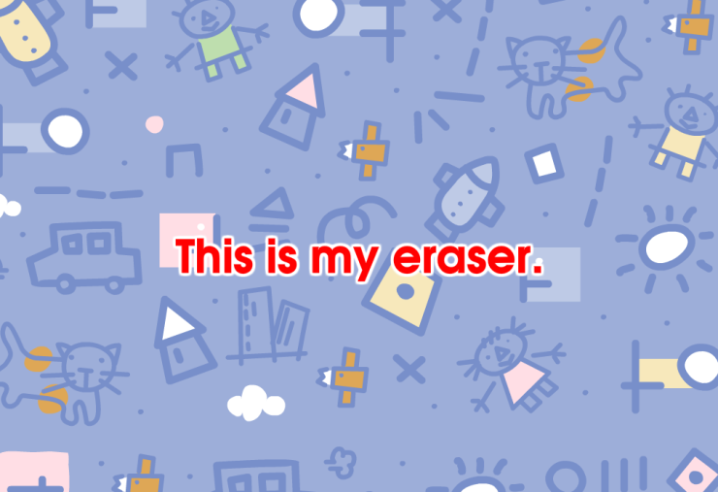
Review
Let’s sing

Slide 3
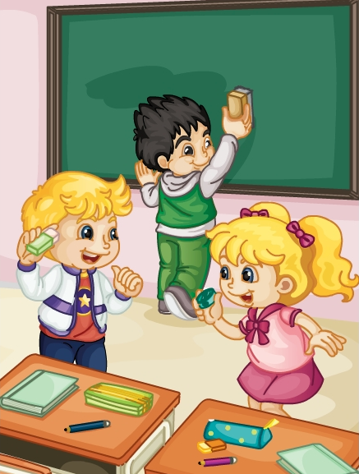
Review
Role-play
Hi, Kate! This is my eraser.
Hi, Peter. This is my sharpener.

Slide 4
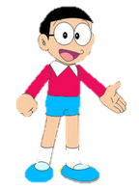
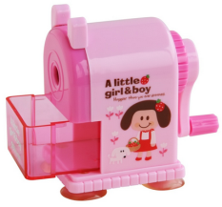
Lead-in
Look and guess
This is my sharpener.
Wow! It’s nice!

Slide 5
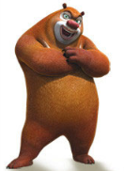
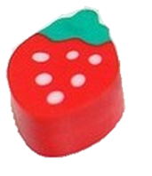
Lead-in
Look and guess
This is my eraser.
Wow! It’s nice!

Slide 6
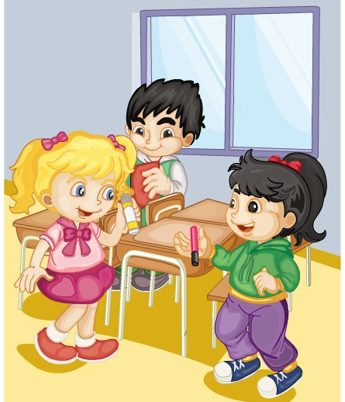
Presentation
Listen and say
听一听，Kate和Li Yan他们说了什么？
Hi, Li Yan! This is my glue.
Look, Kate! This is my marker.
Wow! It’s nice!

Slide 7
Presentation
Listen and imitate
Hi, Li Yan! This is my glue.
Look, Kate! This is my marker.
Wow! It’s nice!

Slide 8
Show time
两人一组，练习对话并表演，其他同学评价。
 | 模仿录音中的语音语调，有感情地朗读。
 | 可以脱离课本，适当改动其中部分，语音地道。
 | 适当添加内容，意思完整，有创新，表演生动。
Good
Great
Excellent

Slide 9
Presentation
Just learn
glue
This is my glue.

Slide 10
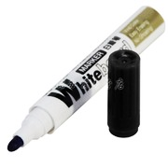
Presentation
Just learn
marker
This is my marker.

Slide 11
Practice
Game 1
大小声
glue marker
eraser sharpener

Slide 12
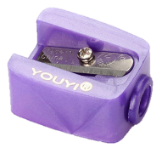
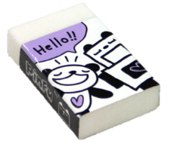
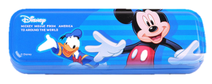
Practice
Game 2
What’s missing?

Slide 13
Practice
Pair work
I say you do
Show me your marker.
This is my marker.

Slide 14
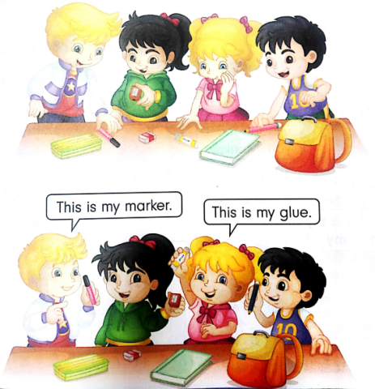
Practice
Group work
Let’s play
This is my marker.
This is my glue.

Slide 15
Summary
本课学到的学习用品类单词有:
glue
marker

Slide 16
Summary
当别人给你介绍完他的东西时，你想要表示赞许，该如何表达？
Wow! it’s nice!

Slide 17
Homework
1. 跟读Just talk部分的课文录音，并注意语音、语调。
2.在四线三格上正确抄写本单元所学的学习用品类单词，三英一汉。
3. 预习Lesson12。
Close

