Slide 1
Lesson 35
The Dream Team
WWW.PPT818.COM

Slide 2
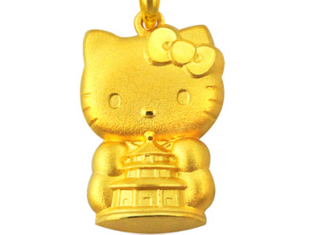
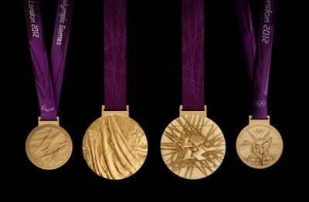
New words
gold n. 黄金
adj. 金色的
medal n. 奖牌

Slide 3
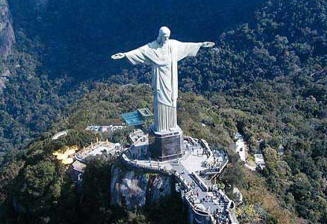
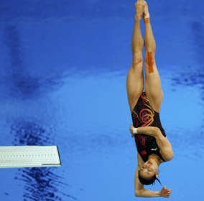
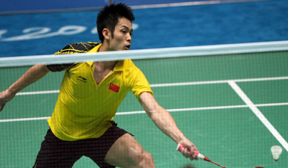
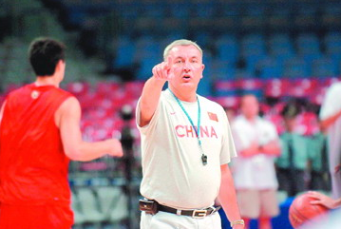
Brazil n. 巴西
diving n. 跳水
badminton n. 羽毛球
coach n. 教练

Slide 4
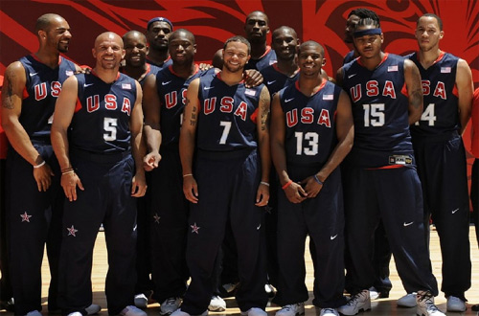
Dream Team

Slide 5
Think about it
Which sports team do you like best? Why?
What is the most important part of a team?

Slide 6
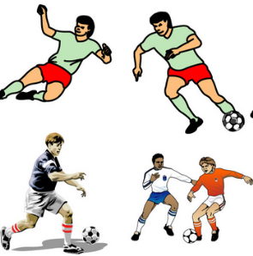
Learning Tip
Other than the dream teams mentioned above, do you know of any other dream teams?
soccer
running

Slide 7
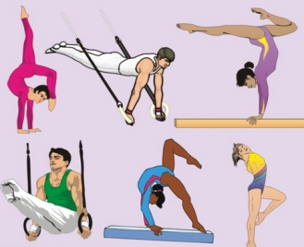
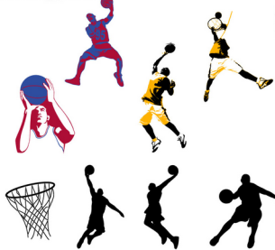
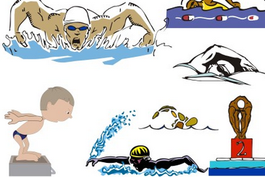
gymnastics
basketball
swimming

Slide 8
Let's Do It!
1. Read the lesson and answer the
questions.
1. What is the dream team of the U.S.?
2. Is the diving team China’s only dream team?
The U.S. basketball team.
No. China also has dream teams in ping-pong and badminton.

Slide 9
3. What does a dream team have?
4. How can the players perform better?
A dream team has not only the best players and the best coach, but also the best team spirit.
By working together, they perform better, and they never give up.

Slide 10
2. Complete the clues and do the crossword.
2
5
3
4
1

Slide 11
ACROSS
1. The weather has a big i________ on agriculture.
DOWN
2. Lin Dan, a famous Chinese player, started playing b________ at the age of nine.
3. Her hair is so blond that it almost looks like g___.
influence
badminton
gold

Slide 12
4. We have been practicing Snow White for over a month. We are going to p______ it tomorrow.
5. The c____ held a team meeting to discuss the reasons why they failed.
perform
coach

Slide 13
2
b
a
d
m
i
n
t
o
5
3
c
o
a
h
g
o
d
4
p
r
f
o
r
m
1
i n f l u e n c e

Slide 14
3. Complete the passage with the
correct forms of the given words.
Not every famous athlete is the one who goes the ______ (fast) or the ______ (high). Sometimes people win in other ways. In 1992, at the Barcelona Olympics, Canadian rower Silken Laumann came third in a race. But some people thought her bronze medal was as ____ (good) as
fastest
highest
good

Slide 15
the gold medal. Just before the Olympic race, she was seriously injured. But she didn’t want to miss the Olympics, so she practiced as soon as she got out of the hospital. Taking part in the Olympics was ______________ (important) than winning for her.
more important

Slide 16
4. Work in groups. Take turns acting out a sport. While one group member acts, the others try to guess what sport it is.
You can ask the following questions:
Is it played inside or outside?
Is it on land or in water?
Is it a solo event or a team event?

Slide 17
1. …the U.S. basketball team defeated all the other teams and won the gold medal.
defeat v. & n. 战胜；打败
e.g. I believe nothing can defeat you. 我相信什么都打不垮你的。

Slide 18
2. American Bob Beamon won the gold medal in the long jump.
1) gold (n.&adj.) golden (adj.)
金（的） 金色的，金子般的
e.g. golden time
金色时光
A gold watch is much more valuable than a golden watch.
纯金的表远比金色的表值钱。

Slide 19
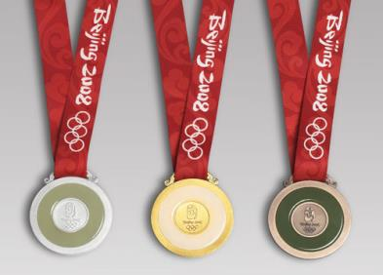
2) medal 奖牌；勋章
e.g. gold medal 金牌 silver medal 银牌
bronze medal 铜牌

Slide 20
3. They had a great influence on people everywhere…
influence n. & v. 影响；作用
have an influence on… 对……有影响
e.g. All of these countries have had an
influence on Switzerland's history,
culture and language.
这些国家对瑞士的历史、文化和
语言都产生过影响。

Slide 21
The climate seems to have an influence on these birds.
气候对这些鸟好像有影响。

Slide 22
【运用】
Complete the following sentences.
1. 我们读的东西影响我们的思考。
What we read ____ ____ ________ on our thinking.
has an influence

Slide 23
2. 这部电视剧对儿童有负面影响。
This TV play has ____ ____ ________ on children.
3. 我不想知道你的观点，因为不想受你影响。
I don’t want to know your opinion because I don’t want you to _________ ____.
a bad influence
influence
me

Slide 24
4. Time after time, these teams have won gold medals for China.
time after time 多次；反复
e.g. We have warned you time after
time.
我们再三警告过你。
He visited the museum time after
time.
他常常参观博物馆。

Slide 25
What do you know about dream team?
What is China’s dream team?
Do you know any other dream teams in other countries?
Make a list.

