Slide 1
Lesson 41 Show and Tell!
WWW.PPT818.COM

Slide 2
Warming up
1) 我自己洗我的衣服。
2) 你怎么处置了我的自行车?
3) 我们必须尽力学好英语。
4) 你什么时候加入了火箭俱乐部？
I wash my clothes _______.
myself
What did you ________my bike?
do with
We must ___________English well.
try to learn
When did you _____the rocket club?
join

Slide 3
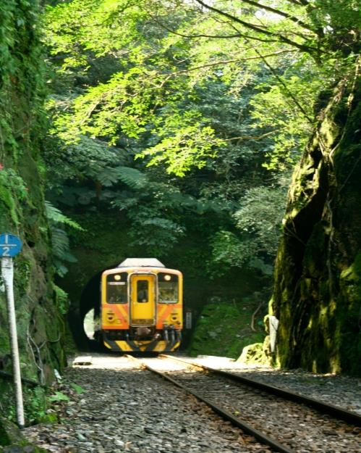
through prep.
穿过

Slide 4
Listen and answer .
Listen to the tape with the following questions:
1. Where is Danny’s hobby ?
It’s in a big box in the parking lot.
2. Can Danny’s hobby go through the door ?
No, it can’t.

Slide 5
Read and answer
Read the text with the following questions:
1. What does the sign say on the box?
The sign says “fragile this side up!”
2. How many hobbies does Danny have? What are they?
Danny has two hobbies, They are learning his family and gardening .

Slide 6
Language notes
He has four books full of stamps!
他有四本装满邮票的集邮册。
full of 充满，装满。
full of stamps 在这里是后置定语，用来修饰books。
e.g. 车里挤满了人。
The bus is full of people.
我有满满一篮子花。
I have a basketball full of flowers.
be full of=filled with
瓶子里装满了牛奶。
The bottle is full of milk.
= The bottle is filled with milk.

Slide 7
3. Finally, it’s Danny’s turn.
终于，轮到了丹尼。
句型It’s one’s turn to do sth. 表示“轮到某人做某事了”。
e.g.轮到吉姆做家务了。
It’s Jim’s turn to do housework.
注意：提问“轮到谁做某事”时，英语要用whose。
e.g.该轮到谁值日了？
Whose turn is it to be on duty?

Slide 8
4. It won’t go through the door.
它无法从门里通过。
through是介词
表示 “通过、穿过”
辨析：through; cross

Slide 9
through 穿过
表示从物体的内部空间中“穿过”，它强调一个立体范围，具有in的意味。
e.g.我花了三个小时才穿过森林。
It took me three hours to walk through the forest.

Slide 10
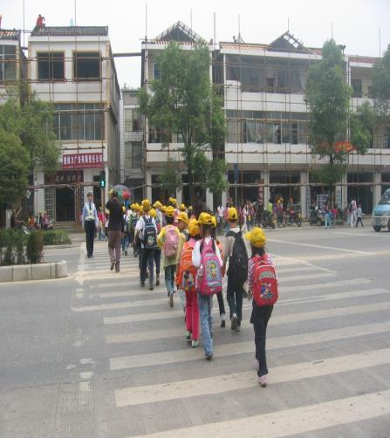
cross v. 横穿
表示 横穿的意思。通常用在比较小的范围内。
e.g.学生正在过马路
The students are crossing the road.

Slide 11
5. Get your hobby out of the box, Danny.
把你的爱好从盒子里拿出来，丹尼.
get…out of 相当于take…out of
表示“把…….取出来”。
e.g.请把它们从书包里拿出来。
Please get them out of the bag.

Slide 12
6. Many people enjoy learning about their family trees.
许多人都喜欢了解自己的家谱。
learn about sth. 了解……
其间可以用much, a lot ,more 等词修饰。
e.g.你想更多地了解中国历史吗？
Would you like to learn more about the history of China?
相关短语：hear about 听说
know about 了解

Slide 13
Translate
1) 那个瓶子里装满了水。
2) 轮到我展示自己的爱好了。
3) 她喜欢和其他青少年交换邮票。
4) 老人从袋子里拿出两元钱。
5) 这头大象太大，过不了这个门。
6) 我们打算明年组织一个集邮俱乐部。
That bottle water.
is full of
the hobby.
It’s my turn to show
She likes stamps other teenagers.
trading/to trade
with
The old man two yuan his bag.
got/took
out of
The elephant is too big to the door.
go through
We are going to a stamp collecting club next year.
organize

Slide 14
Thank you!

