Slide 1
Module 8 Sports life
Unit 2 He was invited to competitions around the world.
WWW.PPT818.COM

Slide 2
学习目标
1.能够读懂介绍刘翔的短文，获取主旨大意及相关细节信息。
2.能够掌握一般过去时被动语态的概念和用法。
3.能使用一般过去时被动语态写一篇短文介绍乒乓球运动员张怡宁。
4.通过学习，加深对我国体育运动状况和体育明星
的了解，学习运动员顽强拼搏的精神。

Slide 3
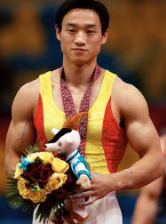
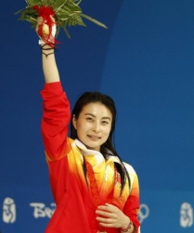
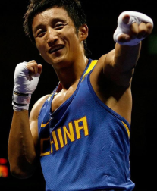
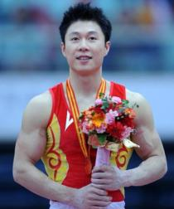
新课导入
思 考
Who are they?

Slide 4
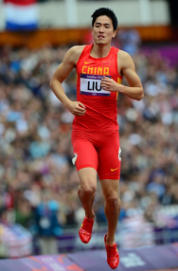
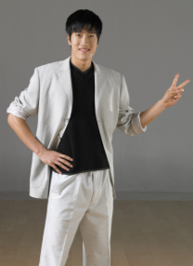
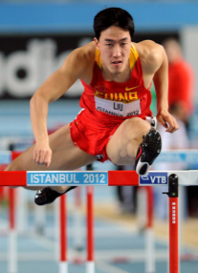
新课导入
Who is he?
Liu Xiang

Slide 5
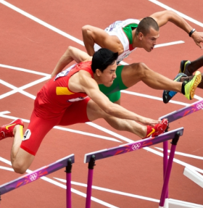
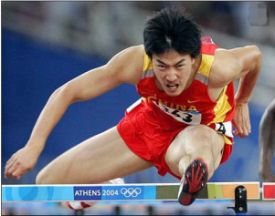
新课导入
在2004年的“雅典奥运会”: 110米跨栏比赛中，一个生疏的名字在每个中国人的耳边回荡，那就是“刘翔”。他以惊人的速度12秒91夺得了世界冠军，并且打破了多年的记录。

Slide 6
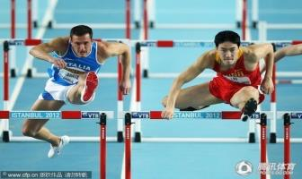
新课导入
在2006年国际田联超级大奖赛洛桑站男子110米栏的决赛中, 中国选手刘翔以12秒88的成绩打破了沉睡13年之久的男子110米栏世界纪录, 并夺得金牌！该项目原世界纪录是由刘翔和英国名将科林-杰克逊共同保持的12秒91。2012年2月18日晚23点53分, 在英国伯明翰举行的国际田联室内赛男子60米栏决赛中, 刘翔以7秒41获得冠军, 打破了他自己保持的亚洲纪录! 罗伯斯以7秒50获得亚军。

Slide 7
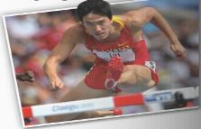
新课讲解
1
Look at the picture and the title of the passage in Activity 2.
Liu Xiang — trained to be
the best in the world
☺ Who is he?
☺ When and where did he get his Olympic gold medal?
☺ What was his feeling at the moment?
☺ Has he ever suffered from injury or defeat?

Slide 8
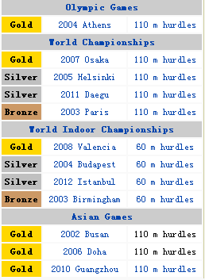
新课讲解
Say what you know about Liu Xiang and how he became a sports hero.
Personal information:
Born: July 13, 1983
Height: 1.89m
Weight: 85kg

Slide 9
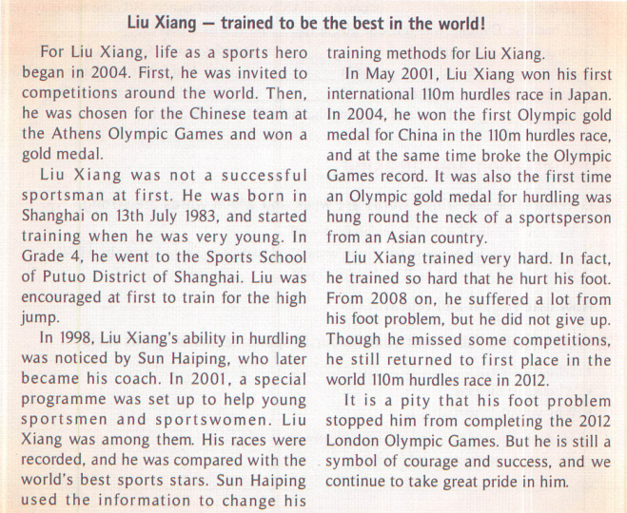
新课讲解

Slide 10
新课讲解
2
Listen to the passage and choose the sentence which best expresses the main idea.
a) Liu Xiang was helped by his sports school to win a gold medal.
b) Liu Xiang will be a star and not a sports hero.
c) Liu Xiang has trained for many years and won many gold medals.
√

Slide 11
新课讲解
3
Match the years with the notes to complete the timeline.
Match the years with the notes to complete the timeline.
2012－________ a)won his first international 110mhurdles race
2008－________ b)hurdling ability noticed
2004－________ c)born in Shanghai
2001－________ d)won Olympic gold medal
1998－________ e)started training at a sports school
1993－________ f)returned to first place
(Grade 4) g)suffered from foot problem
1983－________
f
g
d
a
b
e
c

Slide 12
新课讲解
4
Complete the passage with the correct
form the words in the box.
ability Asian courage method pride race
The Chinese take great (1)________in Liu Xiang. At first, he was not very successful, but his coach noticed his (2)________in running and jumping, and helped him change his training (3)________．He won a number of important (4)________and became the first (5)________sportsperson to win an Olympic gold medal for hurdling. However, from 2008 on, he missed some competitions because of a foot problem. Although he did not complete the 2012 Olympic Games, he is still a symbol of great (6)________and success.
pride
ability
methods
races
Asian
courage

Slide 13
新课讲解
5
Write the notes in Activity 3 in full sentences.
Liu Xiang was born in Shanghai in 1983.
He won his first international 110m hurdles race in 2001.
His hurdling ability was noticed in 1998.
He won the Olympic gold medal in 2004.
He started training at a sports school in 1993.
He returned to first place in 2012.
He suffered from his foot problem in 2008.

Slide 14
新课讲解
6
Look at the verb forms in the two sentences.
Sun Haiping noticed Liu Xiang’s ability in hurdling.
Liu Xiang’s ability in hurdling was noticed by Sun Haiping.

Slide 15
新课讲解
Now write sentences about table tennis player Zhang Yining. Use the correct verb form.
Coach Wang Biling noticed Zhang Yining.
Zhang Yining was noticed by Coach Wang Biling.
Wang Biling asked Zhang Yining to go to Beijing Shichahai Sports School.
Zhang Yining was asked to go to Beijing Shichahai Sports School by Wang Biling.

Slide 16
新课讲解
Zhang Yining’s training programme took up a lot of her time.
A lot of Zhang Yining’s time was taken up by her training programme.
Zhang Yining’s mother advised her to study as well as train hard.
Zhang Yining was advised to study as well as train hard by her mother./
Zhang Yining was advised by her mother to study as well as train hard.

Slide 17
新课讲解
7
Write a passage about Zhang Yining.
Use the sentences you have written in Activity 6 to help you.
Zhang Yining was noticed by Coach Wang Biling. She was asked by Wang Biling to go to Beijing Shichahai Sports School. A lot of Zhang Yining’s time was taken up by her training programme, but Zhang Yining was advised by her mother to study as well as train hard.
Possible answer
→

Slide 18
新课讲解
Language points 1
Point
encourage /ɪn'kʌrɪdʒ/ v. 鼓励
encourage sb. to do sth. 鼓励某人做某事；
encourage sb. in sth. 在某事上鼓励某人。
eg: He encouraged me to have a try.
他鼓励我试一试。

Slide 19
新课讲解
Language points 2
Point
set up 设立；创办
set up 的用法
指“设立”、“创办”无形的东西，如组织、机构等。 | eg：The students set up a self­learning group to help each other. 学生们成立了一个自学小组互相帮助。
指“竖立”、“架起”，针对规模较小的建筑物或某种设施。 | eg：Shall we set up a tent here？ 我们在这儿搭帐篷如何？

Slide 20
新课讲解
Language points 3
Point
record /rɪ'kɔːd/ v. 记录
/'rekɔːd/ n. 纪录；记载
break the record打破纪录;make a record 创造纪录
keep/hold a record 保持纪录;the national record 国家纪录
the Asian record 亚洲纪录;the world record 世界纪录
eg: He holds the record for the 1，000 metres.
他保持着1000米的纪录。

Slide 21
新课讲解
Language points 4
Point
break /breɪk/ vt. (使)破；打破(纪录)
过去式：broke 过去分词：broken
break 的有关词组：
break down 垮掉；出故障 ; break in 打断；闯入
break up 结束；破碎 ; break into 破门而入；强行闯入
break out (战争，不愉快事件)爆发，突然发生
break off (使)分离；停止；中断

Slide 22
新课讲解
Language points 5
Point
stop sb./sth. from doing sth.阻止某人/某物做某事
eg：The policewoman stopped the naughty
boy from playing with the fire.
这个女警察阻止了那个淘气的小男孩玩火。
stop doing sth.停止正在做的某事；
stop to do sth.停下来去做另一件事。

Slide 23
新课讲解
Language points 5
辨析protect...from..., prevent...from...,stop...from...与keep...from...
protect... from... | 保护……不受……侵袭， from后接能带来伤害或损害之物。 | An umbrella will protect you from the rain.雨伞可以保护你不淋雨。
prevent... from...， stop... from...， keep... from... | 阻止某人/某物做某事，from后接动名词，三个短语之间结构相似，也可以互换，此外，prevent和stop后的介词from可以省略，但在被动结构中不可省略。keep后的from不可省略。 | Nothing can prevent/stop/keep us from going there. 什么也阻止不了 我们去那儿。

Slide 24
新课讲解
Language points 6
时间顺序法
短文以时间为线索，按时间的顺序来展开。我们在写作过程中可以用这种方法，使文章条理清楚。

Slide 25
当堂小练
一、根据句意及首字母或汉语提示完成句子
1.Grace did very well in the long jump，but she didn't break the
school r this time.
2.Look！Some players are training for the big boat r for
the coming Dragon Boat Festival on the river.
3.To do so needs great （勇气）.
4.Be confident，please.I believe that you have the a to
solve the difficult problem by yourself.
5.—Can you tell me the best m to improve my spoken
English？
—The best way is to speak it very often.
ecord
ace
courage
bility
ethod

Slide 26
当堂小练
二、从方块中选择适当的词填空
by；among；to；as；for
6.Yi Siling won the first Olympic gold medal China at
the London Olympics.
7.Yoga （瑜伽） is very popular the young people.
8.Yi Jianlian started his career a professional player in
Guangdong Province.
9.Chinese is spoken a large number of people in the
world.
10.After five years，he returned his hometown and
found that great changes had taken place there.
for
among
as
by
to

