Slide 1
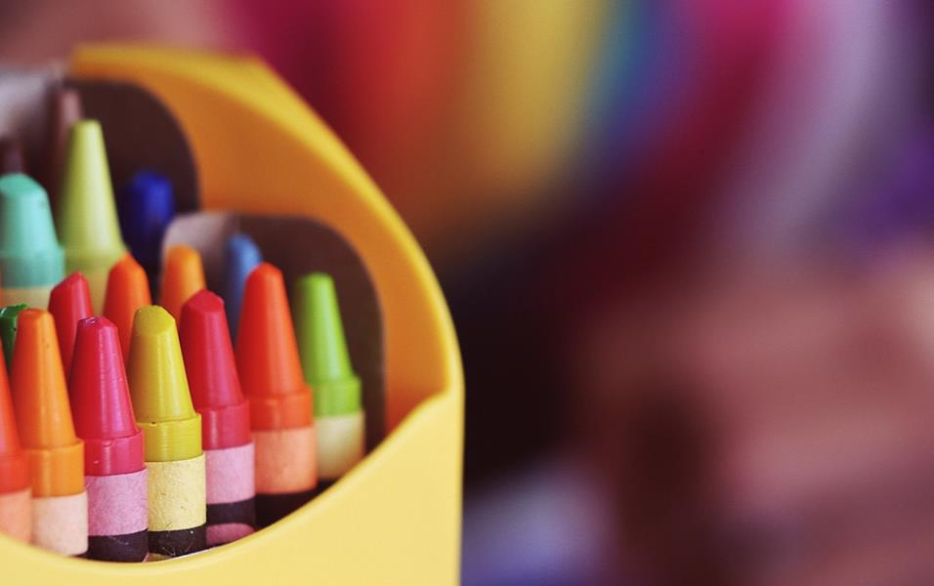
Unit5 What colour is it?
人教精通版·三年级上册
WWW.PPT818.COM

Slide 2
Contents
01
02
03
04
05
Warm-up
Review
Presentation
Practice
Summary
Listen to a wsong
Guessing game
New word and sentences
Choose
Summarise

Slide 3
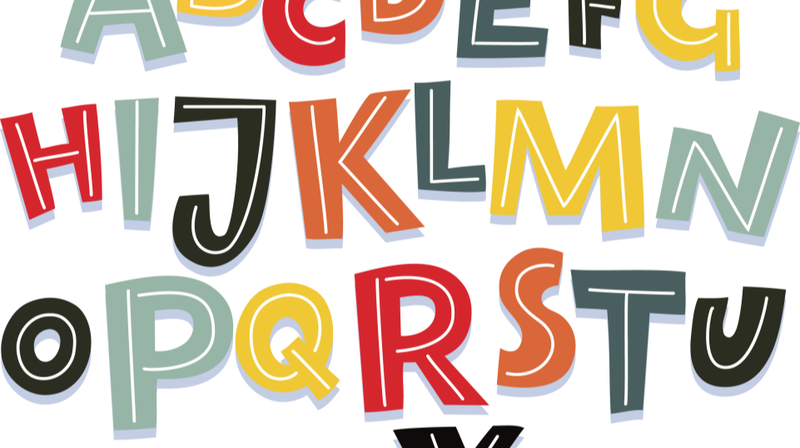
Apple song
Apple round , apple red.
Apple juicy apple sweet.
Apple apple I love you,
Apple sweet I love to eat.

Slide 4
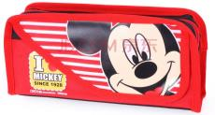
Warm-up
Guess, what's in my bag

Slide 5
Review
What colour is it?
It' s blue.

Slide 6
Presentation
blue
蓝色

Slide 7
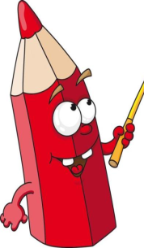
What colour is it?
It' s red.

Slide 8
red
红色

Slide 9
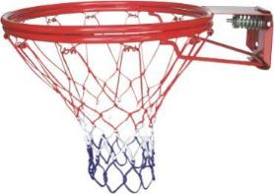
blue
red
3
4
red
blue
1
2

Slide 10
What color is it ?
It's red！
It's blue！
！

Slide 11
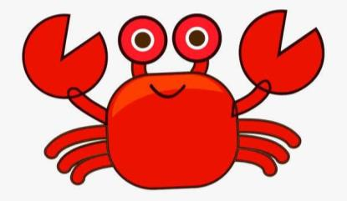
What color is it ?
It's blue！
It's red！

Slide 12
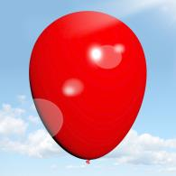
What colour is it?
It's red.

Slide 13
What colour is it?
It's blue.

Slide 14
What colour is it?
It's red.
How nice!

Slide 15
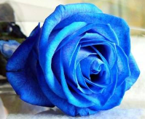
What colour is it?
It's blue.
How nice!

Slide 16
Practice
选择题
1、Choose the blue one（）
2、Choose the red one（）
3、Choose the blue one（）
4、Choose the red one（）

Slide 17
Summary
单词: red blue
句子：What colour is it? It's ...

Slide 18
Thank you!
Goodbye!

