Slide 1
Unit 2
I think that mooncakes are delicious！
第2课时
WWW.PPT818.COM

Slide 2
课内基础自测
Ⅰ.根据句意及汉语提示写出所缺的单词
1．A thief went into the house and ________(偷) some money
from it.
2．—What do you like for ________(甜食)?
—I like ice­cream.
stole
dessert

Slide 3
3．The old man grows some flowers in the ________(花园).
4．I ________ (欣赏) him for his wisdom and bravery.
5．Hou Yi ________(放置) out fruits and desserts in the garden.
garden
admire
laid

Slide 4
Ⅱ.从方框中选出合适的短语，并用其适当形式填空
call out, shoot down, folk story,
lay out, in the shape of
1．Long long ago, there was a man called Hou Yi who once
____________ the nine suns.
2．Look at the birthday cake. It is ____________ a heart. It is so
special.
shot down
in the shape of

Slide 5
Ⅱ.从方框中选出合适的短语，并用其适当形式填空
call out, shoot down, folk story,
lay out, in the shape of
3．The boy helped his parents to ________ the bowls and plates.
4．He ____________ my name, but I didn't hear him.
5．How many ____________ do you know about the
Mid­Autumn Festival?
lay out
called out
folk stories

Slide 6
Ⅲ.根据汉语意思完成句子
1．他们庆祝这个节日已经有三百年的历史了。
They ________ ________ _________ this festival for three
hundred years.
2．不管谁打电话找我，就说我现在正忙。
________ ________ me to answer the phone, tell him I'm
busy.
have been celebrating
Whoever wants

Slide 7
3．饭前洗手是一个好习惯。
________ a good habit ________ ________ hands before meals.
4．在他离开纽约之后，我很想念他。
I missed him so much ________ ________ ________ New York.
5．月亮又亮又圆以至于他能看见自己的妻子在那儿。
The moon was ________ bright and round ________ he could
see his wife there.
It's to wash
after he left
so that

Slide 8
课后巩固提升
Ⅰ.单项选择
( )1.He refused ________ me the truth. I got a little angry
with him.
A．tell B．told
C．telling D．to tell
D

Slide 9
( )2.The hunter used the gun to ________ the birds in the tree.
A．look down B．shoot down
C．write down D．break down
B
[解析]look down意为“向下看”；shoot down意为“射下”；write down意为“写下”；break down意为“出故障”。句意：猎人用枪射下树上的鸟。由句意可知选B。

Slide 10
( )3.The firefighters tried their best to ________ the big forest
fire.
A．lay out B．look out
C．give out D．put out
D

Slide 11
( )4.I can go to the movie ________ I finish my homework, so I
have to finish my homework first.
A．before B．after
C．while D．although
B

Slide 12
( )5.They walked for a long time. They were ________ tired
that they wanted to stop to have a rest.
A．so B．such
C．enough D．too
A

Slide 13
Ⅱ.阅读理解
Here are some special festivals in the world. Have you heard of them?
The Cologne Carnival(科隆狂欢节) It is one of Europe's biggest street festivals. It starts at 11：11 a．m. on November 11 and lasts till February 14 next year. Local people call the time the “crazy” season. During the festival, people put on colorful clothes and play music to celebrate it in the street. Each year, about 1.5 million people take part in it.

Slide 14
Red Wednesday in Iran(伊朗) Red Wednesday is a fire jumping festival in Iran. Fires are lit in public places on the eve of the last Wednesday of the year. People jump over the fire. They hope that it will take all the bad things away.

Slide 15
Day of the Dead It is celebrated in Mexico every year between October 31 and November 2. It's not a scary day like its name, instead, it's a colorful holiday. People believe the spirits of their ancestors(祖先) will return to the world of the living on that day. They share food and drinks to keep the spirits alive and the spirits can be with them in this way.

Slide 16
The Desert Festival in Tunisia(突尼斯) Tunisia is a very important country in North Africa. Every year on the last Sunday in December, the Desert Festival is held in Tunisia. As “ships of the desert”， camels are very important in the festival. There is camel racing and camel wrestling(摔跤).

Slide 17
【主旨大意】 本文主要介绍了世界上几个特殊的节日，即科隆狂欢节、伊朗的跳火节、墨西哥的亡灵节和突尼斯的沙漠节。

Slide 18
( )1.What festival lasts the longest time?
A．The Cologne Carnival.
B．Red Wednesday in Iran.
C．Day of the Dead.
D．The Desert Festival in Tunisia.
A
[解析]推理判断题。由第一栏中的“It starts at 11：11 a．m. on November 11 and lasts till February 14 next year.”可知狂欢节从11月一直持续到第二年的2月。对比其他几个节日的时间，可推断出科隆狂欢节持续的时间最长。

Slide 19
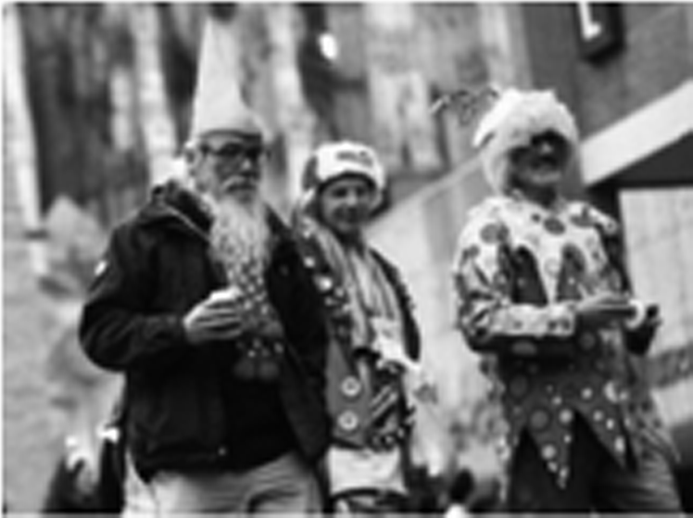
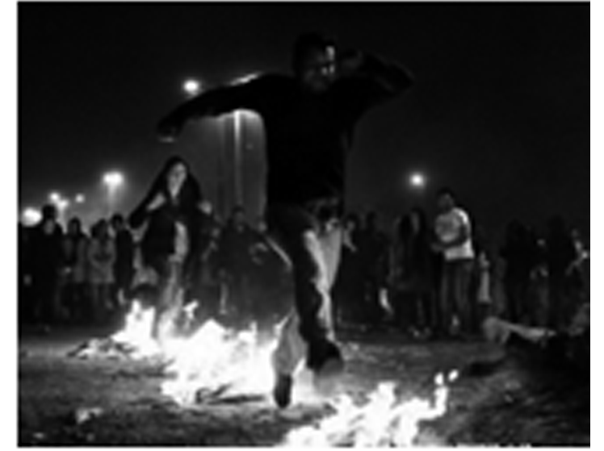
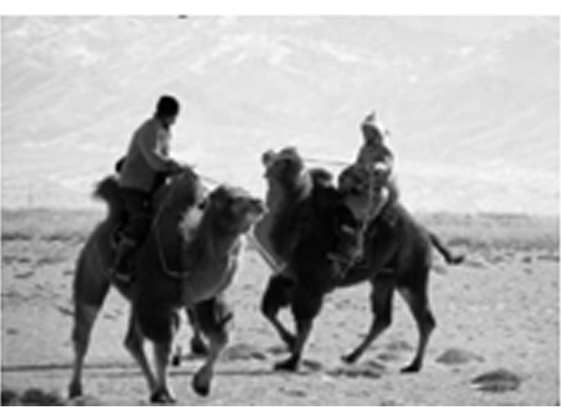
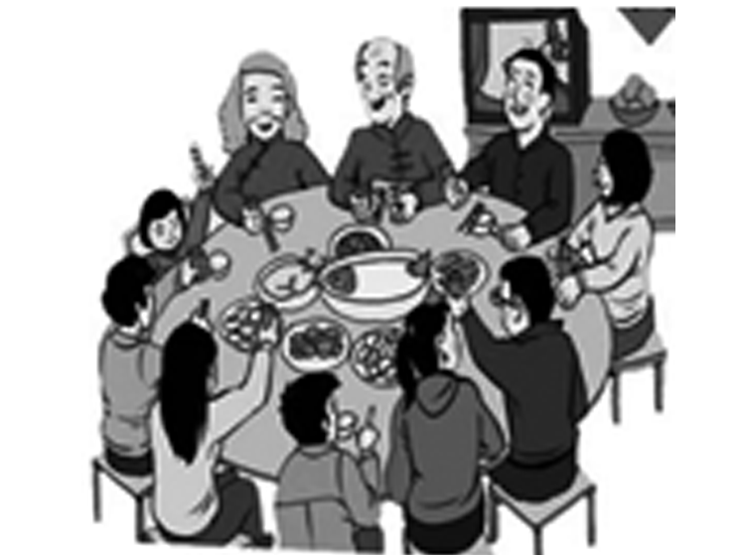
( )2.Which picture is about Red Wednesday in Iran?
A B
C D
B
[解析]细节理解题。由第二栏中的“People jump over the fire.”可知人们跳火，与图画B相符。因此选B。

Slide 20
( )3.Which of the following is NOT true about Day of the Dead?
A．It lasts about three days.
B．It reminds people to think of their ancestors' spirits.
C．It's a colorful holiday.
D．Their ancestors can be with them on that day really.
D
[解析]细节理解题。由第三栏中的“People believe the spirits of their ancestors will return to the world of the living on that day.”可知D项错误。

Slide 21
( )4.When is the Desert Festival in Tunisia every year?
A．On November 11.
B．On the last Sunday in December.
C．On December 31.
D．From October 31 to November 2.
B
[解析]细节理解题。由第四栏中的“Every year on the last Sunday in December…”可知沙漠节在每年的12月的最后一个周日。

Slide 22
( )5.Where can we probably find this passage?
A．In a storybook.
B．In a cookbook.
C．In a travel magazine.
D．In a sports magazine.
C
[解析]主旨大意题。全文主要介绍了几个特殊的节日，最有可能来自旅游杂志。

Slide 23
Ⅲ.2017·安顺 任务型阅读
The Duanwu Festival in China, also called Dragon Boat Festival, is celebrated on day 5 of the fifth month every year according to the Chinese lunar calendar. For thousands of years, this festival has been marked by people's eating zongzi and racing dragon boats. (A)To hold the dragon­boat races is in memory of Qu Yuan. He was one of the greatest poets in ancient China.

Slide 24
Qu Yuan was born in Zigui of Hubei Province over 2，200 years ago. Qu Yuan was an honest minister(大臣)of the State of Chu during the Warring States Period (475—221 BC). He was upright, patriotic(爱国的) and wise. (B)屈原想给自己的祖国带来和平并让它变得更强大。But the country was in the hands of bad officials. He could do nothing to change it and failed. (C) He was very discouraged. At last, Qu Yuan ended his life by throwing himself into the Miluo River.

Slide 25
It is said that people tried to save him by jumping into the river. But it was too late and all their efforts were in vain. Also, they were so sad and they threw rice into the water to feed Qu Yuan's spirit.
Now we read his poem Li Sao which was filled with deep love for his country. We can see the dragon­boat races and have a kind of Chinese food named zongzi to eat during the Dragon Boat Festival.

Slide 26
【主旨大意】 本文介绍了中国的一个传统节日——端午节。这个节日是为了纪念伟大的诗人——屈原。文章也介绍了该节日的传统风俗——吃粽子和看龙舟比赛。

Slide 27
根据短文内容，完成下列任务。
1．请将下画线(A)部分的英文句子译为中文：
__________________________________________________
2．请将下画线(B)部分的中文句子译为英文：
__________________________________________________
__________________________________________________
举办龙舟赛是为了纪念屈原。
Qu Yuan wanted to bring his own motherland/country peace and to make
her/it become stronger.

Slide 28
3．How has the Duanwu Festival been marked by Chinese
people over thousands of years?
___________________________________________________
___________________________________________________
4．请将下画线(C)部分的句子变为由how引导的感叹句：
___________________________________________________
It has been marked by people's eating zongzi and racing dragon boats./
People have marked it by eating zongzi and racing dragon boats.
How discouraged he was!

Slide 29
5. What is the reason why Qu Yuan killed himself in the Miluo
River?
___________________________________________________
___________________________________________________
Because the country was in the hands of bad officials, and he could do
nothing to change it.

Slide 30
谢 谢 观 看！

