Slide 1
111111111111111111111111111111111111111111111111111111111111111111111111111111111111111111111111111111111111111111111111111111111111111111111
Unit 1 Going to Beijing
五年级下册
Lesson 6 Danny Is Lost !
WWW.PPT818.COM

Slide 2
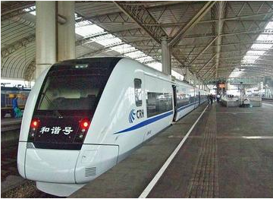
Have you ever taken a train？

Slide 3
Story time
Jenny，Danny，Li Ming and Mrs. Li are going on a trip to Beijing. Mr. Li drive sthem1 to the train station.
Li Ming gets the tickets.
Then they go to the train. They stand beside the train.
Mr. Li says good bye to them.
“Danny ？ Oh，no ！ Where’s Danny ？”says Jenny. “I can’t find Danny！ Danny is lost！”
Mr. Li says，“Don’t worry，Jenny. I can find Danny.”
Mr. Li looks for Danny at the train station. “Danny ！ Danny ！ Where are you，Danny？” he calls.

Slide 4
Story time
There is Danny！ He is buying fruit！
Mr. Li says，“Danny ！ There you are！”
“Hi，Mr. Li！” says Danny. “Do you like these bananas or 3 those bananas ？”
“Danny ！ Don’t buy the bananas！”says Mr. Li. “The train is leaving ！”
Danny runs to the train.
Danny jumps on the train. Jenny says，“There you are，Danny ！”
Mr. Li says，“Have a good trip ！”
“We’ll miss you ！” says Li Ming.
“I’m hungry ！” says Danny.

Slide 5
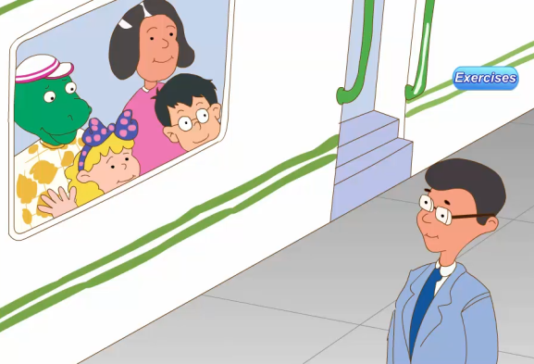
Story time

Slide 6
讲故事是一门古老而值得尊敬的艺术。很多人天生就喜欢讲故事和听故事。本节课就是一则关于大家去火车站坐车，结果丹尼脱队被李先生找回的故事。

Slide 7
能听懂和理解这个简单的故事，并根据故事进行简单的问答活动
完成配套的课后作业。

