Slide 1
Module 4 Life in the future
Unit 2 Every family will have a small plane.
WWW.PPT818.COM

Slide 2
Warming-up
Free talk
In thirty years’ time, …
What will you do?
Where will you live?
Will you be rich or poor?
Will you have an expensive car?
How many children will you have?
Will you be handsome/pretty?

Slide 3
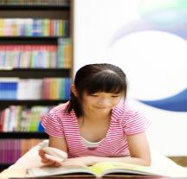
Warming-up
Look and say. Use “will”.
On Sunday she will listen to the music.
On Sunday she will read a book.

Slide 4
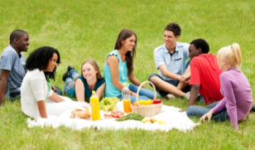
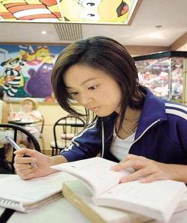
Warming-up
On Saturday they will have a picnic.
On Saturday she will do her homework.

Slide 5
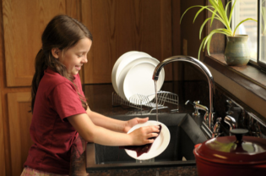
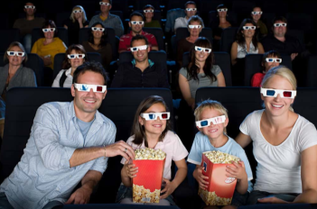
Warming-up
On Sunday she will help with the housework.
On Sunday, they will see a movie.

Slide 6
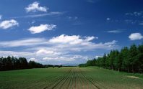
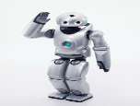
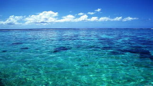
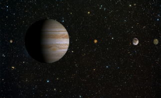
Pre-reading
New words.
air n. 天空；空中；空气
rain n. 雨；雨水
v. 下雨
land n. 陆地
robot n. 机器人
sea n. 海；海洋
space n. 太空；空间

Slide 7
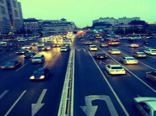
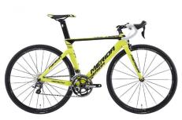
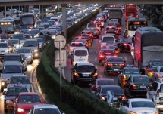
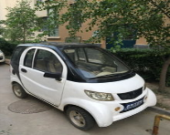
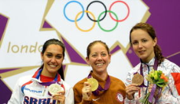
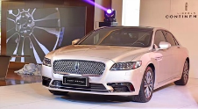
Pre-reading
traffic n. 交通
bike n. 自行车
traffic jam 交通堵塞
￥ 20,000,000
￥1,000
cheap
adj. 便宜的
expensive
adj. 贵重的
come true
实现，成真

Slide 8
Pre-reading
1 Work in pairs. Look at the pictures and describe what you see.
Use the words and expression from the box to help you.
air land job machine rain
robot sea space traffic jam wind

Slide 9
While-reading
2 Read the passage and match the pictures in Activity 1
with the paragraphs.
B
A
C
D

Slide 10
While-reading
Fast reading
3 Read the passage and match the paragraphs with the headings.
1. Weather _________ [ ]
2. Clothes _________ [ ]
3. Jobs _________ [ ]
4. Travel _________ [ ]
B
A
D
C

Slide 11
While-reading
Careful reading
Read Para. A and fill in the blanks.
1. In the future, a change of weather ______ ______ a change
of clothes.
2. Clothes will be ______ when we are cold, and _____ when
we are hot.
won’t mean
warm
cool

Slide 12
Read Para. B and fill in the table.
While-reading
Now | Light rain and _____ _____ in spring.
Future | The weather will be quite _______ or even ____ all year, with ______ rain and _____. The sea level will ______ as well.
cold
wind
warm
hot
heavy
wind
rise

Slide 13
Read Para. C and check (√) the true sentences.
While-reading
1.We won’t travel by bus or bike any more. □
2. Every family will have a big plane. □
3. It will be expensive to travel by plane. □
4. The plane can not only travel over land, but also
over the sea or even into space. □
√
√

Slide 14
Read Para. D and finish the following questions.
While-reading
1. Why will people have long holidays?
__________________________________________
__________________________________________
2. Will people do light and easy jobs?
__________________________________________
Machines and robots will do all the heavy and
difficult jobs and working hours will be short.
Yes, they will.
3. Find out three pairs of opposites in this part.
_______—________ _______—________
_______—________
long
short
heavy
light
difficult
easy

Slide 15
While-reading
4 Check (√) the true sentences.
(1) People have to change clothes in hot weather. □
(2) The weather will be warm in spring. □
(3) A lot of people will travel by plane so
maybe there will be traffic jams in the air. □
(4) People will have long holidays because
machines will do heavy work. □
√
√
√

Slide 16
Post-reading
Cultural Background.
Future
Cities in the Future
There will be some new cities on the sea. The cities on water will have two levels(层级). People will live on the second level; the first level will be used for traffic, shops and factories.
Health in the Future
Many new ways of curing illness will be successful using products of genetic engineering (基因工程) . However, some new illnesses will come out. Maybe at that time, people will live much longer than now and there won’t be any dangerous illnesses.
Food in the Future
Biotechnology(生物技术) will make food better and healthier. The taste of fruit and vegetables will be better and food can be kept longer.

Slide 17
Post-reading
5 Complete the passage with the correct form of the words
from the box.
air cheap everywhere into rise true
Will travel in the future be expensive? No, it’ll be ______________.
We’ll travel (2) ___________ by plane.
We’ll be able to (3) ___________ over the traffic jams on the land, and we’ll be able to go (4) ___________ space.
But maybe there’ll be traffic jams in the (5) ___________ too.
What do you think?
Do you think this idea about life in the future will come (6) ___________?
cheap
everywhere
rise
into
air
true

Slide 18
Post-reading
6 Match the words with their opposites.
easy expensive hot large light long warm
cheap cold cool difficult heavy short small

Slide 19
Post-reading
Language points.
1. The sea level will rise as well. 海平面也会升高。
句中的“as well”表示“也，又”，常用于肯定句末尾。
e.g.She can dance, and sing songs as well. 她既会跳舞，也会唱歌。
拓展：
also意为“也”，放在be动词、助动词、情态动词之后，行为动词之前。
too意为“也”，放在肯定句句末。
either 意为“也”，放在否定句句末。

Slide 20
Post-reading
2. … not only over land, but also over the sea or even into space.
……不仅是在陆地上空飞行，而且还可以飞到海上甚至进入太空。
not only… but also意思是“不仅……而且……”。
若连接两个并列成分作主语，其谓语通常与靠近的主语保持一致，称为就近原则。
e.g.
Not only the students but also the teacher likes the sea.

Slide 21
Post-reading
3. Working hours will be short so people will have long holidays.
(1) 该句的主语是动名词短语working hours，当动名词短语做主语时，
谓语动词要用单数。
e.g. Playing basketball is my favourite sport.
打篮球是我最喜爱的运动。
(2) 句中的so是连词，意为“因此，所以”。在词句中连接两个并列的
分句构成一个并列句。前一个分句表示原因，后一个分句表示结果。
e.g. She felt too tired, so she went to bed early.
她感觉太累了，所以很早就睡了。

Slide 22
Post-reading
8 Look at the sentences.
Working hours will be short. People will have long holidays.
Working hours will be short so people will have long holidays.
Now complete the sentences with so.
(1) Every family will have a plane so…
(2) The weather will get hot so…
(3) Machines and robots will do the heavy and difficult jobs so…

Slide 23
Post-reading
Possible answers.
(1) Every family will have a plane so travel will be fast.
(2) The weather will get hot so we won’t need warm clothes.
(3) Machines and robots will do the heavy and difficult jobs
so we will have more time.

Slide 24
Post-reading
Exercise.
一、根据括号内所给内容将下列句子改为一般将来时。
1. People in the north often go skating in winter. (next winter)
2. There are two cinemas in that town. (next year)
People in the north will go skating next winter.
There will be two cinemas in that town next year.
3. He comes back late. (in two days)
He will come back in two days.

Slide 25
Post-reading
Exercise.
二、单项选择题。
1. She sings and plays the piano ____.
A. two B. also C. as well D. either
2. Not only my friends but also I ____ interested in football.
A. be B. am C. is D. are
3. ____ English aloud is a good way to learn English.
A. Read B. Reads C. Reading D. Sang
C
B
C

Slide 26
Post-reading
Exercise.
三、根据汉语提示完成句子。
1. 我相信你的想法会实现的。
I’m sure your idea will ________ ________.
2. 他不但会讲汉语，而且会讲英语。
He can speak ______ ______Chinese, ______ ______ English.
3. 因为车辆太多，现在大街上经常有交通阻塞。
Now there are often ________ ________ in the street because of
too many cars.
4. 将来的生活将会是怎样？
What will life be like ______ ______ ________?
come
true
not
only
but
also
traffic
jams
in
the
future

Slide 27
Summary
What + be+某物+like…? ……怎么样？
come true （希望，梦想等）实现成真
mean v. 意味着
a kind of 一种……
light rain 细雨
heavy rain 大雨；暴雨
as well 也 ，又
cheap adj. 便宜的

Slide 28
Homework
1. Try to retell the passage in Unit 2.
2. Preview Unit 3.

Slide 29
Goodbye!

