Slide 1
Unit 8 Culture Shapes Us
Home to Many Cultures
WWW.PPT818.COM

Slide 2
学习目标
1. To review some words about countries and people.
2. To learn about expressions of describing numbers.
3. To learn about how to describe numbers and different cultures.

Slide 3
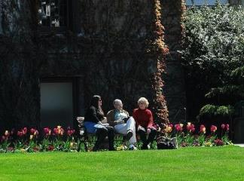
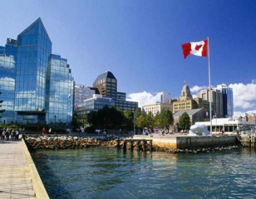
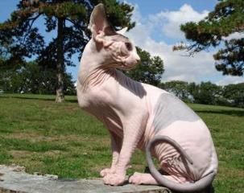
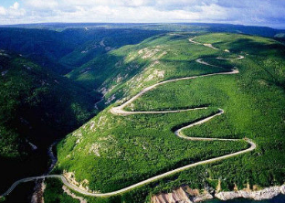
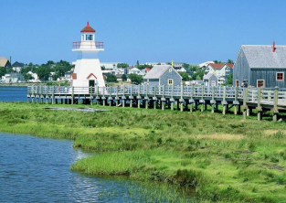
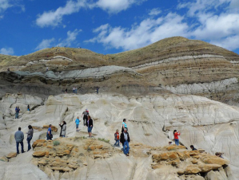
Warming up
加拿大风光

Slide 4
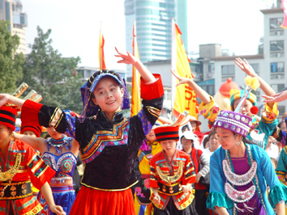
Why are there different cultures in one country?
Talk about it

Slide 5
New words
1. percent n. 百分之......
2. central adj. 中部的，中间的
3. immigrant n. 移民
4. according to prep. 根据；依据
5. official adj. 官方的；正式的
6. custom n. 习惯；习俗；风俗

Slide 6
Read and answer the questions:
Reading
1.What percent of Canadians are from the First Nations?
2. What languages do most immigrants to Canada speak?
Three percent.
The language of their first country and English or French.

Slide 7
Reading
3. Why are there many cultures in Canada?
4. What’s the Canadian way of understanding the world?
Because many immigrants from every part of the world come to Canada.
It’s that people should respect and accept one another and help one another.

Slide 8
Language points
1. The rest are from every part of the world: Asia, Africa, Central America, South America and other European countries.
rest n. 表示“剩余部分”，可以指人，也可以指物，常用搭配为：the rest of the +名词。
当 the rest 或 “the rest of the +名词” 作主语时，谓语动词的数要与 the rest 所表示的名词的数保持一致。

Slide 9
Language points
2. According to a survey, the number of European immigrants dropped from 90 percent to 25 percent, .......
1) according to… “根据......”，后加名词或代词，用作状语,多用于句首。
2) the number of“......的数量”，作主语时，谓语动词使用单数形式。

Slide 10
Fill in the blanks with correct forms of the given words.
Exercise
1. He came back from_______(Canada) three years ago, but he keeps in touch with his_________(Canada) friends.
2. If you could travel to only one__________(Europe) country, which one would you choose?
3. He wonders what this means for the future of________(Asia) markets.
Canada
Canadian
European
Asian

Slide 11
Exercise
4. Understanding cultural __________(difference) is very important for companies involved in international business.
5. I’d like to take you to our city’s_______(centre) park.
differences
central

Slide 12
Exercise
用所给词的适当形式填空。
1. The rest of his life _____ (be) spent in the United States. The rest of students in our class ___________ (pass) the exam already.
2. He ___________ (respect) by everyone for his honesty.
3. Our teacher told us that the earth _____ (go) around the sun.
4. Mike invited me ______ (see) a film this evening.
is
have passed
is respected
goes
to see

Slide 13
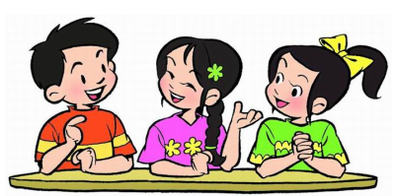
Discussion
Imagine that you come from Canada, this is your first time to China. This is a good chance to talk with your Chinese friends.
(About your nation, culture, way of understanding or living habits)

Slide 14
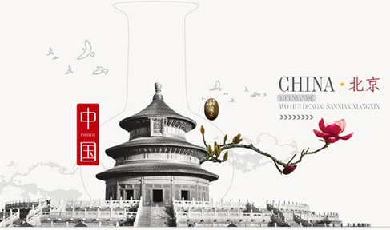
Work in groups. List some Chinese traditional customs. Try to find some similarities and differences between Chinese and other cultures.
Project

Slide 15
Homework
Write an e-mail about some similarities and differences between China and Canada.

