Slide 1
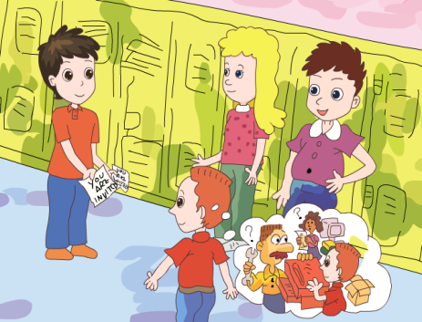
人教版八年级上册
Unit 9
Can you come to my party?
Section A（第2课时）
WWW.PPT818.COM
0

Slide 2
1. 运用Can you come to …?句式进行问答，能发出、接受或拒绝邀请。 2.学会有礼貌地拒接别人，并阐述合适的理由。 3.掌握以下句型： I’m not sure. I might… Sorry, I have to… Sorry, I can’t. I must… I don’t know. I might have to…
学习目标
0

Slide 3
自学互研
新词自查
根据句意及汉语提示完成句子
1. I won’t go to the party if she didn’t invite (邀请) me.
2. My parents told us not to accept (接受) other one’s gifts.
3. Lin Tao invited me to his home but I refused (拒绝).

Slide 4
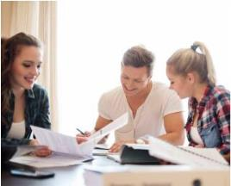
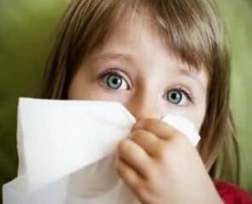
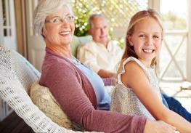
情景导入
Ask and answer
A: Can you… ?
B: Sure, I’d love to.
A: How about you ? Can...?
C: Sorry, I can’t. I must …
go to the doctor
prepare for the exam
have the flu
visit my grandparents

Slide 5
3a Complete the answers with might and one of the phrases in the box.
watch TV
on the weekend
my cousin
visit my grandparents
practice the violin

Slide 6
1. A: What are you going to do on Saturday?
B: I’m not sure. I might__________________ 2. A: What are you planning to do after school?
B: I don’t know._________________________
3. A: When will you finish the science homework?
B: _____________________________________ 4. A: Who are you going to the movies with?
B:______________________________________
5. A: Are you free to come to my place on Saturday?
B: ______________________________________
practice the violin.
I might watch TV.
I might finish it on the weekend.
My cousin might go to movies with me.
Sorry, I might visit my grandparents.

Slide 7
3b Complete the sentences below. Use the words in brackets to help you.
Inviting: (can / play tennis)
_____________________________________________
Accepting:____________________________________ 2. Inviting: (would like to/ go to the movies)
Reason:(might have to)
_____________________________________________
Refusing : ____________________________________
Can you come to play tennis?
Sure, I’d love to.
Would you like to go to the movies?
Sorry, I might have to go to the doctor.

Slide 8
3. Inviting: (can/hang out with us tonight)
Reason: (must)
______________________________________________
Refusing: _____________________________________
4. Inviting: ( would like to/come to my birthday party)
______________________________________________
Accepting:_____________________________________
Can you hang out with us tonight?
No, I can’t. I must meet my friends.
Would you like to come to my birthday party?
Sure. That sounds great.

Slide 9
3c Write down everything you have to do next week. Choose a day and time to have a party. Then invite classmates to your party.
Mon.
Tue.
Wed.
Thur.
Fri.
Sat.
Sun.
A: Can you come to my party?
B: When is it?
A: Next week, on Thursday night.
B: I’m sorry. I have to study for a math test.

Slide 10
Read the Grammar Focus.
Can you come to my party on Saturday? | Sure, I’d love to. Sorry, I must study for a math test.
Can you go to the movies tomorrow night? | Sure. That sounds great. I’m afraid not. I have the flu.
Can he go to the party? | No, he can’t. He has to help his parents.
Can she go to the baseball game? | No, she’s not available. She must go to the doctor.
Can they go to the movies? | No, they’re not free. They might have to meet their friends.

Slide 11
Conclusion
表示邀请的句型:
Can you …
接受邀请:
拒绝邀请:
Sure, I’d love/like to.
Sure. That sounds good/great.
I’m sorry, I can’t. I have to/must …
/I’m v.-ing…
I’m afraid not. I have to/must …

Slide 12
Make dialogues
A:Can you …?
B: When is it ?
A: Next week, on Thursday night.
B: Sure, I’d love to./I’m sorry. I have to study for a math test.
Mon. | go fishing
Tue. | go horseback riding
Wed. | visit the museum
Thur. | exercise
Fri. | see a movie
Sat. | study for a test
Sun. | have a piano lesson

Slide 13
Summary
Make invitations
Decline invitations
Sorry, I can’t. I have to...
I’m sorry. I must...
Accept invitations
Sure. That sounds good.
Sure, I’d love to.

Slide 14
问题探究
▲who are you going to the movies with?你和谁一起去看电影？
Who是主格形式，其宾格形式是whom。
辨析：who与whom
Who在句中作主语或表语，可以对人提问。如：Who came here just now(作主语)谁刚刚来这儿了？Who is that young woman?(作表语)那个年轻的女人是谁？
Whom 是who的宾格形式，只能出现在从句里面或是介词（如to， from，at，of）后面，在口语中常用who来代替whom作宾语。
导练：To whom is she talking? 她正在和谁说话？

Slide 15
▲ invite的用法
1）invite sb. to do sth邀请某人做某事
2）invite sb. to some place邀请某人去某地
拓展：invite的名词形式是invitation，其常用短语如下：send out an invitation（to sb.）向某人发出邀请；give sb.an invitation邀请某人；receive an invitation收到邀请；accept an 接受邀请；refuse/turn down sb.’s invitation拒绝某人的邀请。
导练：1）He invites me to have dinner with him 他邀请我和他一起吃晚餐。
2）Mr. Hand invited us to his factory this weekend

Slide 16
课堂评价
一、选择正确的词
1.Thank you for (ask/ asking), but I can’t go to the movies with you.
2.Paul has to study (at/ for) the math test tonight.
3.My sister has too (much/ many) homework to do.
4. Can you come to my party (at/ on) Saturday night?
5. She invites me (watch/ to watch) the basketball match the day after tomorrow.
6. I like playing (piano/ the piano).
asking
for
much
on
to watch
the piano

Slide 17
二. 对话填空。每空一词，单词的首字母已给出。
A: Hey, Xiao Wang, can you go to the m_______ on Saturday?
B: I’m s______, I can’t. I have too much h___________ this weekend.
And I’m not f________ well today.
A: That’s too b____. What’s the matter?
B: I’m not sure. Maybe I have a c______, as I’m feeling a little cold.
A: I think you’d b_____ go to the d_______.
B: I also t______ so.
A: Maybe I’m asking you to come another time.
B: Sure. T______ for asking.
ovies
orry
omework
eeling
ad
old
etter
octor
hink
hanks

Slide 18
三、选择题
1. Can you play tennis with on Saturday ?
A. us B. we C. our D. ours
2. Henry his homework this afternoon.
A. have to do B. have to doing
C. has to do D. has to doing
3. Tony is playing tennis the school team.
A. on B. in C. to D. with
4. Jim play soccer with his friend this weekend, because he is very busy.
A. can B. cans C. cann’t D. can’t

Slide 19
5. — ?
—It’s October the 14th.
When is today B. what’s today
C. What time is today D. What day is today
6. He is with his father the whole day.
A. fish B. fishes C. to fish D. fishing
7. —Can you come to my party?
— .
A. Sure, I love B. Sure, I love to
C. Sure, I’d love to D. Sure, I’d love.

Slide 20
8. —Would you like to play football with us?
—____________, but I’m busy.
A. No, I can’t B. No, I wouldn’t
C. Yes, I’m glad D. Yes, I’d love to
9. —___________I take the newspaper away?
—No, you mustn’t. You ______ read it only here.
A. Must; can B. May; can
C. Need; must D. Must; must

Slide 21
Homework
Write an invitation based on the following information.
It’s a Birthday Party
For whom:
Time:
Place:
Come and have fun!
Lucy
Friday, July 15, at four thirty
Lucy’s house, 15th Street

