Slide 1
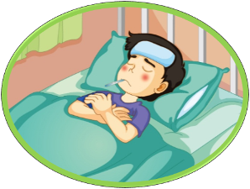
Unit 4 What’s wrong with you?
人教精通版英语五年级下册
WWW.PPT818.COM

Slide 2
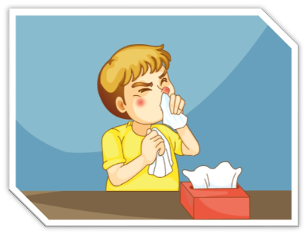
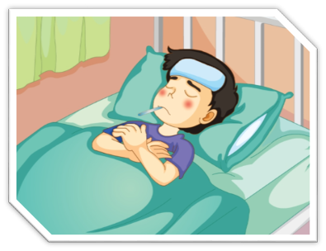
>>Warm-up
Let’s review
have a bad cold
have a fever

Slide 3
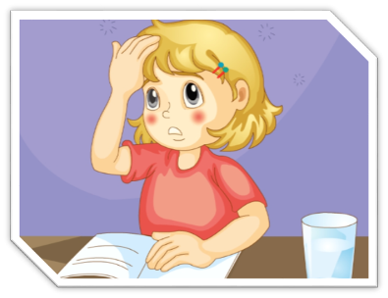
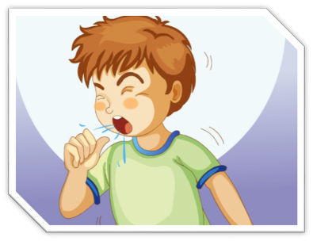
>>Warm-up
Let’s review
have a headache
have a cough

Slide 4
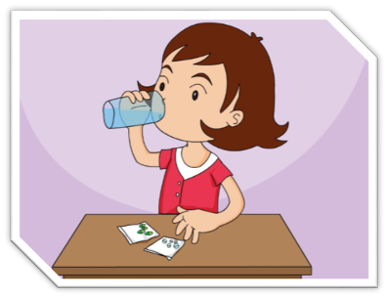
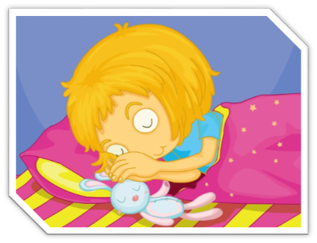
>>Warm-up
Let’s review
take some medicine
take a good rest

Slide 5
>>Lead-in
What’s wrong with you?
I have …
Can I go to school tomorrow?
No. You should…

Slide 6
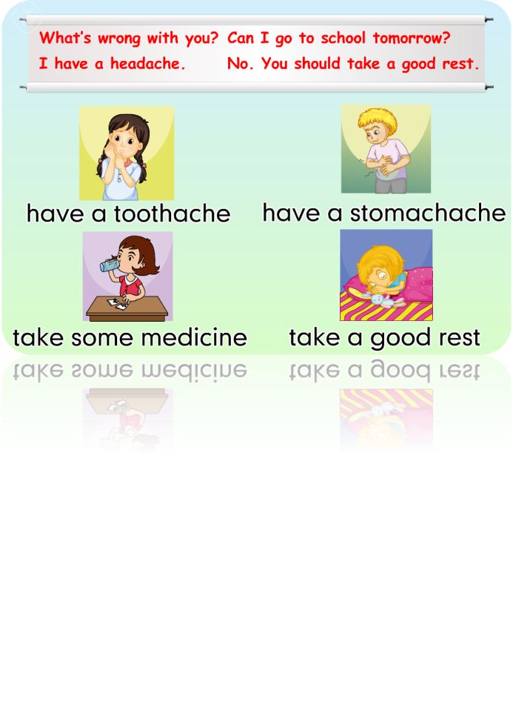
>>Presentation
Just practise

Slide 7
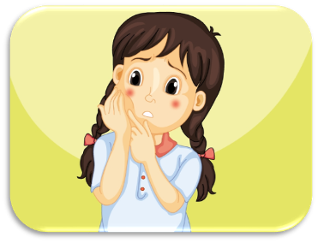
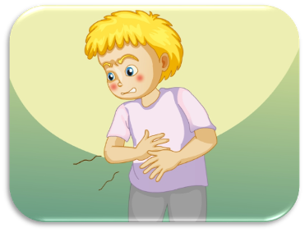
>>Presentation
Just practise
have a toothache
have a stomachache

Slide 8
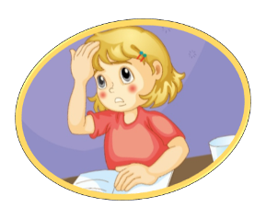
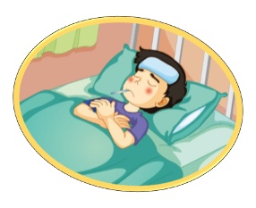
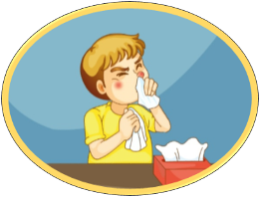
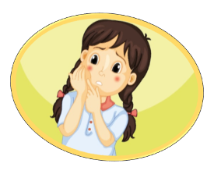
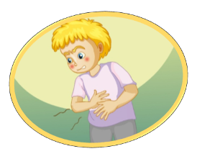
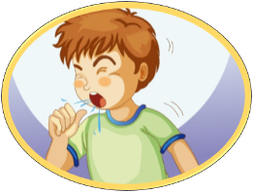
>>Practice
I have a…
headache
bad cold
fever
toothache
cough
stomachache

Slide 9
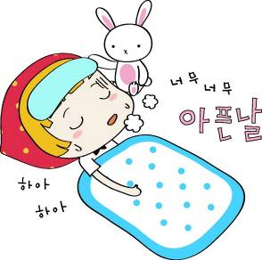
>>Practice
headache
bad cold
toothache
fever
What’s wrong with you?
stomachache
cough
No. You should…
I have a fever.
Can I go to school tomorrow?

Slide 10
>>Practice
Just write
wrong
错的
with
和……一起
head
face
头
脸
ear
耳朵
arm
胳膊
What’s wrong with you?
I have a headache.

Slide 11
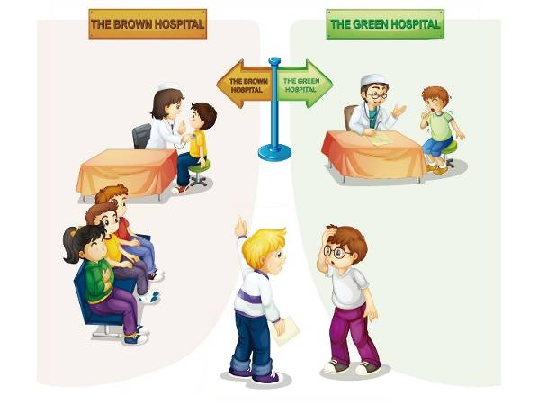
>>Practice
Let’s act
Group Work
What’s wrong with you?
I have a cold.
I have a cough.
Where is…?

Slide 12
>>Presentation
Let’s sing

Slide 13
>>Summary
重点词组：
have a toothache
have a stomache
如何询问和回答病情？
--- What’s wrong with you?
--- I have a fever and a headache.
如何建议对方吃药和休息？
You should take some medicine and take a good rest.

Slide 14
>>Homework
1. 观看课文动画，按照正确的语音、语调朗读课文。
2 .熟读Let’s chant部分。
3 . 预习Lesson23。
close

