Slide 1
Unit4 Where do you work?
人教精通版五年级上册
WWW.PPT818.COM

Slide 2
>>Warm-up
Let’s sing

Slide 3
>>Review
Play a game
快速抢答
job

Slide 4
>>Lead-in
Look and say
What’s her job?
She is a teacher. She works in a school.
work

Slide 5
>>Presentation
Look and say
Now you are a teacher. Where do you work?
I am a teacher. I work in a school.

Slide 6
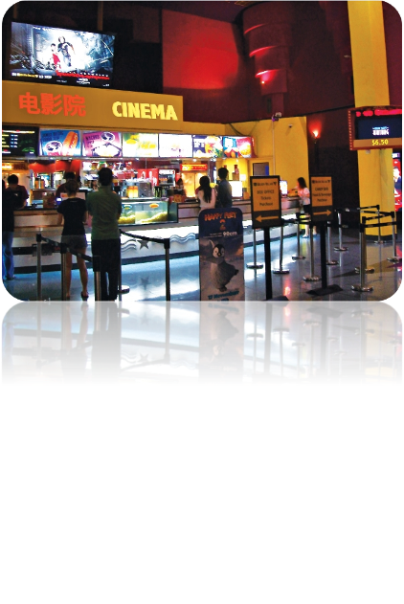
>>Presentation
Look and say
Where do you work?
cinema
I work in a cinema.

Slide 7
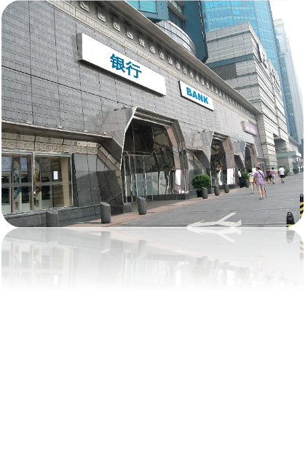
>>Presentation
Look and say
Where do you work?
bank
I work at the Bank of China.

Slide 8
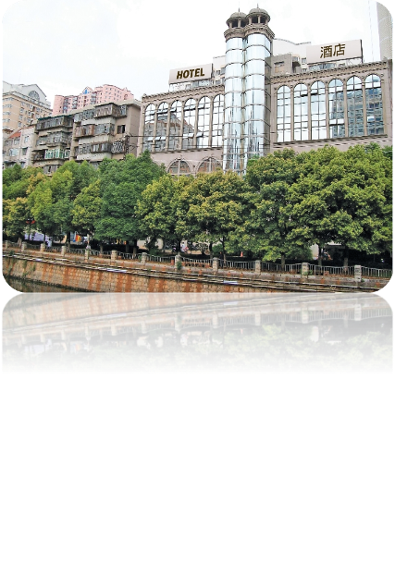
>>Presentation
Look and say
Where do you work?
hotel
I work in a hotel.

Slide 9
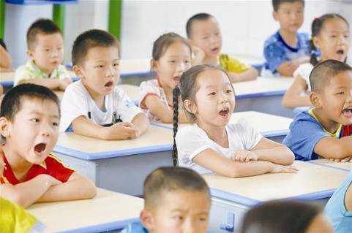
>>Presentation
Look and say
You are students. You study in our school.
study

Slide 10
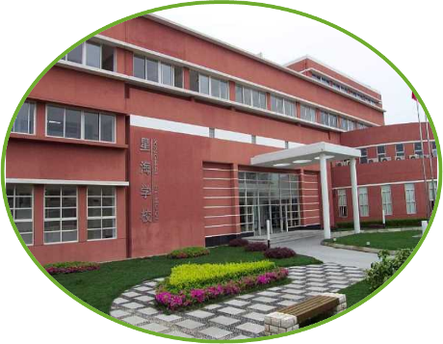
>>Presentation
Look and say
Where do you study?
I study at Xinghai School.

Slide 11
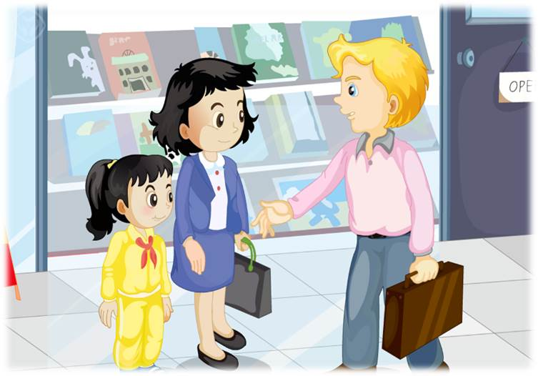
>>Presentation
Let’s watch

Slide 12
>>Presentation
1. Where does Mrs Wu work now?
2. Where does Mr White work now?
3. Where does Mrs Wu’s daughter study now?
Read and answer
She works in Beijing Cinema.
He works at the Bank of China.
She studies at Sunny School.

Slide 13
>>Presentation
Just talk
Listen and imitate
Mr White: Hi, Mrs Wu! Nice to see you again.
Mrs Wu: Nice to see you, too!
Mr White: Where do you work now?
Mrs Wu: I work in Beijing Cinema. How about you?
Mr White: I work at the bank of China.
Mr White: How about your daughter? Where do you
study now?
Daughter: I study at Sunny School.

Slide 14
>>Practice
Read it by yourself for one minute .
自读对话一分钟。
一分钟倒计时
60
Learning tip :
10
10
50
自己读对话，比一比看谁能在一分钟内读完，并且读得准确、流利！
20
20
40
30
30
开始

Slide 15
>>Practice
Show time
小组合作，练习对话并表演，其他同学评价。
Pronunciation (语音) |  | Fluency (流利) | Cooperation (合作)
OK!
Great!
Super!

Slide 16
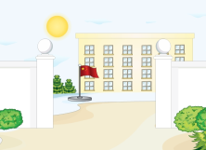
>>Practice
Look and match

Slide 17
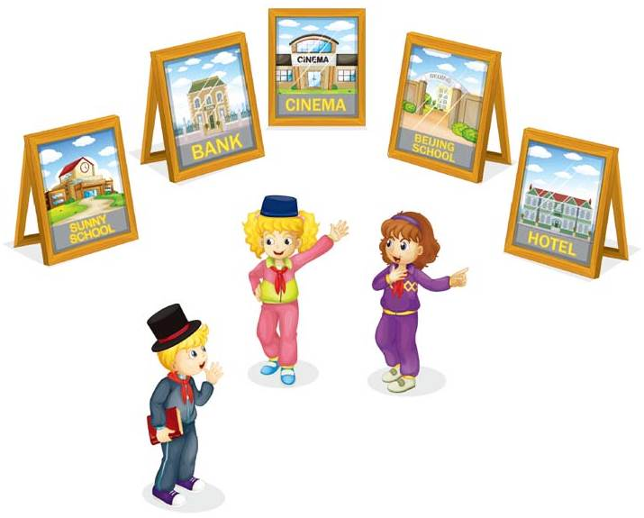
>>Practice
Let’s act
2
I study at Beijing School.
1
4
Where do you study?
I work in a hotel.
3
Where do you work?

Slide 18
>>Practice
活动
Group work
首先，每位学生为自己设计一个身份卡片，如： I’m _______. I work _________. 然后，以小组为单位，组长将组员的卡片收上来，打乱顺序发给不同的学生，学生根据自己手中的卡片内容，自选搭档进行对话练习，如：—What’s your job? —I’m a ____. —Where do you work? —I work in a _____.
a worker
in a factory

Slide 19
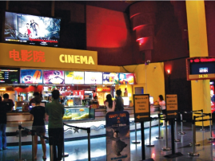
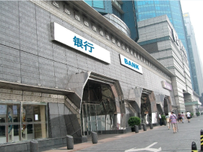
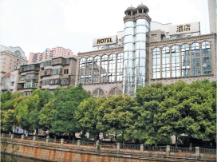
>>Summary
本课的重点单词：
hotel
cinema
bank

Slide 20
>>Summary
如何询问他人工作和学习近况？
—Where do you work/study now?
—I work/study in/at …

Slide 21
>>Homework
1.观看课文动画，按照正确的语音、语调朗读课文对话。 2.查找更多与学过职业相关的工作场所。并将其英语表达记录在生词本中，或做成图文并茂的手抄报，与同学们共享。
3.预习 Lesson 21。

