Slide 1
Module 8 Story time
Unit 1 Once upon a time…
WWW.PPT818.COM

Slide 2
Warming-up
Look and say
Boys and girls, do you like fairy tales? How many fairy tales (童话故事) do you know? Can you say the names of these fairy tales?
?

Slide 3
Warming-up
Look and say
?

Slide 4
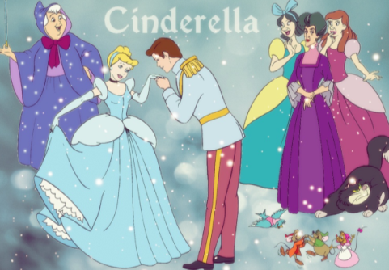
Warming-up
Look and say
?

Slide 5
Warming-up
Look and say
?

Slide 6
Warming-up
Look and say
?

Slide 7
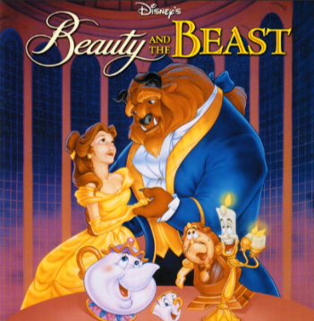
Warming-up
Look and say
?

Slide 8
Warming-up
What’s your favourie story?

Slide 9
Pre-listening
Words & Phrases
hair
gold
forest
once upon a time
decide
go for a walk
n. 头发
n. 金色；黄金；金牌
n. 森林
从前
v. 决定
散步
basket
notice
all alone
dark
pick up
n. 篮子
v. 注意到
独自一人的
adj. 黑暗的
拿起；举起

Slide 10
Pre-listening
Words & Phrases
soon
lost
around
little
towards
knock
door
adv. 立刻；不久
adj. 迷路的
prep. 环绕着；围绕
adj. 小的
prep. 往；向；朝……方向
v. 敲
n. 门
v. 应门；回答
v. 推
v. 进入
n. 碗
adj. 感到饿的；饥饿的
adj. 合适的；恰当的
v. 吃完；喝完；用尽
answer
push
enter
bowl
hungry
right
finish

Slide 11
Pre-listening
1 Listen and check (√) the true sentences.
1) The story is Goldilocks and the Three Bears. ( )
2) The story begins: Once upon a time… ( )
3) Goldilocks was a girl with hair of gold. ( )
4) Goldilocks lived in the forest. ( )
5) She decided to go for a walk in the park with
her basket. ( )
√
√
√
near
forest

Slide 12
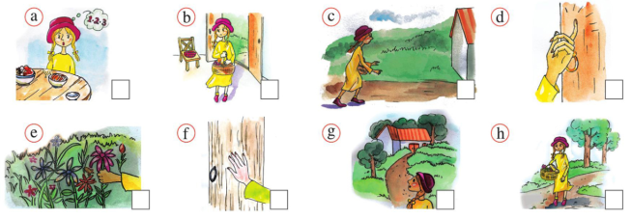
Pre-listening
2 Look at the pictures and answer the questions.
basket decide forest gold hair story
Who was Goldilocks?
Where was she?
What did Goldilocks
notice?

Slide 13
While-listening
3 Listen and number the pictures in Activity 2 in the
correct order.
8
7
4
5
1
6
3
2

Slide 14
Post-listening
4 Answer the questions.
1) Did she pick any flowers in the forest?
2) Did she notice a big tree in the forest?
3) Was the door open?
Yes, she picked some flowers.
No, she noticed a little house.
No, Goldilocks pushed the door and then it was open.

Slide 15
Post-listening
4 Answer the questions.
4) Was there food in the bowls?
5) Did she want to eat the food?
6) Did she like the big bowl?
Yes, on a table there were three bowls with some nice food in them.
Yes, she did.
No, she didn’t.

Slide 16
Post-listening
Language points and grammar points
1. All alone in the dark, dark forest, Goldilocks picked some flowers. 金凤花姑娘独自一人走在漆黑的森林里，摘了一些花。
alone adj. 独自的；单独的
adv. 独自
She left school alone. 她独自一人离开了学校。
辨析：alone和lonely
它们作形容词时都可以作表语。alone侧重于独自一人，无他人在场；lonely 作形容词时表示“孤独的”，用于人时，指心理状态，也作定语，修饰地点，意为“荒凉的”。

Slide 17
Post-listening
2. And soon she was lost. 很快她迷路了。
be lost 迷路=get lost
3. … so she hurried towards it, …
……所以她赶快向房子走去……
hurry v. 赶紧；急匆匆
后跟地点名词时，应接“介词to+地点名词”的结构，即“匆匆赶往某地”；后跟地点副词时，省略介词to。
n. 匆忙；急忙
in a hurry 匆忙

Slide 18
Post-listening
一般过去时 The simple past tense
定义
表示过去某个时间里发生的动作或存在的状态，也表示过去经常性、规律性、习惯性的动作或者状态或者主语过去所具备的能力和性格。
构成
1. 主+was/were+表语
2. 主+动词过去式+(宾语)
3. 主+could/had to等＋动词原形

Slide 19
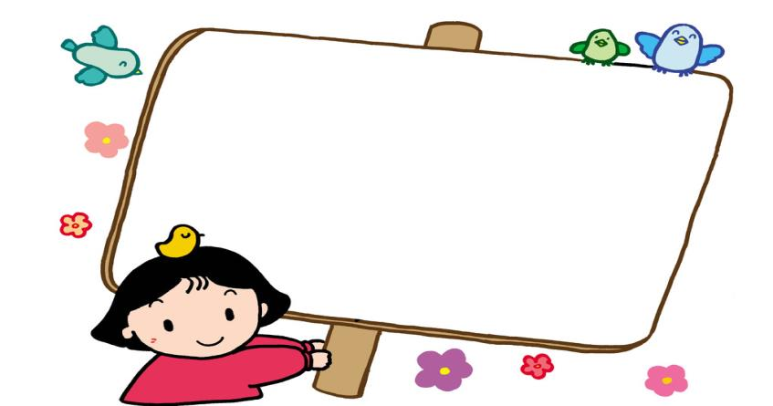
Post-listening
实义动词的一般过去时形式变化
否定形式：主语+did (do/does的过去式) not (即didn’t)+动词原形+其他.
一般疑问句：Did+主语+动词原形+其他?
答语：Yes, 主语+did.
No, 主语+didn’t.

Slide 20
Post-listening
5 Complete the passage with the correct form of the words from the box.
around bowl dark enter knock nobody pick push towards
One day Goldilocks walked into the forest and (1) _______ some flowers. It was very (2) _______ and soon she was lost. She looked (3) _______ her, and saw a little house, and she walked (4) _______ it. Then she (5) _______ on the door, but there was (6) _______ in. She (7) _______ the door and (8) _______ the house. There were three (9) _______ on the table, a small one, a big one and a very big one.
picked
dark
around
towards
knocked
nobody
pushed
entered
bowls

Slide 21
Post-listening
6 Listen and notice the different ways the speaker says the words.
/t/ | /d/ | /ɪd/
finished knocked liked noticed picked pushed stopped | answered entered hurried lived | decided
Now listen again and repeat.

Slide 22
Post-listening
规则动词过去式的变化及发音
1. 一般情况下加ed，如finished, knocked, picked, pushed。
2. 以不发音字母e结尾的加d，如liked, moved, tasted。
3. 以辅音字母加y结尾的变y为i再加ed，如study——studied。
4. 以1个元音字母加1个辅音字母结尾的重读闭音节，双写最后一个辅音字母再加ed，如stop——stopped。

Slide 23
Post-listening
词尾读音有3种：
1. 在浊辅音和元音后读[d]，如lived, watered, listened, played。
2. 在清辅音后读[t]，如liked, helped, watched。
3. 在[t],[d]音后读[ɪd]，如planted, wanted, handed。

Slide 24
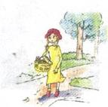
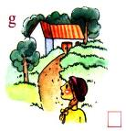
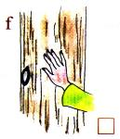
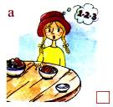
Post-listening
7 Listen and repeat.
1) Goldilocks walked into the forest.
2) She noticed a little house.
3) She knocked on the door.
4) She liked the food.

Slide 25
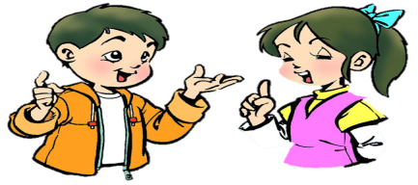
Post-listening
8 Work in pairs. Tell the story.
Once upon a time…there was a little girl called Goldilocks. She lived near a big forest. She had hair of gold...
How does the story begin?

Slide 26
Post-listening
Test
一、汉译英。
从前
散步
独自一人的
拿起；举起
环顾四周
once upon a time
go for a walk
all alone
pick up
look around

Slide 27
Post-listening
二、写出下列动词的过去式。
is/am ________ plant _________ hurry _________
are _________ does _________ dance _________
worry ________ ask _________ decide _________
finish ________ like _________ pick _________
stop _________ push _________
was
planted
hurried
were
did
danced
worried
asked
decided
finished
liked
picked
stopped
pushed

Slide 28
Post-listening
三、句型变换。
1 There was a car in front of the house just now.
否定句：_______________________________________________
一般疑问句:____________________________________________
肯定回答：_____________________________________________
否定回答：_____________________________________________
2 They played football in the playground.
否定句：_______________________________________________
一般疑问句：___________________________________________
肯定回答：_____________________________________________
否定回答：_____________________________________________
There wasn’t a car in front of the house just now.
Was there a car in front of the house just now?
Yes, there was.
No, there wasn’t.
They didn’t play football in the playground.
Did they play football in the playground?
Yes, they did.
No, they didn’t.

Slide 29
Summary
1. 词汇：hair, gold, forest, basket, notice, dark, soon, lost, around, little, towards, knock, door, answer, push, enter, bowl, hungry, right, finish
2. 句型：
(1) There be…肯定和否定形式 (2) Once upon a time…
(3) Who was Goldilocks? (4) Where was she?
(5) What did Goldilocks?
(6) —Did she often go for a walk in the forest alone?
—No, she didn’t.
(7) One bowl was small, one was big and one was very big.
3. 语法：一般过去时
4. 语音：动词 + ed /t/ /d/ /ɪd /

Slide 30
Homework
1.Tell a story to your friends.
2. Review the conversation in Unit 1.
3. Preview the new words and expressions in Unit 2.

Slide 31
Goodbye!

