Slide 1
Unit 7
International charities
Task
WWW.PPT818.COM

Slide 2
_{Charity show}
Amy wants to write about the work of an
ORBIS nurse called Diana for her class
Presentation. She found these pictures of Diana.

Slide 3
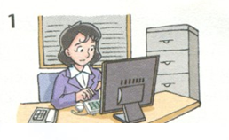
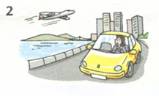
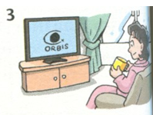
Diana was a secretary of a company.
She was afraid of flying.
She learnt about ORBIS.

Slide 4
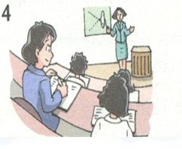
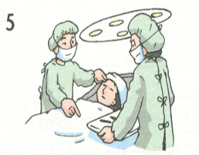
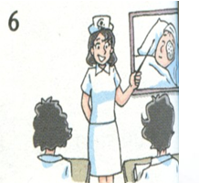
She trained as a nurse.
She works for ORBIS.
She enjoys her work.

Slide 5
B Amy wrote a report on Diana and her
charity work. Read Amy's report.
Diana was once a secretary of a big company. She lived in a comfortable flat and drove to work. She travelled to many places, but she seldom took the plane. She was afraid of flying.
One day, Diana saw a TV programme about ORBIS. She learnt about the Flying Eye Hospital. She wanted to help poor people with eye problems see again, so she made up her

Slide 6
mind to train as a nurse and attended courses after work.
Diana is working for ORBIS now. She has to travel over 300 days a year. She is getting used to travelling by plane.
Diana enjoys her work. She is glad to be able to help people see again. She does not have as much money as before, but she thinks her life is more meaningful.

Slide 7
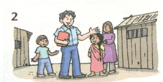
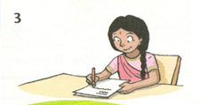
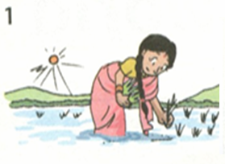
C You want to write a report on the work
of UNICEF. Search for information on the
internet. You can also use the information
below. Use Amy's report as a model.

Slide 8
Name: Mandeep
Country: India
Family: many children, poor
In the past: used to work on the farm all day,
could not read or write
One day: a UNICEF officer came and
learnt about the conditions of
the local people
Now: entered a school, can read and write
Future: hopes to become a teacher

Slide 9
According to Amy's report, try to make a chart flow like this:
Diana used to
work…
travel…
one day
now
Diana thinks
I think

Slide 10
According to the information on part C, can you make a chart flow ?
Mandeep used to
get up…
one day
now
Mandeep hopes
I think

Slide 11
According to the chart flow, write a report on Mandeep’s life!
Try to finish it within 5 minutes!
Read your report out!

Slide 12
Sample writing
Mandeep used to get up at 5 a.m. every morning. She was born in India. She worked on the farm all day, planting rice in the hot sun. Her family was very poor. Mandeep did not go to school so she was unable to read and write.
One day, a UNICEF worker came to her village. He said it was important for children to get an education. He wanted all children in the village to learn to read. He gave Mandeep some school books and she was very happy.

Slide 13
Now, Mandeep goes to school every day. She can read and write. She enjoys school and is grateful to UNCEF for helping her.
Mandeep says that she hopes to be a teacher.
I think that it is sad that some children are too poor to go to school. If children learn to read and write, they will have a better future. Mandeep is lucky that she was helped by UNICEF. We are so lucky that we can come to school every day. I hope to work for UNICEF when I finish school.

Slide 14
Discussion
Do you want to work for a charity?
Which one do you prefer in the future, working for a charity or having an ordinary job?
( * People working for a charity are not paid well.
* Some are volunteers and do not get paid at all. Others work for very little money.)

Slide 15
Language points
She wanted to help poor people with eye
problems see again, so she made up her mind to
train as a nurse and attended courses after work.
她想帮助有眼疾的病人重见光明，于是她决定
接受护士培训，并在下班后去上课。
make up one’s mind to do sth 意思是“作出决定，
下定决心做某事。如：
I hope you can make up your mind quickly.

Slide 16
2. She is getting used to travelling by plane.
她习惯乘飞机往来各地。
Be/get used to sth. /doing sth. 意思是“习惯于，
适应”。如：
I find the job tiring at first, but I am used to
it now.
起初我觉得这份工作很累人，但是现在习惯了。

Slide 18
Homework
Review the main language points and
important structures learnt in this unit.

Slide 19
Thank you!

