Slide 1
Can you come to my party?
WWW.PPT818.COM

Slide 2
Revision
1. Write down these phrases.
prepare for …
1) 为……做准备 ______________
2) 得了流感 _____________
3) 去见朋友 ________________
4) 当然，我愿意去 _______________
5) 太多作业 ___________________
have the flu
meet the friends
Sure. I’d love to.
too much homework

Slide 3
6. 对不起，我没空。
______________________
7. 直到……才 _____________
8. 闲逛 ___________
9. 明年见______________________
Sorry. I’m not available/free.
not … until
hang out
See/Catch you next year.

Slide 4
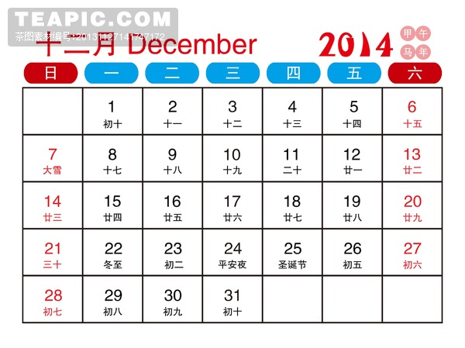
calendar
1st,2nd,3rd
21st,22nd,23rd

Slide 5
Write the dates for this week on the
calendar.
1a
Sunday the ______ | Monday the ______ | Tuesday the ______ | Wednesday the ______
Thursday the ______ | Friday the ______ | Saturday the ______
28th
29th
30th
31st
1st
2nd
3rd

Slide 6
weekdays:
weekend:

Slide 7
Write these words below the correct
dates on the calendar in 1a.
1b
today tomorrow yesterday
the day before yesterday
the day after tomorrow weekday weekend

Slide 8
Sun. | Mon. | Tue. | Wed. | Thu. | Fri. | Sat.
the day before yesterday,
weekday
the day after tomorrow, weekday
today, weekday
weekend
weekend
yesterday, weekday
tomorrow, weekday

Slide 9
周一至周五的任一天_________ 周末________
周一___________ 周六___________
周二___________ 周日___________
周三___________ 昨天___________
周四___________ 今天___________
周五___________ 明天___________
前天 _____________________
后天 _____________________
weekday
weekend
Monday
Saturday
Tuesday
Sunday
Wednesday
yesterday
Thursday
today
Friday
tomorrow
the day before yesterday
the day after tomorrow

Slide 10
What’s the date today?
It’s December 31st.
What day is it today?
It’s Wednesday.
What’s today?
It’s Wednesday the 31st.
What’s the time?
It’s 11 a.m.
Wednesday
十二月
31

Slide 11
单项填空:
--- What’s today?
--- ________.
A. It’s Tuesday B．It’s January 1st
C. It’s sunny today
D. It’s Wednesday the second

Slide 12
--- ______
--- It’s September 10th.
A. How is it today? B. What’s today?
C. What day is it today? D. What’s the date?

Slide 13
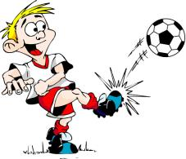
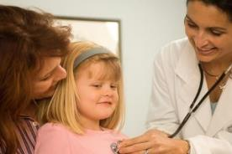
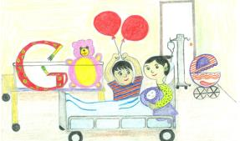
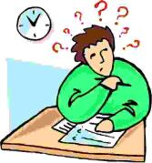
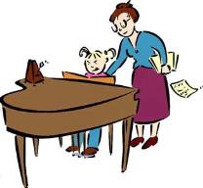
选词配图：
look after his sister, go to the doctor, have a piano lesson, play soccer, study for a test
1
2
3
4
5

Slide 14
1d
Listen. Can Vince play tennis with Andy? Circle Yes or No.
Vince’s activities | Days
____ play soccer | a. today b. tomorrow c. the day after tomorrow
____ go to the doctor
____ study for a test
____ have a piano lesson
____ look after his sister
Yes No
b

Slide 15
1e
Listen again. Match Vince’s activities with the days in 1d.
Vince’s activities | Days
____ play soccer | a. today b. tomorrow c. the day after tomorrow
____ go to the doctor
____ study for a test
____ have a piano lesson
____ look after his sister
b
a
a
b
c

Slide 16
have a piano lesson 上钢琴课
与have有关的短语：
have a lesson 上课 have a try 试一试
have a (good) rest 休息 have a look 看一看
have a good time 玩得愉快 have meals 吃饭
have breakfast / lunch/ dinner/ supper
吃早饭/午饭/晚饭

Slide 17
1f
Pair work
A: Hi, Vince. can you play tennis with me?
B: When?
A: Today.
B: Sorry, I can’t. I …

Slide 18
A: Hi, Vince?
V: Yeah, hi, Andy!
A: Vince, can you play tennis with me?
V: Uh, when?
A: Today.
V: Uh, no, sorry, I can’t. I have to go to the doctor and study for a test today.

Slide 19
A: How about tomorrow?
V: Sorry, tomorrow I’m playing soccer
and I have a piano lesson.
A: Oh. Well, what are you doing the day
after tomorrow?
V: I have to babysit my sister.
A: Oh, I see.
V: I’m sorry, Andy. I’m really busy this
week!

