Slide 1
Mother’s Day
WWW.PPT818.COM

Slide 2
English name: Linda
Favourite colour:
Family member:
father, mother, husband,
baby and I

Slide 3
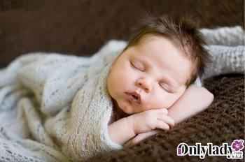

Slide 4
pretty
care
prepare
准备

Slide 5
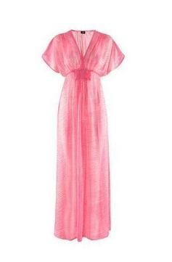
surprise 惊喜

Slide 6
?
Ann
Jacky

Slide 7
Listen and choose
What is Jacky going to do for his mother?
He’s going to _____. Then he will _____.
A
C
A. buy some food B. buy flowers
C. cook supper
2. What is Ann going to do on Mother’s Day?
She’s going to _____.
B
A. do some housework B. make a card
C. make a model plane

Slide 8
What are the presents?
在对话中找出关键词，把它们画出来。

Slide 9
A: Today is Mother’s Day. I’m going to …
What are you going to do for your mother?
B: I’m going to …
Then I will …
A: Why(为什么) are you going to …?
B: Because my mother …
A: I think your mother will be very happy.
B: Thank you. I hope it will be a big surprise.

Slide 10
Fill in the blanks.
Today is _______ Day. Jacky is going to buy some ______ on his way home. Then he will cook for
______. His mother is very ______. She takes care of Jacky day and night. So Jacky wants to do some _________ for her.
Ann is going to make a ______, and write “Thank you, Mum. I love you!” on it. She’s going to put it under her mother’s ______. That will be a ______ surprise.
Mother’s
food
supper
kind
housework
card
pillow
big

Slide 11
Homework
Read the dialogue fluently.
Do something for your parents and write it down.
(用4-5句话写写你打算为父母做的事。)
3. Surf on the Internet about Mother’s Day.

