Slide 1
Unit 6 Topic 3
I will remember our friendship forever.
Section C
WWW.PPT818.COM

Slide 2
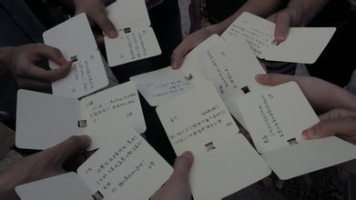
send cards to each other

Slide 3
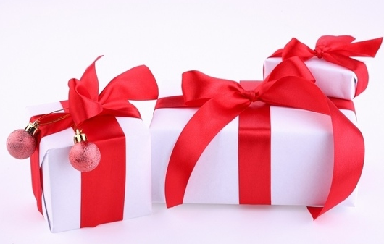
exchange gifts

Slide 4
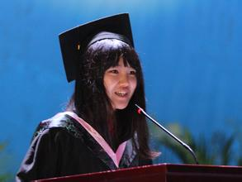
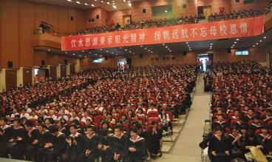
give a graduation speech
have a graduation ceremony

Slide 5
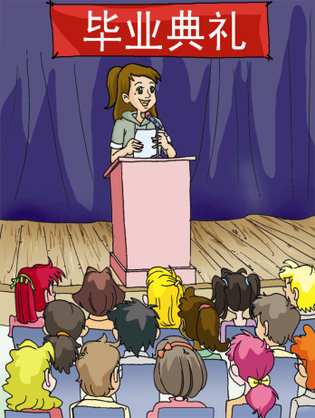
Let’s have a speech!

Slide 6
Pair work
Discuss in pairs what event may happen on the day of the graduation ceremony and note down you ideas.

Slide 7
1b Read 1a and answer the following
questions.
1. What is a graduation ceremony?
2. Where is it usually held?
3. Why is it both exciting and sad for the graduates?
4. What does graduation mean according to the passage?

Slide 8
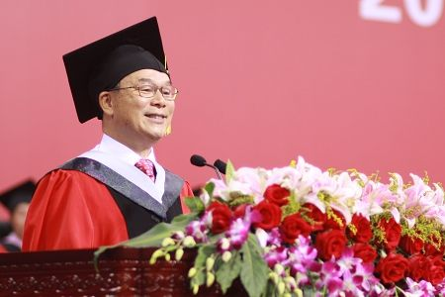
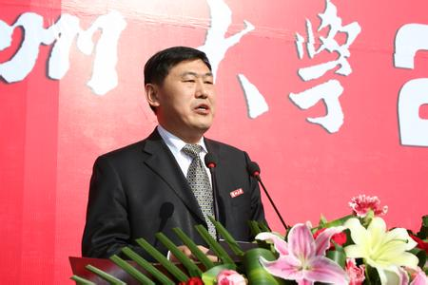
The graduation ceremony is very important for us. The principal will give us a speech.

Slide 9
We will receive a document called “diploma” at the graduation ceremony.

Slide 10
What is a graduation ceremony?
2. Where is it usually held?
3. Why is it both exciting and sad for the graduates?
4. What does graduation mean according to the passage?
A graduation ceremony is a custom which takes place when students graduate from a school.
It is usually held in a big hall or in the open air.
Because it marks the end of a period in a student’s school life and it is time for them to say goodbye to their classmates.
It means change, and leaving unforgettable faces and places behind.

Slide 11
1c Read 1a again and match the words with their
meanings.
principal A. a piece of paper that a student
receives when he has completed
all the courses successfully
diploma B. head of a school
relative C. a member of your family
possibility D. the fact that something might happen

Slide 12
Key points
A graduation ceremony is a custom which takes place when students graduate from a school.
定语从句，修饰custom；而when引导的时间状语从句包含在该定语从句中。

Slide 13
Key points
It is also sad, because the time when they studied with friends has come to an end.
已经结束
eg： Their studies have come to an end.

Slide 14
Key points
Graduation means change, and leaving unforgettable faces and places behind.
leave … behind 永久离开，留在记忆深处
毕业意味着变化，意味着把那些不能忘却的面容和地方留在记忆深处。

Slide 15
2 Complete Kangkang’s diary with the correct forms of the
following words or phrases.
learn take go back have a great time
hard graduate see...off keep in touch with
Friday, July 1st Sunny
The graduation ceremony is over. We will leave school soon. I feel very excited because I am one of the best ________. At the same time, I am a little sad because I have to say goodbye to my classmates and teachers. I want ______ some photos with them and I will give some gifts to my teachers as well. In the past three years, I _____________ in Beijing
graduates
to take
had a great time

Slide 16
International School. I __________ not only how to study, but also how to be a man. In the future, I will work much _____. I hope I can be an astronaut when I grow up.
Maria, Jane and Michael __________ to their hometowns tomorrow and I will ___ them ___ at the airport. We will _______________ each other by sending e-mails, making telephone calls or writing letters. We will be good friends for ever. I wish my classmates and teachers health, happiness and good luck.
have learned
harder
will go back
see off
keep in touch with

Slide 17
Written work
You are leaving school soon. How do you feel and what will you say to your teachers and old friends? Write a short passage about it.
How you feel | What you will say
I feel thankful. … | Thank you for helping me with my math. …

Slide 18
You can write like this:
I’m leaving school soon. I feel thankful for my teachers and friends. Thanks to their help, I have made great progress in my studies. I have spent 3 fantastic years with them and those wonderful memories will live with me forever. I’ll also express my special thanks to my friends Michael, Maria and Jane. They’ve helped me a lot with my English. But I may not see them in the future. This makes me a little sad. In the future, I’ll study much harder to realize my dream—to be a scientist.

Slide 19
Summary
Learn some new words and phrases:
principal, document, diploma, congratulate,
period, possibility, anniversary, come to
an end
2. Learn to talk about the feelings about
farewells.
3. Learn some information about graduation.

Slide 20
Homework
What kind of graduation ceremony would you like? Think about it, and then write down your ideas.

