Slide 1
Unit 2
How often do you exercise?
Section B 2a-2e
WWW.PPT818.COM

Slide 2
Review
Tina and Bill:
1.How often do you exercise?
2.How often do you eat fruit?
3.How many hours do you sleep every night?

Slide 3
2a
Rank these activities according to how often you think your classmates do them (1=most often, 6= least often).
1
watch TV
go to the movies
play computer games
exercise or play sports
use the Internet
go camping in the country
2
5
2
3
4
6

Slide 4
Words review
result
percent
online
television
although
through
mind
n. 结果；后果
n. 百分之……
adj.&adv. 在线(的)；联网(的)
n.电视节目；电视机
conj. 虽然；尽管；即使
prep.以；凭借；穿过
n.头脑；心智

Slide 5
Words review
body
such
such as
together
die
writer
dentist
magazine
n.身体
adj.&pron.这样的；那样的；类似的
例如；像…… 这样
adv. 在一起；共同
v. 消失；灭亡；死亡
n.作者；作家
n.牙科医生
n.杂志；期刊

Slide 6
Words review
however
than
more than
almost
none
less
less than
point
adv.然而；不过
conj.&prep.(用以引出比较的第二部分)比
多于
adv. 几乎；差不多
pron. 没有一个；毫无
adv.较少；较小
adj.&pron.较少的；更少的
少于
n.得分；点

Slide 7
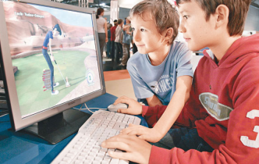
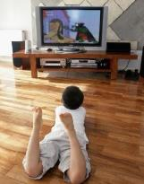
Let’s do a survey.
What do you do in your free time? Doing exercise, use of the Internet or watching TV?
What activities do you think is healthy for the mind and the body?

Slide 8
Reading
Read the passage quickly and find the answer to the questions below.
How many kinds of free time activities are mentioned（提到）in the passage?
__________________________________
2. What is the best way to relax?
__________________________________
Three.
The best way to relax is through exercise.

Slide 9
2b Read the article
What Do No.5 High School Students Do in Their Free Time
Last month we asked our students about their free time activities. Our questions were about exercise, use of the Internet and watching TV. Here are the results.
We found that only fifteen percent of our students exercise every day. Forty-five percent exercise four to six times a week. Twenty percent exercise only one to three times a week. And twenty percent do not exercise at all!
We all know that many students often go online, but we were surprised that ninety percent of them use the Internet every day. The other then percent use it at least three or four times a week. Most students use it for fun and not for homework.

Slide 10
The answers to our questions about watching television were also interesting. Only two percent of the students watch TV one to three times a week. Thirteen percent watch TV four to six times a week. And eighty-five percent watch TV every day! Although many students like to watch sports, game shows are the most popular.
It is good to relax by using the Internet or watching game shows, but we think the best way to relax is through exercise. It is healthy for the mind and the body. Exercise such as playing sports is fun, and you can spend time with your friends and family as you play together. And remember, “old habits die hard”. So start exercising before it’s too late!

Slide 11
Read the second paragraph, fill in the blanks:
______ %
every day
15
20
______ %
no exercise
20
______ %
1-3 times
a week
______ %
4-6 times a week
45
Exercise

Slide 12
Read the third paragraph, fill in the blanks:
______ %
3 or 4 times a week
10
______ %
every day
90

Slide 13
Read the forth paragraph, fill in the blanks:
______ %
4-6 times a week
______ %
1-3 times a week
13
2
______ %
every day
85
Watch TV

Slide 14
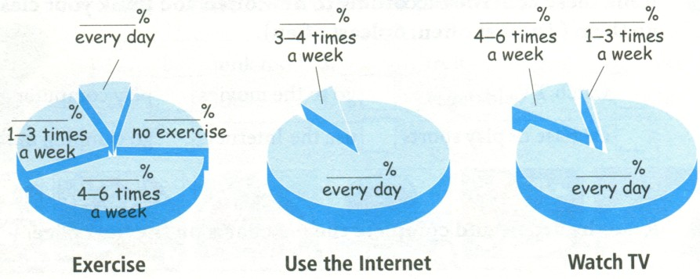
Complete the pie charts.
15
10
13
2
20
20
45
90
85
4 times a week

Slide 15
2c Read the article again and answer
the questions.
1.How many students do not exercise at all?
2.How many students use the Internet every day?
3.How often do most students watch TV? What do
they usually watch?
20% students do not exercise at all.
90% students use the Internet every day.
Most students watch TV every day. They usually
watch game shows.

Slide 16
4.What does the writer think is the best way to relax? Why?
5.Do you think the students at No.5 are healthy? Why or why not?
Exercise, because it is healthy for the mind and
the body.
No , I don’t think so.Because they watch TV more
and exercise less.

Slide 17
2d Write sentences with percentages using always, usually or sometimes.
1. 90%:________________________________
2. 85%:________________________________
3. 45%: ________________________________
4. 10%: ________________________________
5. 13%: ________________________________
6. 2% : ________________________________
Ninety percent students always use the Internet.
Eighty-five percent of students always watch TV.
Forty -five percent of them usually exercise.
Ten percent of them sometimes use the Internet.
Thirteen percent of them sometimes watch TV.
Two percent of them sometimes watch TV.

Slide 18
Language points
1. She says it’s good for my health.
她说它对我的健康有益。
1)此句为宾语从句, says后面跟的从句
的时态必须和主句中谓语动词时态
保持一致, 都用一般现在时。
2) be good for 对……有好处

Slide 19
例如：
Vegetables are good for our health.
蔬菜对我们的健康有益。
Junk food are not good for our
health.
垃圾食品对我们的健康有害。

Slide 20
2. only one to three times a week
每周只有一到三次
注意这种表达, “to”为介词。
翻译：
1) 两到三次。
two to three times.
2) 每月四到五次。
four to five times a month.

Slide 21
3. The answers to our questions about watching television were also interesting.
对我们提出的有关看电视的问题的答案也挺
有意思。
1）句子主语为 the answers ，故谓语用 were。
2） 表示“…的答案”要用“answer to…”
如：
There’s no easy answer to this problem.
这个问题没有简单的答案。
Her answer to your question is a big “NO”!
她对你所提的问题的答案是一个大大的“不”字！

Slide 22
3）表示“有关…的（问题）”用question about…
如：
He asked us some questions about our daily habits.
他问了一些有关我们日常习惯的问题。
Her questions about you were not so friendly.
她有关你的那些问题并不那么友善。

Slide 23
4.Although many students like to watch sports, game shows are the most popular.
虽然很多学生喜欢看体育节目，但游戏类节目是最受欢迎的。
although 为连词，意为：“虽然，尽管”。
注意：在英语中，当表示“虽然…，但是….”这样的意思时，although和but不能在同一个句子中使用。也就是说，在一个句子中，有although就没有but ，反之亦然。如：
Although the car is old , it still runs well.
=The car is old , but it still runs well.
这辆小车旧了，但是依然跑得不错。

Slide 24
5. So start exercising before it’s too late!
所以赶紧锻炼起来，不要等到来不及了。
It’s too late 字面意思为“为时太晚，来不及了”
是英语的一个常用表达。如：
Now you know you are wrong , but it’s too late.
你现在知道错了，已经太晚了。
句中， It’s too late 与before共同组成从句，表示“不要等到为时已晚；不要等到来不及的时候；
趁还来的及”。如：
You should work harder before it’s too late to catch up.你现在用功还赶得上。

Slide 25
6. But my mother wants me to drink it
want to do sth. 想要做某事
want sb. to do sth. 想要某人做某事
Do you want to go to the movies with me?
你想和我一起去看电影吗？
The teacher doesn’t want us to eat
hamburgers.
老师不想让我们吃汉堡包。

Slide 26
Choose one of these free time activities or think of your own. Then ask your classmates how often they do this activity and make a pie chart.
2e
How often do you play sports?
1-3 times a week.
Every day.
How often do you read books?

Slide 27
Group work
How often do you…? | Numbers of classmates (总40)
1-3 times a week
4-6 times a week
every day
20
10
10

Slide 28
______ %
4-6 times a week
______ %
every day
25
25
______ %
1-3 times a week
50
Play sports

Slide 29
Thank You!

