Slide 1
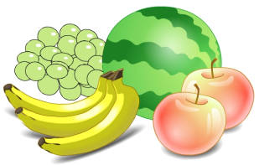
Unit6 It’s a grapefruit.
人教精通版五年级上册
WWW.PPT818.COM

Slide 2
>>Warm-up
Let’s sing

Slide 3
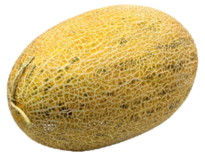
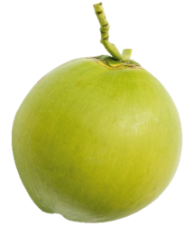
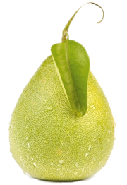
>>Warm-up
Let’s review
?
?
hami melon
?
coconut
grapefruit

Slide 4
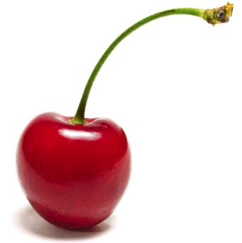
>>Presentation
Look and say
What’s this?
cherry
It’s a cherry.

Slide 5
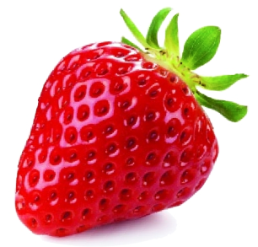
>>Presentation
Look and say
What’s that?
It’s a strawberry.
strawberry

Slide 6
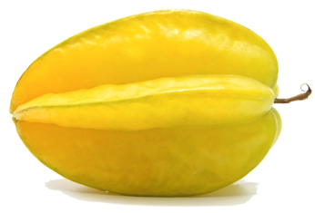
>>Presentation
Look and say
star
+
fruit
star fruit（杨桃）
It’s a star fruit.

Slide 7
>>Practice
Game1
大小声
hami melon
coconut
grapefruit
star fruit
cherry
strawberry

Slide 8
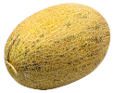
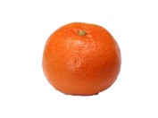
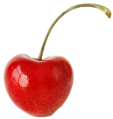
>>Practice
Game2
魔法大转盘

Slide 9
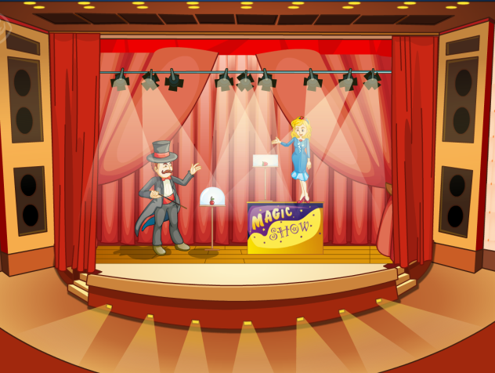
>>Presentation
Just talk
Let’s watch

Slide 10
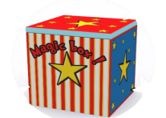
>>Presentation
Key points
Is this a cherry?
Yes, it is.

Slide 11
>>Presentation
Key points
Is that a cherry, too?
No, it isn’t. It’s a strawberry.

Slide 12
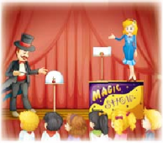
>>Presentation
Just talk
Listen and imitate
Magician: Look, everyone! What’s this?
Children: Is that a cherry?
Magician: Yes, it is. And what’s that?
Children: Is that a cherry, too?
Magician: No, it isn’t. It’s a strawberry.

Slide 13
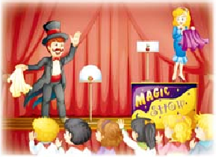
>>Presentation
Just talk
Listen and imitate
Magician: Look, everyone. What’s this?
Magician: Look, boys and girls. What’s this?
Children: It’s a strawberry.
Magician: And what’s that?
Children: Wow! That’s a cherry.

Slide 14
>>Practice
Read it by yourself for one minute .
自读对话一分钟。
一分钟倒计时
60
Learning tip :
10
10
50
自己读对话，比一比看谁能在一分钟内读完，并且读得准确、流利！
20
20
40
30
30
开始

Slide 15
>>Practice
Show time
小组合作，练习对话并表演，其他同学评价。
Pronunciation (语音) |  | Fluency (流利) | Cooperation (合作)
OK!
Great!
Super!

Slide 16
>>Practice
Look, say and match
q y t o q o v m s
h c k a t l n x t
s o h m l p e a r
e c f k u e c e a
f o d h j a o k w
g n a w e c r a b
p u f r g h f s e
g t t l m s p d r
l e m o n e l o r
i l k c h e r r y

Slide 17
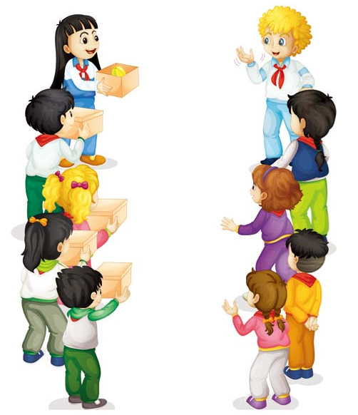
>>Practice
Let’s play
3
You’re wrong.
2
1
Is this a peach?
Yes, it is.
No, it isn’t.
You’re right.
5
7
Is that a cherry?
4
Is that a star fruit?
6

Slide 18
>>Practice
活动
Do a survey
四人一组，调查小组成员最喜欢吃的食物及水果。
Name
fruit
food

Slide 19
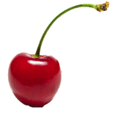
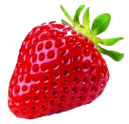
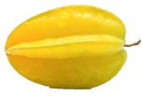
>>Summary
本课新学习的水果类单词有：
cherry
strawberry
star fruit
本课学习的重点句型：
—Is this/ that …?
—Yes, it is. / No, it isn’t.

Slide 20
>>Homework
1.观看课文动画，按照正确的语音、语调朗读课文对话。 2.查找书籍或网络，制作一份有关中国地方特产水果的手抄报。
3.预习 Lesson 35。

