Slide 1
Unit6 Lesson3
She works in a hospital.
WWW.PPT818.COM

Slide 2
Let's chant!
Teacher, farmer, doctor;
She’s a super teacher;
He’s a super farmer;
She’s a super doctor;
Teacher, farmer, doctor;
Super, super, super.

Slide 3
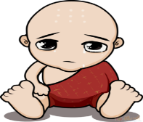
Listen and answer
How many jobs are there mentioned
in the text?
文中提到了几种工作？

Slide 4
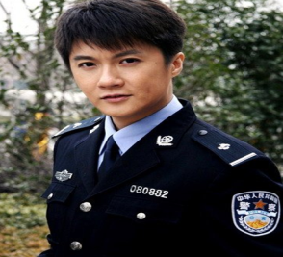
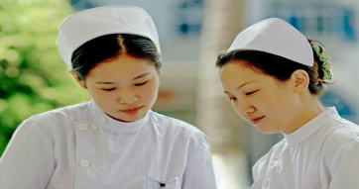
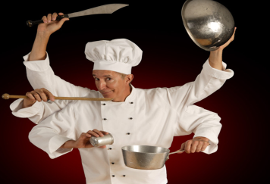
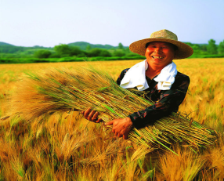

Slide 5
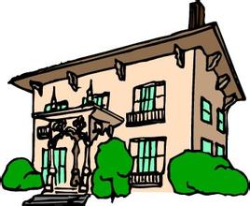
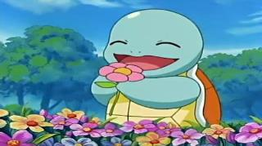
Listen again and answer
1. Where does the nurse work?
2. Where does the gardener work?

Slide 6
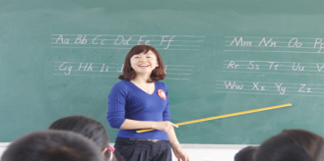
teacher
farmer
nurse
doctor

Slide 7
Summary:
Please tell me:
What you’ve learned.
请告诉老师：
这节课你学到了什么，有什么收获。

Slide 8
Practise
my
nurse
That’s ____ mother. She is a _______.
She works ___ a hospital.
2) His father is a ____________（警察）.
3) That’s Li Qiang’s father. He is a _____（厨师）
4) That’s my __________. He is a _________.
He works ___ a park.
in
policeman
cook
grandpa
gardener
in

Slide 9
Homework
1. Listen to the tape and read after the tape.
2. 选择你喜欢的职业，表演给自己的好友。

Slide 10
Thank you for listening!

