Slide 1




陕旅版
四年级下册
Unit5 Where Are You Going?
第一课时
WWW.PPT818.COM
0

Slide 2
>>Review
Play a game
play
football
fly a kite
do
exercise
see a
film
What’s missing?
do some
washing
climb the
mountain
do his
homework

Slide 3
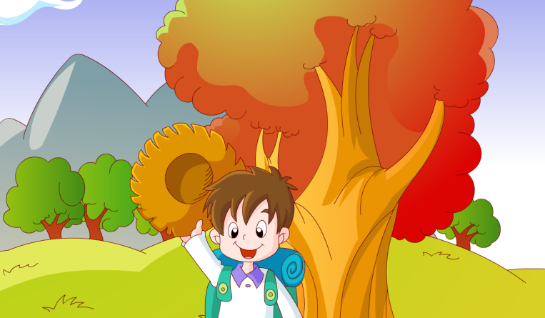

>>Warm-up
Sing a song

Slide 4
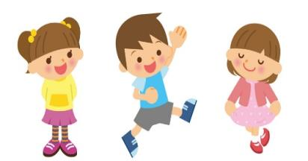

>>Lead-in
Free talk
What do you often do on the weekend?

Slide 5
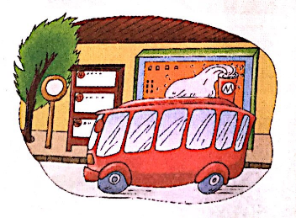

>>Presentation
Let’s learn
Let’s go to the bus stop!
bus stop

Slide 6
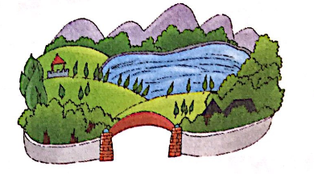
>>Presentation
Let’s learn
We can fly a kite in the park.
park

Slide 7
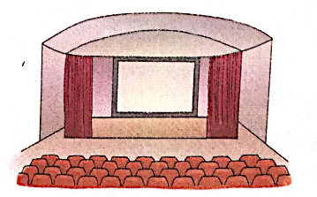
>>Presentation
Let’s learn
We are in the cinema.
cinema

Slide 8
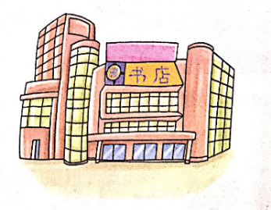
>>Presentation
Let’s learn
Now we are in the bookstore.
bookstore

Slide 9
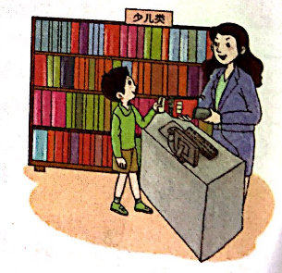

>>Presentation
Let’s learn
In the bookstore, we can buy a story book.
buy a story book

Slide 10
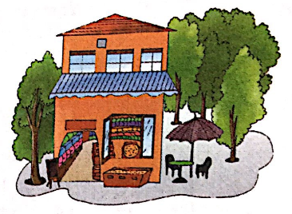

>>Presentation
Let’s learn
Let’s buy some water in the shop.
shop

Slide 11
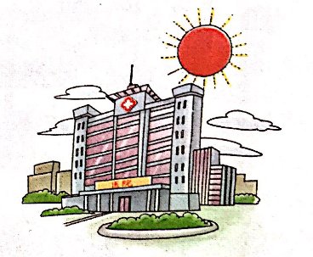
>>Presentation
Let’s learn
I have a cold. Let’s go to the hospital.
hospital

Slide 12
>> Practise
Quick response
park
cinema
shop
hospital
bookstore
buy stop
buy a story book

Slide 13

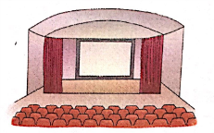



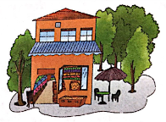
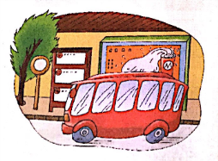
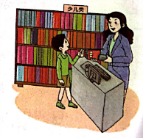
>>Practice
Magic fingers

Slide 14


>> Practise
Read and complete
①
A
They want to see a film. They are going to the ___.
②
Kevin wants to buy some books. He is going to the ___.
D
③
B
The children are going to the ___ to fly kites.
④
C
The students is going to the ___ buy a pencil.
A. cinema B. park C. shop D. bookstore
答案

Slide 15

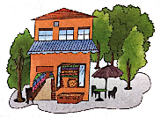

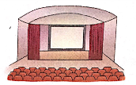
>> Summary
本课所学的重点单词：
park cinema shop bookstore

Slide 16


>> Summary
本课所学的重点单词：
hospital bus stop buy a story book

Slide 17


>> Homework
1.听课文录音并跟读，按照正确的语音、语调朗读并表演课文对话。
2.同伴之间互相提问本节课所学的新单词，并默写一遍。
3.预习 Unit5 A Let’s talk。
close

