Slide 1
Does he speak Chinese?
Section A
WWW.PPT818.COM

Slide 2
Teaching aims and demands
1. Learn some useful words and expressions:
could, tell, sure, speak, some, poor, with, help sb. with sth., problem，pet, often, want
2. Learn present simple to do and personal pronouns:
(1)—Do you come from the U.S.A.?
—No, I don’t.
(2)—Do you like Chinese?
—Yes, I do.
3. Ask for permission and make requests:
(1)—Could you help me with it?
—No problem.
(2)—Could you please tell me your name?
—Sure.

Slide 3
Review
—How are you? —I’m fine. Thank you…
—What’s your name? —My name’s … .
—Nice to meet you. —Nice to meet you, too.
—How old are you? — I’m___ years old.
—What’s your phone number? ____.
—Who is she? —She’s _____.

Slide 4
—Is she…? —Yes, she is./No, she isn’t. She’s… .
—Where is she from? —She’s from….
—Does she have a/an…? —Yes, she does./No, she doesn’t.
—What color is her hair? —It’s black.
—Is she tall or short? —She’s tall.
—What does she look like? —She’s tall with black hair.
—Whose___ is she? —It’s mine.

Slide 5
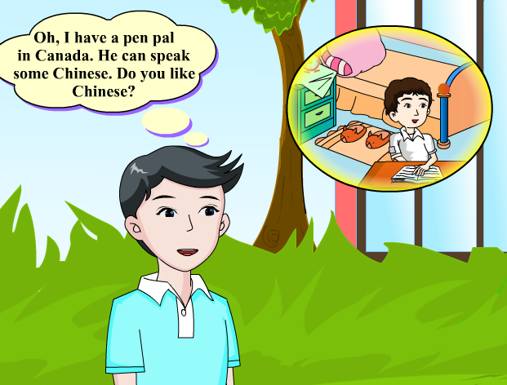
1a Look, listen and say
、
需要播放时请点击图片

Slide 6
Exercise
1. Where does Jane come from?
A. Japan B. Canada C. China
2. Does Jane speak English?
A. No, she doesn’t.
B. Yes, she does.
C. We don’t know.
3. Whose Chinese is poor?
A. Jane’s. B. The boy’s. C. Maria’s.

Slide 7
Listen to 1a and write T (True) or F (False).
( ) 1.Jane likes Chinese.
( ) 2. Li Xiang’s pen pal is from America, too.
( ) 3.Li Xiang’s pen pal can speak Chinese very well.
( ) 4.Li Xiang will help Jane with her Chinese.
T
F
F
T

Slide 8
Practice
(1) Could you please …?
(2) Sure.
(3) Do you like English?
(4) Yes, I do./ No, I don’t.
(5) Could you help me with my …?
(6) No problem.

Slide 9
Read 1a again, fill in the blank.
The girl’s name is Jane. She comes from _______. She ______ English. Jane likes Chinese very much, but her Chinese is _____, Li Xiang can help her ________ her Chinese.
Canada
speaks
poor
with

Slide 10
This is my pen pal. His name is Liu Xiaohua. He is twenty-five years old. He lives in Hong Kong. He speaks Chinese. He says he wants to visit the Great Wall. He is very cool.
居住

Slide 11
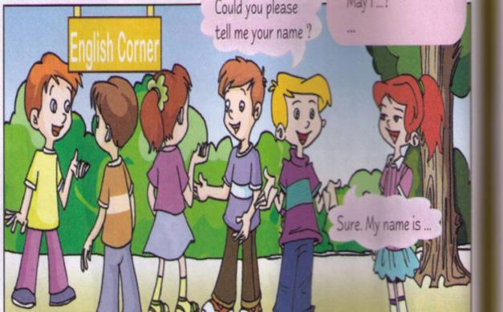
Make a simple conversation
Could you please tell me your name?
Could you please…？
May I …？
Sure. My name is …

Slide 12
Example
T: Excuse me, could you please tell me your name?
S1: Sure. My name is …
T: Do you come from the U.S.A.?
S1: No, I don’t. I come from …
T: Do you like English?
S1: Yes, I do./ No, I don’t.
…

Slide 13
创设情景: 你的好朋友来教室找你，同学看见了他，与你对话。
S4: Who is that?
S5: He is my good friend.
S4: Could you please tell me his name?
S5: Sure. His name is… We can call him … for short.
S4: Does he like English?
S5: Yes. He likes it very much.
S4: May we study English with him?
S5: No problem.

Slide 14
230031
安徽合肥第二中学
张 伟 （收）
中国香港九龙大道D座
Who is the letter from?
It’s from my pen pal.
pen pal = pen friend
Notes:
14

Slide 15
Project
1.（做个调查，采访本小组的同学，了解一下他们中有几个人喜欢英语角及其原因，目的：及时帮助那些对英语不感兴趣或者说是不喜欢英语的同学。）
Group | one | two | three | four | five | six
Like (number)
Dislike (number)

Slide 16
Explanation
—Excuse me. Could you please tell me your name? 劳驾, 请你把你的名字告诉我？
—Sure. 当然可以。
（1）Excuse me. 打扰了，对不起，请原谅。是英语常用的客套用语，用于日常生活中向对方提出要求，询问情况，打搅他人等场合，以表示向对方致歉或表示礼貌。具体可用于以下几种情况：
Excuse me. Where is the supermarket? 劳驾，请问超市在哪里？（向陌生人问路）

Slide 17
Excuse me. Are you Mr. Brown? 请问你是布朗先生吗？（向别人询问情况）
Excuse me. May I ask you a question? 打扰了。我可以问你一个问题吗？（表示客气地请求）
Excuse me. Listen to the teacher, please. 对不起。请听老师说。（向别人提出请求前想引起对方的注意）
（2）Could you please tell me your name? 这是一句比较客气的语句，相当于：May I know your name? （我可以知道你的名字吗?）

Slide 18
（3）sure用作副词，与OK/ All right. / Certainly. 同义，意为“当然”、“一定”、“的确”等意思。常用在口语中，一般单独使用，对别人的请求做出爽快的肯定回答。如：
—Would you like to come? 你想来吗？
—Sure! 当然
—Excuse me! Can I borrow your bike? 对不起。我可以借你的自行车吗？
—Sure! Here you are. 当然可以。给你。

Slide 19
He can speak Chinese. 他能说汉语。
speak是动词，可以作不及物动词，也可以作及物动词，意为“说”、“讲话”等，作及物动词时只能加语言作宾语。如：
Jane, can you speak Japanese? 简，你会说日语吗？
speak强调说话的能力、方式和对象，不强调说话的内容。作及物动词时接表示语言的名词或代词作宾语。speak作不及物动词时后常接介词to或with sb.表示“与……说话”。speak也常作为打电话用语。如：
I can speak a little Chinese.
我会说一点点汉语。

Slide 20
3. Could you help me with it? 你能帮助我吗？
help sb. with sth. 意为帮助某人做某事。如：
⑴ Could you help me with Chinese?你能帮助我学习英语吗？
（2) I can help you with it. 我可以帮助你完成它。

Slide 21
4.【辨析】study与learn
两者都有“学习”之意。
（1）study 有“学习、研究”之意，通常表示比较深入和周密的学习和研究。如：
Mr. Wang goes to Japan to study the history of Japan.
王先生去日本研究日本的历史。
（2）learn则表示“学习、学会、学到”之意，一般用于初学阶段，强调学习成果。如：
I learned 20 English words last week.
我上周学了20个英语单词。

Slide 22
（3）study和learn 都作“学习”讲时，不强调上述区别，可以通用。如：
When did you begin to study/ learn English? 你什么时候开始学习英语的？
（4）表达“学做某事”，只能用learn。
My sister is learning to do some cooking.
我姐姐正在学习烹饪。

Slide 23
5. No problem. 没问题（当然了）。
当别人向你提出某种请求或者帮助时,你可毫不犹豫地说“No problem”。其中problem是“难于处理的事情；难题”的意思。如：
How do you do with the problem?
I have a problem with my bike?
—Can you give me a ticket?
“你能给我弄到一张票吗?”
—Of course, no problem.
“当然行, 没问题。”

Slide 24
Summary
very much
—Could you please tell me your…?
No problem.
—Sure.
help…with
—Do you…?
—Yes, I do./No, I don’t.

Slide 25
Let’s chant.

Slide 26
Homework
自编一个对话，运用下面句型：
① Could you please …?
② Sure.
③ — Do you …?
— Yes, I do./No, I don’t.
④ No problem.

