Slide 1
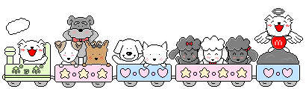
广州版小学英语四年级上册
Unit 9 Look at this T-shirt
WWW.PPT818.COM

Slide 2
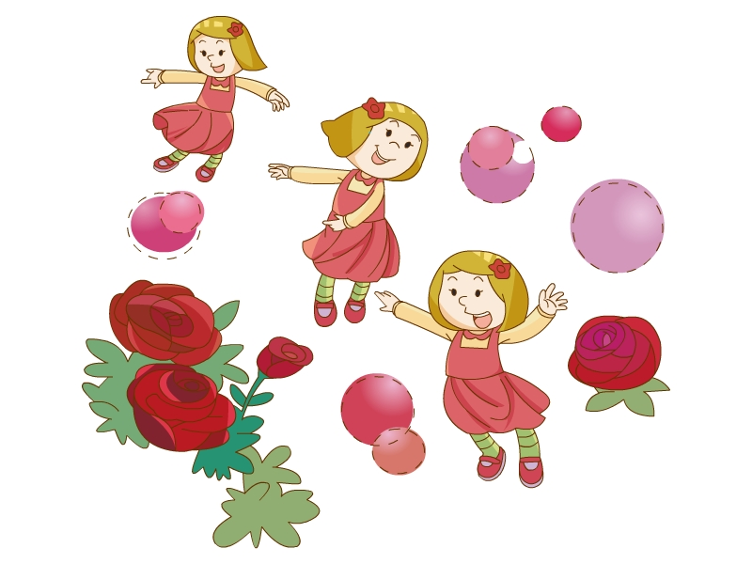
Little red dress
Let`s sing

Slide 3
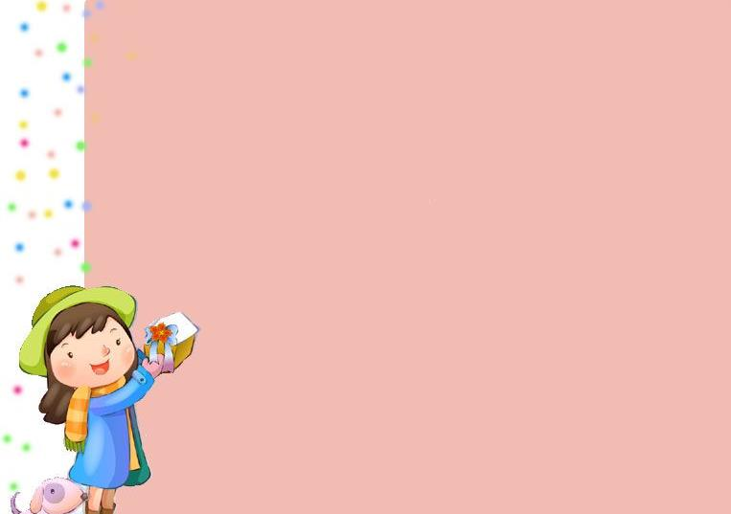
Let`s chant
Skirts for summer,
coats for winter,
when is autumn,
I wear sweaters.
Sandals for summer,
boots for winter,
when is autumn,
I wear trainers.
skirt
shirt
T-shirt
sweater

Slide 4
Let’s play
29
71
65
84
88
32
94
55
52
63
45
37
69
24
73
81
(flash game： 复习两位数）

Slide 5

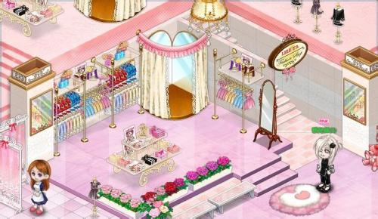
Welcome to the clothes shop,
do you know this clothes?

Slide 6

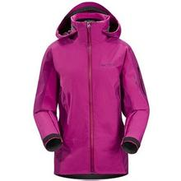
cat
cap
redcap
cat
jac
market
jacket
purple jacket

Slide 7
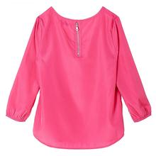
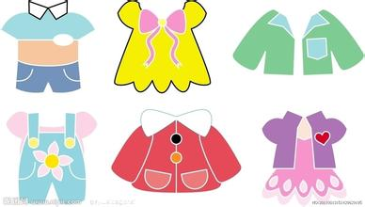
house
blouse
pink blouse
mathes
clothes

Slide 8
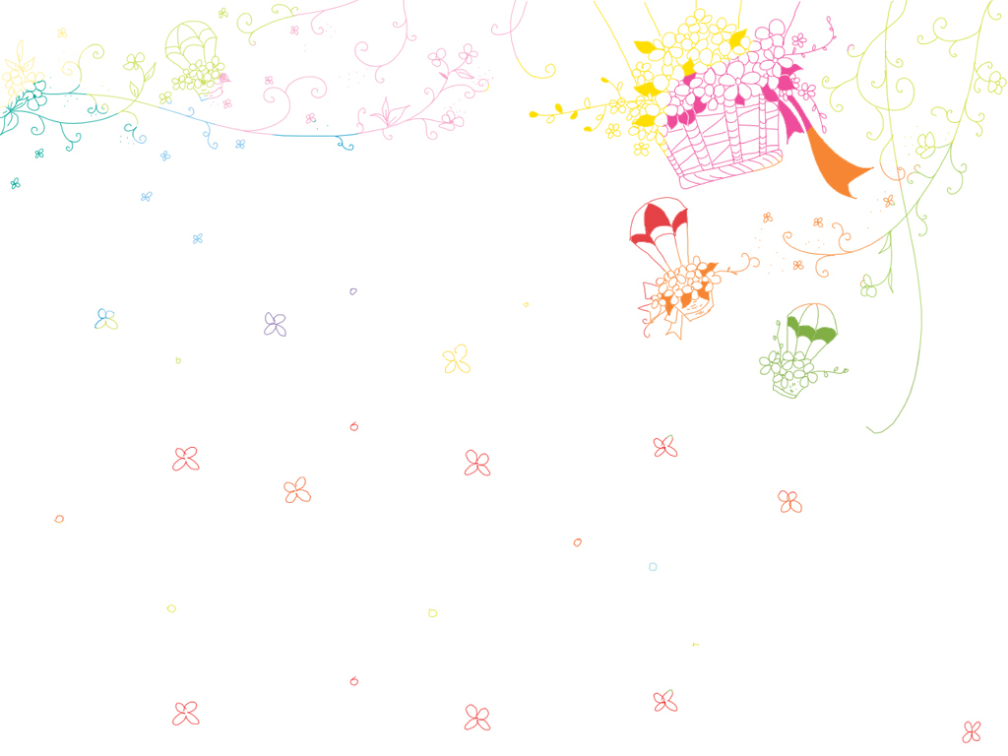
Listen to the dialogue,
and then answer the questions:

Slide 9
1.Where is Lily?
She is in the clothes shop.
2.What doesn`t Lily like?
She doesn`t like the red T-shirt.
3.What does Lily like?
She likes a purple blouse.
4.How much is it?
It`s two hundred and fifty yuan.
5.Will Lily take it? Why?
No.Because it is too expensive.She won`t take it.

Slide 10
Change a dialogue into a passage:
Lily is in the ____ ____. She doesn`t like the ____ _____. She likes the ____ ____. But it`s __ _____ __ ___ ___.It`s too ______. She ____ ___ __.
clothes
shop
red
T-shirt
purple
blouse
two
hundred
and
fifty
yuan
expensive
won`t
take
it

Slide 11
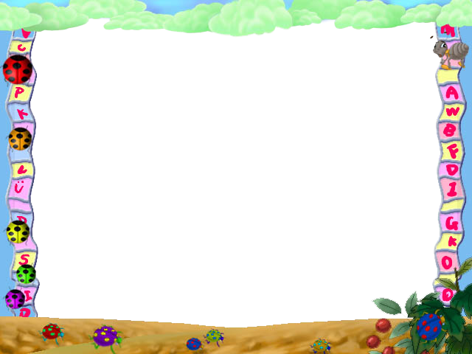




Sharp your eyes
￥15
￥28
￥285
￥845
A:How much is the …?
B:It`s …
打开英语书51页，用以上句型练习图1.2

Slide 12


A:Look at this … Do you like it?
B:It`s Ok. But I don`t like…
I like…
A:Here it is.
B:How much is it?
A:It`s …
B:It`s too… I won`t take it.
用以上句型，练习书本51页第3、4、5幅图
￥285

Slide 13
Shopping Sentences
Shop assistants | Customers
Do you like..? It’s \They’re … yuan. | I want to buy ….\Very much. \No, thanks. How much…? That`s too expensive.I won`t take it. \It`s OK. I`ll take it.

Slide 14
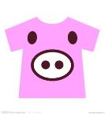
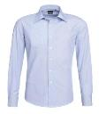


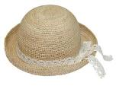

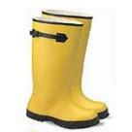
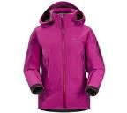





clothes
A:Look at… Do you…? B:It`s ... How much …?
A:It`s … B:What about ...?
A:It`s … B:That`s… I won`t…

Slide 15
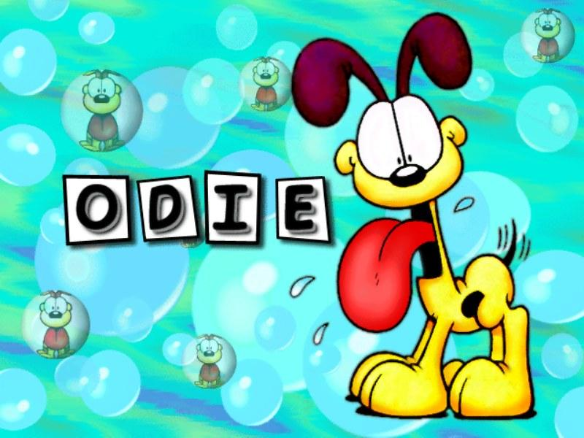
Thank you
and good bye!

