Slide 1
Natural Disasters
Section B Reading and Thinking
WWW.PPT818.COM

Slide 2
Ⅰ
Ⅱ
Ⅲ
Ⅰ.知识体系图解
crack
ruin
shock
electricity
trap
bury
breathe
revive
effort
unify
wisdom
suffer

Slide 3
Ⅰ
Ⅱ
Ⅲ
严重受损;破败不堪
似乎;好像;仿佛
震惊;吃惊
遭受
结束
站起来
……的数目
成千上万的
吹走
只有;只不过
挖出
倒塌;跌倒

Slide 4
Ⅰ
Ⅱ
Ⅲ

Slide 5
Ⅰ
Ⅱ
Ⅲ
Ⅱ.释义匹配
1.crack A.to bring together
2.trap B.a piece of equipment for catching animals
3.revive C.the situation within which something exists or happens
4.unify D.a very narrow space between parts of something
5.context E.to come or bring something back to life,health,existence,or use
答案:1.D 2.B 3.E 4.A 5.C

Slide 6
Ⅰ
Ⅱ
Ⅲ
Ⅲ.阅读导学
根据P50课文内容,选择正确答案。
1.What does the first paragraph mainly tell us?
A.How an earthquake happens.
B.Some signs of the earthquake.
C.Why strange things happen there.
D.What the peaceful city looked like.
2.What happened at about 3:00 am on July 28?
A.People felt the earth was shaking.
B.Fish were seen jumping out of water.
C.Strange loud sound was heard in the sky.
D.Bright stars were seen in the sky.
答案:B
答案:C

Slide 7
Ⅰ
Ⅱ
Ⅲ
3.How did the author feel about the earthquake in the text?
A.Serious and hopeless.
B.Sad and hopeless.
C.Serious and hopeful.
D.Angry but hopeful.
4.What can we infer from the text?
A.The whole city was at an end.
B.The army’s coming brought hope to the city.
C.People lost hope when faced with the terrible earthquake.
D.The signs before the earthquake weren’t obvious at all.
答案:C
答案:B

Slide 8
重点词汇
重点句式
随堂练习
1.ruin n.& vt.破坏;毁坏
【课文原句】In less than one minute,a large city lay in ruins.不到一分钟,一个大城市便成为废墟。
【词汇精讲】句中的ruin意为“破坏;毁坏”,是名词。ruin还可以做及物动词,意为“破坏;毁坏”。
No matter how famous a brand is,it can be ruined once it betrays the trust of consumers.
无论一个品牌有多大名气,一旦辜负了消费者的信任它就有可能会毁灭。
When they returned to their hometown the next day,they found it in ruins.
当他们第二天回到故乡的时候,他们发现那已经是废墟了。

Slide 9
重点词汇
重点句式
随堂练习
【词汇拓展】
Many ancient sculptures fell into ruin after the earthquake.
地震过后,许多古代的雕塑都毁了。
Our vacation was ruined by the typhoon.
我们的假期被台风给毁了。

Slide 10
重点词汇
重点句式
随堂练习
damage,ruin,destroy

Slide 11
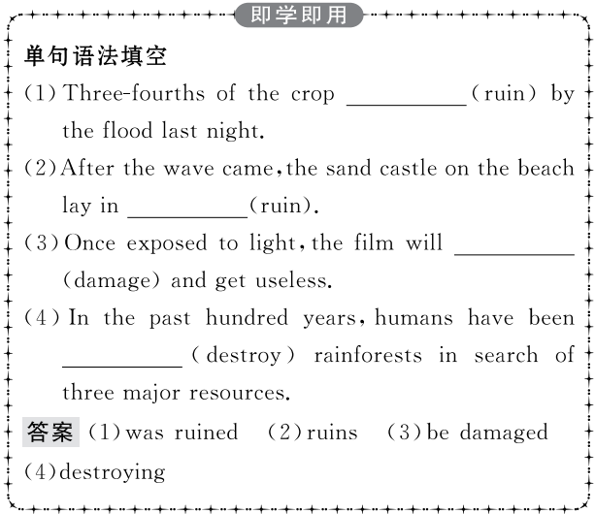
重点词汇
重点句式
随堂练习

Slide 12
重点词汇
重点句式
随堂练习
2.shock n. 震惊;令人震惊的事;休克 vt. (使)震惊
【课文原句】People were in shock—and then,later that afternoon,another big quake shook Tangshan again.
人们都感到震惊——然后,当天下午晚些时候,又一次大地震再次震动了唐山。
【词汇精讲】句中的shock是名词,意为“震惊”,in shock意为“震惊;吃惊”。

Slide 13
重点词汇
重点句式
随堂练习
She brought the roses in,and then just looked at them in shock.
她将玫瑰拿进屋,吃惊地看着它们。
The failure was a great shock to me.
那次失败给我很大的打击。
There was something wrong with the switch and I got a shock.
开关有问题,电了我一下。
The patient was taken to hospital suffering from shock.
病人因休克被送往医院。

Slide 14
重点词汇
重点句式
随堂练习
【词汇拓展】
shock表示“吃惊;震惊;令人震惊的事情”时是可数名词,表示“(身心受到的)打击;震惊”和“休克”时是不可数名词。

Slide 15
重点词汇
重点句式
随堂练习

Slide 16
重点词汇
重点句式
随堂练习
3.breathe vi.& vt.呼吸
【课文原句】Slowly,the city began to breathe again.
慢慢地,这座城市又恢复了生机。
【词汇精讲】句中的breathe意为“呼吸”,是不及物动词。breathe也可做及物动词。
The air is so dirty that it is difficult to breathe.
空气太脏了,呼吸很困难。
People are concerned about the quality of the air they breathe.
人们关心他们呼吸的空气的质量。

Slide 17
重点词汇
重点句式
随堂练习
【词汇拓展】

Slide 18
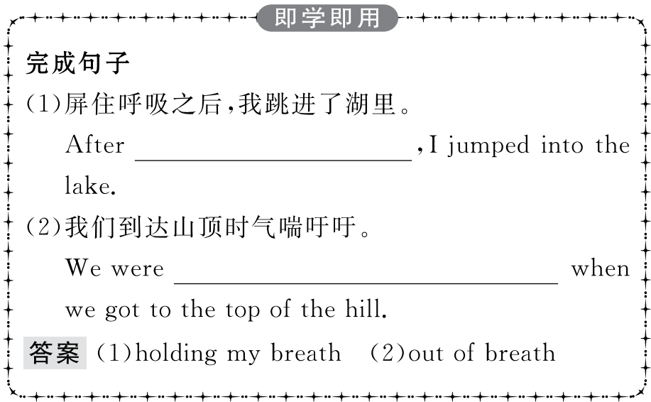
重点词汇
重点句式
随堂练习

Slide 19
重点词汇
重点句式
随堂练习
4.effort n. 努力;艰难的尝试;尽力
【课文原句】With strong support from the government and the tireless efforts of the city’s people,a new Tangshan was built upon the earthquake ruins.
在政府的大力支持和市民的不懈努力下,在地震废墟上建造了一座新的唐山。

Slide 20
重点词汇
重点句式
随堂练习
【词汇精讲】effort表示一般性的努力(即表泛指意义),通常是不可数名词。若强调一次一次具体的努力,通常是可数名词,尤其与all,these等修饰语连用时。
The film industry should make greater efforts to attract more viewers.
电影业要尽更大的努力吸引更多的观众。
Parents arrange everything for their children and spare no effort to pave the way for their success.
父母为孩子安排好一切,不遗余力地为他们的成功铺路。

Slide 21
重点词汇
重点句式
随堂练习
【词汇拓展】

Slide 22
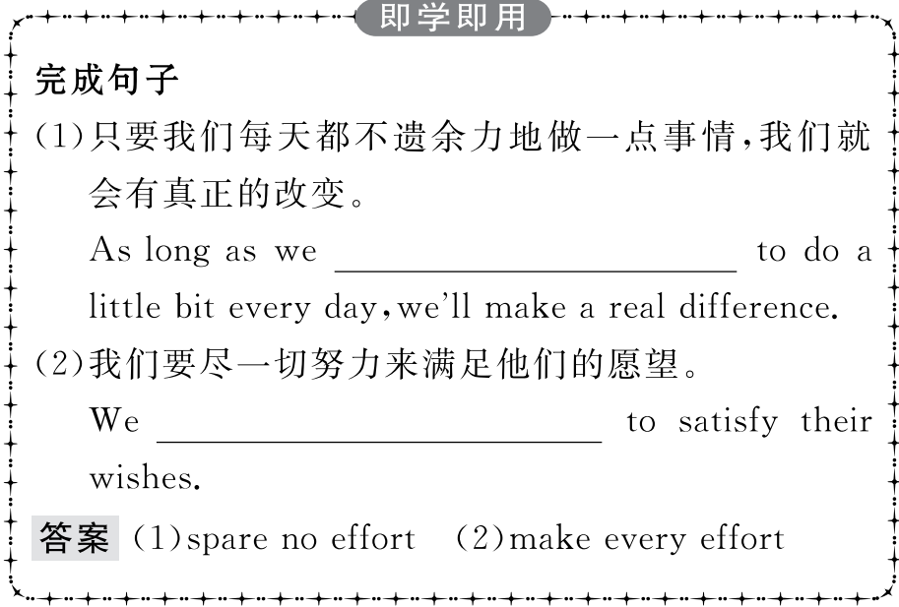
重点词汇
重点句式
随堂练习

Slide 23
重点词汇
重点句式
随堂练习
5.suffer vt.遭受;蒙受 vi.(因疾病、痛苦、悲伤等)受苦
【课文原句】What kind of help do you think people who have suffered an earthquake need?
你认为遭受地震灾害的人需要什么样的帮助?
【词汇精讲】句中的suffer意为“遭受;蒙受”,是及物动词。
I think she suffered a lot in the African forest.
我认为她在非洲丛林里受了不少苦。
Although we are suffering such a severe natural disaster,we will eventually overcome the difficulty as long as we don’t lose heart.
尽管遭受如此严重的自然灾害,但只要不灰心,我们终会克服困难。

Slide 24
重点词汇
重点句式
随堂练习
【词汇拓展】
suffer from遭受;患病
suffer pain/defeat/hardship/damage遭受痛苦/失败/艰难/破坏
suffering n.痛苦;苦恼;让人痛苦的事
sufferer n.患难者;患病者
Many people suffered from this terrible disease and lost their lives.
许多人被这种可怕的疾病夺去了生命。
Don’t worry!The animal won’t suffer any pain.
别担心,这只动物不会感到任何痛苦的。

Slide 25
重点词汇
重点句式
随堂练习
(1)suffer指抽象的损害、痛苦等,如:suffer pain/defeat/losses/the result/side effects“遭受痛苦/失败/损失/(承受)结果/副作用”。
(2)suffer from常加具体的表示不幸或痛苦的名词,如:遭受战争、自然灾害、疾病带来的痛苦。

Slide 26
重点词汇
重点句式
随堂练习

Slide 27
重点词汇
重点句式
随堂练习
1.Chickens and even pigs were too nervous to eat,and dogs refused to go inside buildings.
鸡,甚至猪都紧张得不吃东西,狗也不肯进入大楼里面去。
【句式剖析】本句是一个并列句。在第一个分句中,句子的主语是Chickens and even pigs,动词不定式短语to eat做结果状语。too...to do sth意为“太……以致不……”,too后接形容词或副词,to是动词不定式符号,后接动词原形,动词不定式表示否定意义。
The road was too narrow for large trucks to get through because of landslide.
由于滑坡,路太窄了,大型卡车通不过。
The man was too tired to go any farther.
那个人太累了,走不动了。

Slide 28
重点词汇
重点句式
随堂练习
【句式拓展】
在以下几种情况中,too...to...结构可以表示肯定意义,而不是否定意义:
(1)当不定式前有否定词修饰时。
He is too foolish to understand this.
他太蠢,不会明白这一点。
He is too clever not to understand this.
他太聪明,不会不明白这一点。
(2)当副词too的前面有否定词修饰时。
Never too old to learn.活到老学到老。
It’s never too late to stop smoking.
戒烟何时都不算晚。

Slide 29
重点词汇
重点句式
随堂练习
(3)当副词too后面修饰的形容词是glad,ready,pleased等表示“积极”意义的词汇时。
We are too ready to help you.我们很乐意帮助你。
I shall be only too pleased to get home.
我要回到家里就非常高兴。

Slide 30
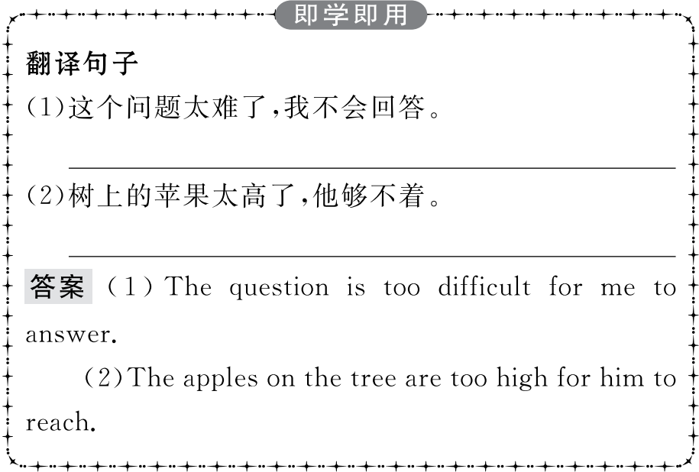
重点词汇
重点句式
随堂练习

Slide 31
重点词汇
重点句式
随堂练习
2.It seemed as if the world were coming to an end!仿佛世界末日即将来临!
【句式剖析】本句是一个主从复合句,主句是It seemed,as if引导的是表语从句。
It looks as if/though it is going to rain.
看起来要下雨了。
Be quick!It looks as if/though the train is going to move.
快点!看起来火车要开了。

Slide 32
重点词汇
重点句式
随堂练习
【句式拓展】
as if =as though既可以引导方式状语从句也可以引导表语从句。当说话者认为句子所述的是不真实的或极少有可能发生或存在的情况时,从句虚拟语气动词时态的形式如下:

Slide 33
重点词汇
重点句式
随堂练习
The woman loves the children as if/though she were their mother.
这位女士爱这些孩子,好像她就是他们的妈妈一样。
The girl listened as if/though she had been turned into a stone.
那女孩倾听着,像已经变成了石头似的。
如果as if引导的从句中的主语和主句的主语相同,且含有be动词,可省略从句主语和be动词,这样as if 后就只剩下名词、不定式、形容词(短语)、介词短语或分词。

Slide 34
重点词汇
重点句式
随堂练习

Slide 35
重点词汇
重点句式
随堂练习
Ⅰ.单句填空
1.With its 10-metre-long pipe,people who (trap) in the ruins,will be able to get supplies including oxygen and water.
答案:were trapped
2.I was looking for my handbag,which (bury) under a pile of old newspapers.
答案:was buried
3.The man took a deep breath and sat up slowly and great effort.
答案:with

Slide 36
重点词汇
重点句式
随堂练习
4.The loss of big trees was greatest in areas where trees (suffer) the greatest water shortage.(2019·浙江卷)
答案:had suffered
5.Babbitt’s team conducted the research to find out (electrical) consumption of the devices.(2018·全国卷Ⅰ)
答案:electricity

Slide 37
重点词汇
重点句式
随堂练习
Ⅱ.课文语篇填空
A terrible earthquake hit the city of Tangshan on July 28,1976,in
thousands of people died and many were injured.People were greatly (shock) because nearly all the buildings fell down and the whole city lay in (ruin).All the electricity was cut off and people began to wonder how long the disaster (last).It seemed as if the world were coming to end.
which
shocked
ruins
would last
an

Slide 38
重点词汇
重点句式
随堂练习
The people of Tangshan didn’t lose hope because 150,000 soldiers were sent to help the rescue workers.The soldiers tried their best
(dig) out those who were trapped.They also built shelters for the (survive).Fresh water was taken to the city by every means. (slow),the city began to come back to life.
It was said that before the earthquake,strange things happened in the countryside.The water in the village wells rose and (fall).Fish jumped out of the ponds.Strange noises were heard in the sky,but people thought little of (they).
to dig
survivors
Slowly
fell
them

Slide 39
重点词汇
重点句式
随堂练习
Ⅲ.概要写作
根据教材P50的语篇内容写一篇60词左右的内容概要。
参考范文
On July 28,1976,a terrible earthquake struck Tangshan and caused great damage to the city.(要点1) Though there were some signs before the earthquake,people thought little of them.(要点2) Soon after the earthquake,soldiers were sent to rescue survivors and the workers helped to rebuild the city.(要点3)With the support of the government,a new Tangshan appeared.(要点4)

