Slide 1
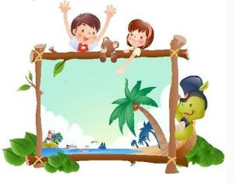
Unit6 My Holiday
陕旅版
五年级下册
第二课时
WWW.PPT818.COM

Slide 2
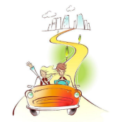
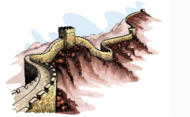
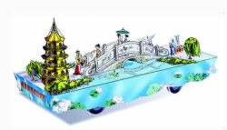
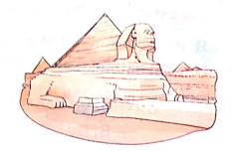
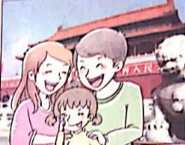
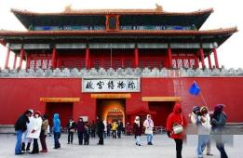
>>Review
Magic fingers

Slide 3
>>Lead-in
Ask and answer
How many months are there in a year?
There are twelve months in a year.
What are they?
They are January, February, March, April, May, June, July, August, September, October, November and December.
答案

Slide 4
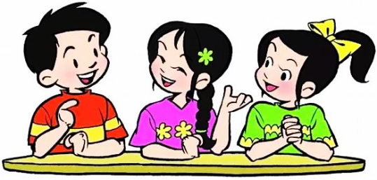
>>Presentation
Free talk
May Day is coming. Are you going to travel?
Where will you go on the holiday?

Slide 5
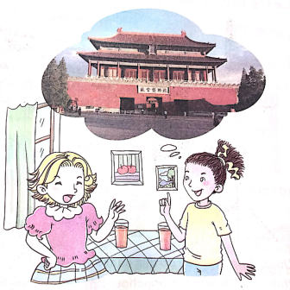
>>Presentation
Ask and answer
What can you see in the picture?
I can see the Palace Museum.
What is the Palace Museum like ?
It is large.

Slide 6
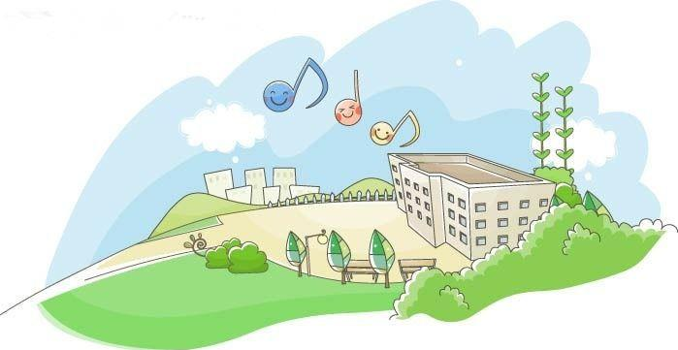
>>Presentation
Let’s learn
-What is your school like?
-It is large and very beautiful.
这是一个在询问某物的特点的句型：
-What is … like?
-It is …

Slide 7
>>Presentation
Listen, then ask and answer
Q 1:Where will Alice go on May Day?
She will go to Beijing with her parents.
Q 2:What can Alice visit in Beijing?
She can visit the Palace Museum, the
Great Wall...
Q 3:What is the Palace Museum like?
It is large.
答案

Slide 8
>>Presentation
Let’s talk
Kitty: May Day is coming. Where will you go on
the holiday?
Alice: I will go to Beijing with my parents.
Kitty: Great! You can visit many places of interest
there, the Great Wall, …
Alice: What is the Palace Museum like?
Kitty: It is large. There are many big house in it.
All the houses are red and yellow. It is really
wonderful.
Alice: Really? I will enjoy my visit there.
点击小喇叭或文本框都可以播放音频

Slide 9
>>Practice
Read it by yourselves for one minute.
自读对话一分钟。
一分钟倒计时
60
10
50
Tips:
20
40
当你自己朗读时，遇到不会读或不明白意思的单词或句子，可以把它圈起来，请教同学或老师！
30
开始

Slide 10
>>Practice
Role play
角色扮演，小组先进行练习，然后展示，其他同学评价。
 | 小组合作，声音洪亮，有感情地正确朗读课文。 |  | C
 | 小组合作默契，声音洪亮，脱离课本，口语表达较准确流利，感情与肢体语言较丰富。 |  | B
 | 小组合作默契，声音洪亮，能结合已有知识或生活，对内容有创新，口语表达准确流利，感情与肢体语言丰富。 |  | A
Good
Great
Excellent

Slide 11
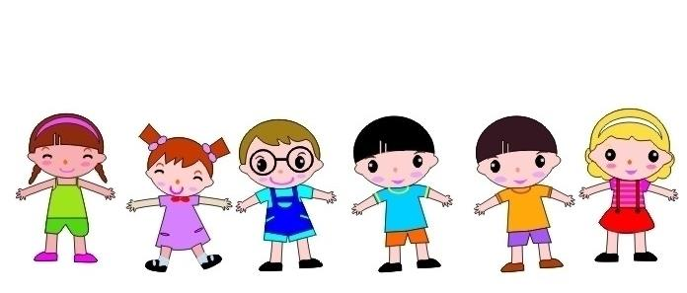
>>Practice
滚雪球
Where
Where will you
Where will you go on
…
Where will
Where will you go

Slide 12
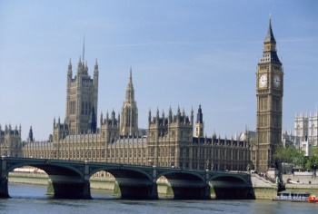
>>Practice
Look and complete
①
A: Where will Sun Feng go?
B: He’ll go to ________.
Beijing
by train
He’ll go there ________.
②
A: Where will Kathy go?
London
B: She’ll go to ________.
She’ll go there _______.
by plane
答案

Slide 13
>>Summary
本课所学的重点句型：
-What is the … like?
-It is …
e.g.
-What is the Palace Museum like?
-It is large.

Slide 14
>>Summary
本课所学的重点句型：
-Where will you go on the holiday?
-I will go to … with …
e.g.
-Where will you go on the holiday?
-I will go to Beijing with my parents.

Slide 15
>>Homework
1.听课文录音并跟读，按照正确的语音、语调朗读并表演课文对话。 2.Pair work:学生2人一组，根据Let’s talk课文内容进行创编新对话。
3.预习B Let’s learn more。
close

