Slide 1
Unit 6 Family
She works in a hospital.
WWW.PPT818.COM

Slide 2
What dose he do?
He's a farmer.

Slide 3
What dose he do?
He's a doctor.

Slide 4
What dose he do?
He's a businessman.

Slide 5
What dose she do?
She's a teacher.

Slide 6
What dose she do?
She's a _______.
nurse

Slide 7
What dose he do?
He's a __________.
policeman

Slide 8
What dose he do?
He's a cook.

Slide 9
What dose he do?
He's a __________.
gardener

Slide 10
hospital

Slide 11
school

Slide 12
police office

Slide 13
farm

Slide 14
park

Slide 15
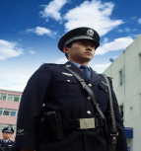
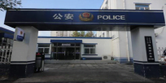
What does she/he do？
She's/He's a ....... .She/He works in a ...... .

