Slide 1
Unit2 What’s your number?
人教精通版四年级上册
WWW.PPT818.COM

Slide 2
Review
Let’s sing

Slide 3
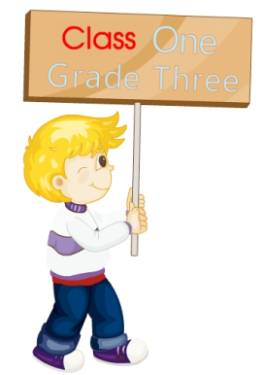
Review
Which class are you in?
I’m in Class One, Grade Three.

Slide 4
Review
Which class are you in?
I’m in Class Two, Grade Four.

Slide 5
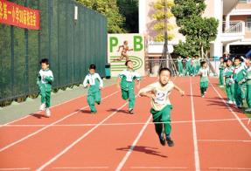
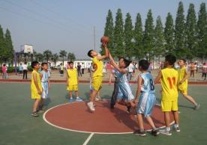
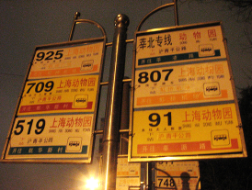
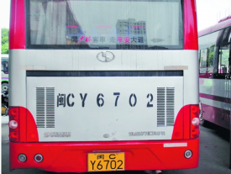
Lead-in
Look and say
What can you see from the pictures?
number

Slide 6
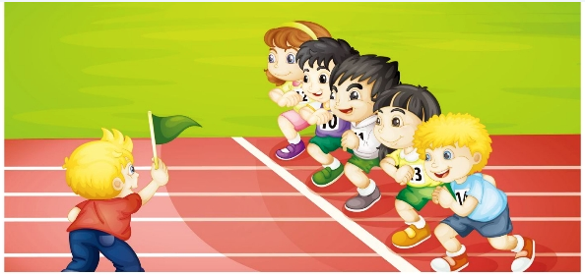
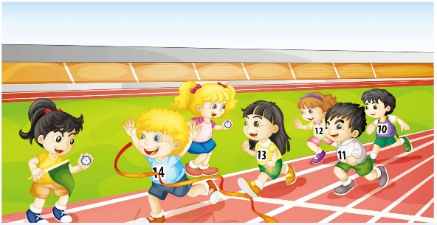
Presentation
Look and say
What numbers can you see?

Slide 7
Presentation
Listen and imitate
1
One, two, three, go!
2
What’s your number?
4
What’s your number?
3
5
I’m number fourteen.
I’m number thirteen.

Slide 8
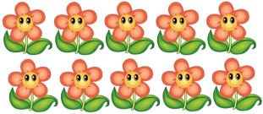
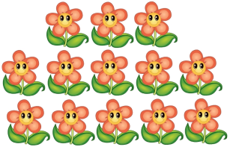
Presentation
+
= ?
three
ten
thirteen

Slide 9
Presentation
+
= ?
four
ten
fourteen

Slide 10
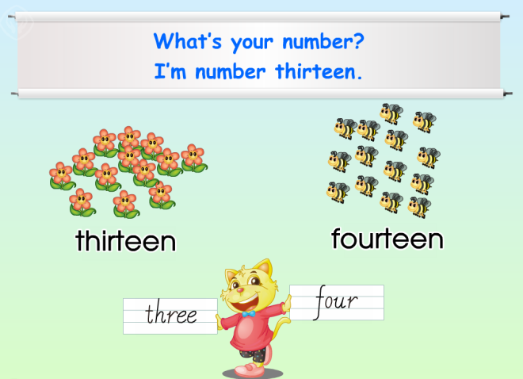
Presentation
Just read and write

Slide 11
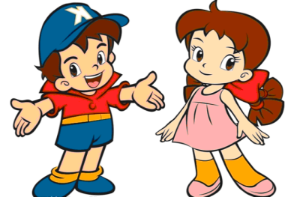
Practice
Pair work
What’s your number?
I’m number …

Slide 12
Show time
五人一组，练习对话并表演，其他同学评价。
 | 模仿录音中的语音语调，有感情地朗读。
 | 可以脱离课本，适当改动其中部分，语音地道。
 | 适当添加内容，意思完整，有创新，表演生动。
Good
Great
Excellent

Slide 13
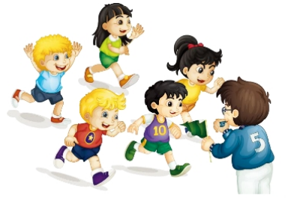
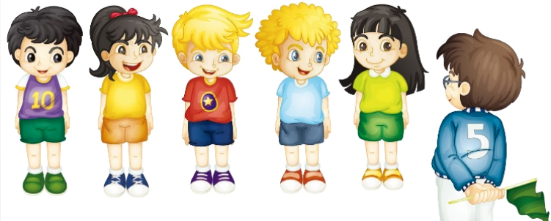
Practice
Let’s play
Line up!
Fourteen!
Ten!
Eleven!
Twelve!
Thirteen!
Start counting from 10 to 14!

Slide 14
Practice
Do a survey
请设计一个调查表，调查小组内其他学生的学号。
Name
Number

Slide 15
Summary
本课学习的数字类单词有:
thirteen
fourteen

Slide 16
Summary
如何询问运动员的号码或学生的学号并作相应回答呢？
—What’s your number?
—I’m number…

Slide 17
Homework
1. 观看Just talk部分的课文动画并跟读，注意语音、语调。
2.运用本课所学句型“What’s your number?”询问班上其他4-5名同学的学号，并制成一张调查表。
3. 预习Lesson 9。
Close

